Slide 1
Unit 7
Dr Sun Yatsen
WWW.PPT818.COM

Slide 2
Memory challenge（记忆大挑战）pay attention to these words
leader
emperor
famous person
free
be born
finally
Dr Sun Yatsen

Slide 3
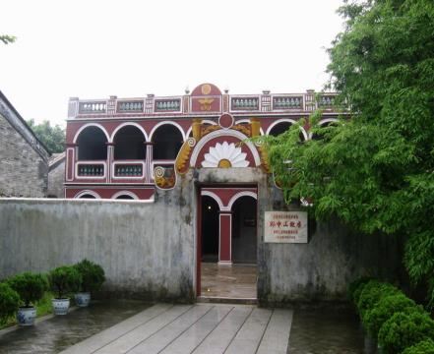
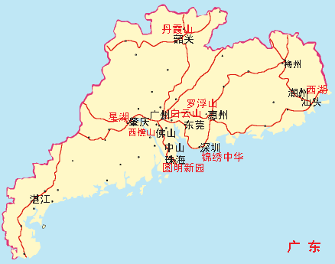
former residence
(故居)
He was born in Zhongshan, Guangdong.
（出生）

Slide 4
Do you remember about Dr Sun Yatsen? Let’s check !

Slide 5
C
1. Dr Sun Yatsen was born in ______.
A. Guangzhou B. Zhuhai C. Zhongshan
2. Dr Sun Yatsen was the father of _____ China.
A. person B. modern C. famous
3. He was a great _____ .
A. man B. leader C. doctor
4. Dr Sun Yatsen was against the ______.
A. emperor B. people C. country
5. Dr Sun Yatsen tried to ______ the people.
A. busy B. change C. free
6. ______ he started to change China.
A. Finally B. First C. second
B
B
A
C
A

Slide 6
Very good !

Slide 7
Let's learn the new words

Slide 10
Please read these sentences

Slide 11
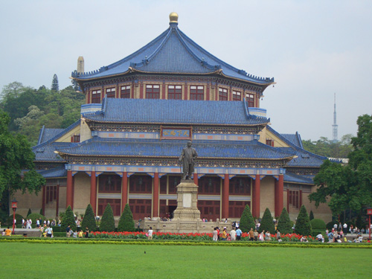
He was born in Guangdong.
He was against the emperor.
He was the father of modern China.
He was very important in Chinese history.
He was a great leader.
He tried to change China and free the people.
Finally he started to change China.
He loved the people and the people loved him.

Slide 12
Dialogue here!

Slide 13
Choose T or F
Zhongshan
F
( ) 1.Dr Sun Yatsen was born in Guangzhou.
( ) 2.He was the father of PRC.
( ) 3.He was a great leader of the Chinese
people.
( ) 4.He wasn’t against the emperor.
F
modern China.
T
F
was

Slide 14
( ) 5.He tried to change China and
free the Chinese people.
( ) 6.He loved the people and all the
Chinese people didn’t love him.
T
F
loved

Slide 15
Now let's listen to
the dialogue again!

Slide 16
Please answer these questions

Slide 17
Was Dr Sun Yatsen a famous historical person?
Yes, he was.
2.Where was he born?
He was born in Guangdong.
3.Was he a great leader?
Yes.

Slide 18
4.Did he love people?
Yes, he did.
5.Did people love him?
Yes, he did.
6. Did he finally start to change China?
Yes, he did.

Slide 19
7. What did he do?
He was against the emperor.
He tried to change China and free the people.
8. Where can we go if we want to know more about Dr Sun Yatsen?
We can go to the Dr Sun Yatsen Memorial Hall.

Slide 20
Please read the
dialogue together!

Slide 21
Please do the exercises now!

Slide 22
Homework:
1. Copy the new words.
2. Listen to the dialogue
and read it 5 times.
3. Finish 《目标》P42-43

