Slide 1
Unit 6 Topic 2
Who is your favorite character in literature?
Section C
WWW.PPT818.COM

Slide 2
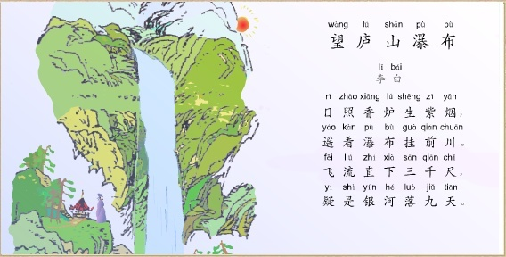
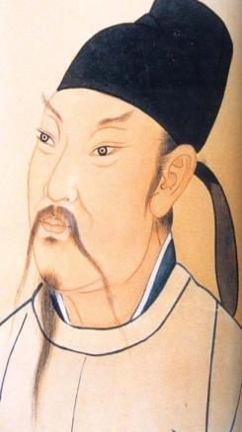

Slide 3
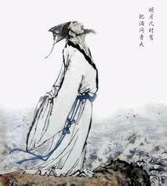
Try to introduce a famous Chinese poet.

Slide 4
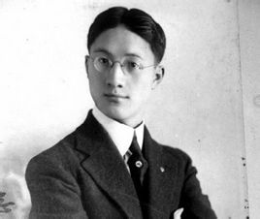
再别康桥
轻轻的我走了， 正如我轻轻的来； 我轻轻的招手， 作别西天的云彩。 那河畔的金柳， 是夕阳中的新娘； 波光里的艳影， 在我的心头荡漾。 软泥上的青荇， 油油的在水底招摇； 在康河的柔波里， 我甘心做一条水草。 那榆阴下的一潭， 不是清泉，是天上虹； 揉碎在浮藻间， 沉淀着彩虹似的梦。 寻梦？撑一支长篙， 向青草更青处漫溯； 满载一船星辉， 在星辉斑斓里放歌。 但我不能放歌， 悄悄是别离的笙箫； 夏虫也为我沉默， 沉默是今晚的康桥！ 悄悄的我走了， 正如我悄悄的来； 我挥一挥衣袖， 不带走一片云彩。
徐志摩（1897~1931）
中国诗人

Slide 5
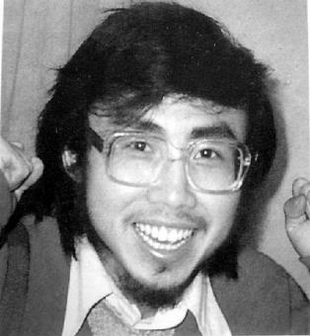
面朝大海 春暖花开
从明天起做个幸福的人 喂马劈柴周游世界 从明天起关心粮食和蔬菜 我有一所房子 面朝大海 春暖花开 从明天起和每一个亲人通信 告诉他们我的幸福 那幸福的闪电告诉我的 我将告诉每一个人 给每一条河每一座山取个温暖的名字 陌生人我也为你祝福 愿你有一个灿烂前程 给每一条河每一座山取个温暖的名字 愿你有情人终成眷属 愿你在尘世获得幸福 我只愿面朝大海 春暖花开
海子（1964-1989）
中国诗人，作家

Slide 6
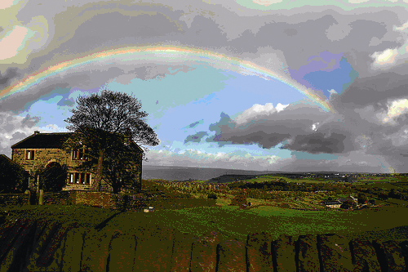
rainbow n. 彩虹

Slide 7
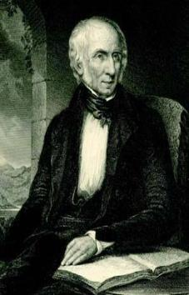
1b Read 1a and answer the following questions.
1. Why did William Wordsworth love to take long walks in the mountains when he was young?
2. What are his poems mainly about?
3. When did he usually get the inspiration of writing a poem?
4. How did he write his poems down?
5. What makes Wordsworth’s poems different from those of other poets?

Slide 8
1. Why did William Wordsworth love to take long walks in the mountains when he was young?
His parents died when he was a child, and his life with his grandparents was not very happy.
2. What are his poems mainly about?
His poems are mainly about the power, beauty and mystery of nature.
3. When did he usually get the inspiration of writing a poem?
He usually got the inspiration of writing a poem during long walks.

Slide 9
4. How did he write his poems down?
He told them to his sister, Dorothy, who wrote them down for him.
5. What makes Wordsworth’s poems different from
those of other poets?
He used simple language in his poems, and he described the lives of common people.

Slide 10
1c Read 1a again and match the words with
their meanings.
1. leading A. to say what somebody or something is like
2. describe B. most important
3. mystery C. happening often
4. common D. something that is difficult to understand or
to explain

Slide 11
Key points
1. both...and... （两者）都……
2. as well as 除……之外；还有
3. And then he told them to his sister, Dorothy, who wrote them down for him.
然后他把自己口头创作的诗告诉给他妹妹，由她记录下来。

Slide 12
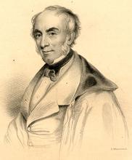
威廉·华兹华斯（William Wordsworth,
1770--1850），英国浪漫主义诗人，与雪莱、拜伦齐名，代表作有《水仙花》。曾获得桂冠诗人称号，湖畔诗人之一，文艺复兴以来最重要的英语诗人之一。

Slide 13
水仙花
I wondered lonely as a cloud
That floats on high o'er vales and hills,
When all at once I saw a crowd,
A host of golden daffodils;
Beside the lake, beneath the trees,
Fluttering and dancing in the breeze.
Continuous as the stars that shine
And twinkle on the Milky Way,
They stretched in never-ending line
Along the margin of a bay.
（节选）
我孤独的漫游，像一朵云
在山丘和谷地上飘荡，
忽然间我看见一群
金色的水仙花迎春开放，
在树荫下，在湖水边，
迎着微风起舞翩翩。
连绵不绝，如繁星灿烂，
在银河里闪闪发光，
它们沿着湖湾的边缘
延伸成无穷无尽的一行。

Slide 14
2 Read the passage and fill in the blanks with the given words and phrases.
both...and... but so there as well as and
William Shakespeare is ____ a playwright _____ a poet. He wrote many comedies, tragedies _________history plays during his lifetime, ____ he is best-known for his tragedies.
Shakespeare was born in a small town in England in 1564. From an early age, Shakespeare was interested in acting in plays. ___ when he was older, he moved to the city of London to become an actor. ______he began to write his own plays. Eventually, he became the Queen’s favorite playwright. He wrote many love poems usually with fourteen lines ____ more than 30 plays. When he was 49, he moved back to his hometown. There he died in 1616.
both and
as well as
but
So
There
and

Slide 15
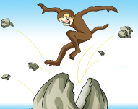
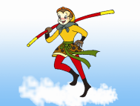
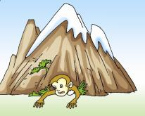
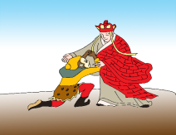
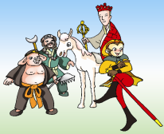
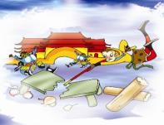
3 Match the descriptions with the correct pictures.
have a fantastic golden iron bar
be held under a mountain
C. be set free by a Tang dynasty monk, Xuanzang
D. be born from a magic stone
E. help Xuanzang travel to the West with Pigsy and Sandy
F. fight against the gods
D
A
B
C
E
F

Slide 16
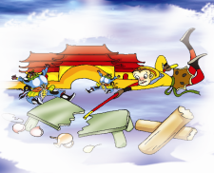
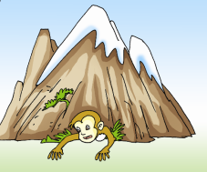
Write the story of the Monkey King with what you have learnt.

Slide 17
Long long ago, there was a rock which later became a magic stone egg. A monkey was born from the stone egg. He had a fantastic golden iron bar which could make bigger or smaller. He used the golden iron bar to fight against the gods. Then he was held under a mountain. However, he was set free by a Tang dynasty monk, Xuanzang. In the end, he helped Xuanzang travel to the West with Sandy and Pigsy.

Slide 18
Summary
1. unlike prep. 不像
2. rainbow n. 彩虹
3. golden adj. 金黄色的
4. both...and... （两者）都……
5. as well as 除……之外；还有
6. And then he told them to his sister, Dorothy, who wrote them down for him.
然后他把自己口头创作的诗告诉给他妹妹多萝西，由她记录下来。

Slide 19
Homework
Search for some foreign poems.
Search for more information and
pictures about fairy tales.

