Slide 1
Module 1
Unit 1 I want a hot dog, please.
WWW.PPT818.COM

Slide 2
Learning goals
能够掌握单词: look, dollar, cent, enjoy, careful。
能够运用句型：
1. —Can I help you?
— I want a hot dog, please.
2. — How much is it?
— It’s thirteen dollars and twenty-five cents.

Slide 3
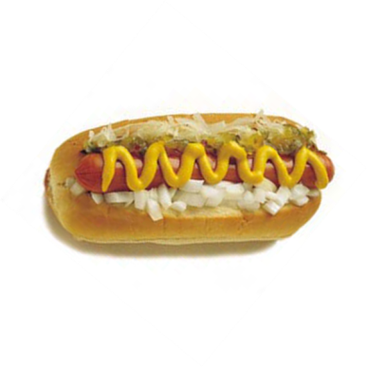
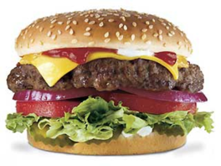
Lead-in
hamburger
hot dog
I want… , please.

Slide 4
课文学习
1 Look, listen and say.
—I want a hamburger.
—I want a hot dog.
—Oh, here comes a “hot” dog.

Slide 5
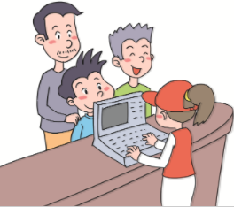
2 Listen, read and act out.
Simon: What do you want, Daming?
Daming: I don't know. What's hot dog? Is it really a dog?
Simon: No, Daming. That's a hot dog.
Daming: It looks good!
Cashier: Can I help you?
Daming: I want a hot dog, please.
Simon: And I want a hamburger.
Simon's dad: A hamburger for me too.

Slide 6
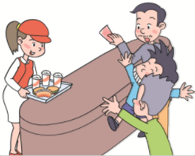
Cashier: And to drink?
Simon: I want a cola.
Daming: A cola for me too.
Simon's dad: Three colas, please.
Cashier: That's two hamburgers, a hot dog and three colas.
Simon's dad: How much is it?
Cashier: It's thirteen dollars and twenty-five cents.
Simon's dad: Here you are.
Cashier: Thank you. Enjoy your meal!

Slide 7
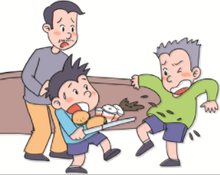
Daming: Let me take them.
Simon's dad: Be careful!
Daming: Oh no! I'm sorry!
Simon: Oh no! My new shorts and shoes!

Slide 8
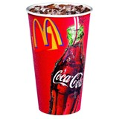
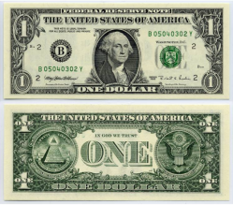
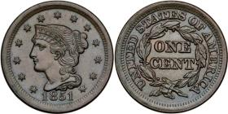
New words
cola
dollar
cent
1 dollar=100 cents

Slide 9
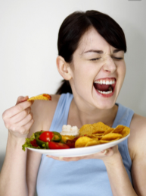
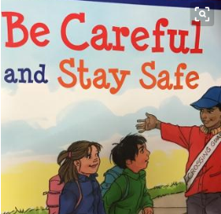
look
enjoy
Be careful!

Slide 10
课文理解
Read and answer.
1. What does Daming want?
He wants a hot dog.
2. What does Simon want?
He wants a hamburger.
3. What do they want to drink?
They want to drink cola.
4. How much is the meal?
It’s thirteen dollars and twenty-five cents.

Slide 11
补充学习
重点句型
1. Can I help you?句型
—Can I help you?
—I/We want(+a/an/some)+某物(, please).
很多英语国家的餐馆、商店、书店、
图书馆等的服务员或营业员会经常用
Can I help you?来招呼客人。

Slide 12
Example
—Can I help you?
—I want a dress, please.
—Can I help you?
—I want some rice, please.

Slide 13
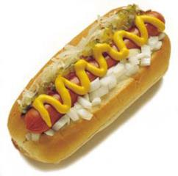
Role-play
Can I help you?
I want… , please.

Slide 14
2. how much句型
—How much is/are+可数名词单数/不可数名词/可数名词复数？
—It’s/They’re+金钱.
可用来询问物品的价格,意为“多少钱”,
后面be动词是is还是are,要根据所询问物
品的数的不同来确定。

Slide 15
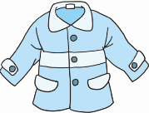
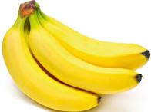
Example
—How much is the coat? 这件外套多少钱？
— It’s twenty dollars. 20美元。
—How much are these bananas? 这些香蕉多少钱？
— They’re ten yuan. 10块钱。

Slide 16
Role-play
How much is…?
It’s…
﹩2.00
﹩3.75

Slide 17
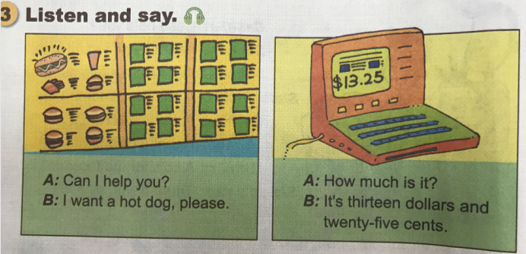
课文学习

Slide 18
4. Practise.
Look and write. Then ask and answer.
﹩3.75
A: Can I help you?
B: ________________________________
How much is it?
A: _______________________________________________
I want a hamburger, please.
It’s three dollars and seventy-five cents.

Slide 19
﹩1.25
A: Can I help you?
B: _______________________________
How much is it?
A: _______________________________
I want a cola, please.
It’s one dollar and twenty-five cents.

Slide 20
﹩2.00
A: Can I help you?
B: _______________________________
How much is it?
A: _______________________________
I want a hot dog, please.
It’s two dollars.

Slide 21
Exercise
单项选择。
( C ) 1. —_________?
— I want a hot dog. A. What is this
B. Do you like hot dog
C. Can I help you
( A ) 2. —_________ is your cola?
— It’s three dollars. A. How much B. How many C. How often

Slide 22
Homework
Read the text to your family.
Practise the dialogue in Part 2 with your partner.

