Slide 1
Unit 5 I Love Learning English!
How Do I Learn English?
WWW.PPT818.COM

Slide 2
Learning targets
1. Be able to use the words: Hong Kong, storybook,
magazine, newspaper, mistake, silly, oops, look
up, at the same time, write down, along with,
in/after class, be afraid to do sth., make mistakes,
laugh at, right now, thanks for
2. To know some ways of learning English
3. To learn some key sentences:

Slide 3
(1)I speak Chinese at home, but I speak English at school every day.
(2)Here are some tips：
(3)So I look them up in a dictionary.
(4)Then I can sing along with the music.
(5)Don't be afraid to make mistakes!
(6)Sometimes I make silly mistakes and I laugh at myself.

Slide 4
Lead in
Do you like English?
How do you learn English?
Do you have any good tips to learn English well?
PPT模板：www.1ppt.com/moban/ PPT素材：www.1ppt.com/sucai/
PPT背景：www.1ppt.com/beijing/ PPT图表：www.1ppt.com/tubiao/
PPT下载：www.1ppt.com/xiazai/ PPT教程： www.1ppt.com/powerpoint/
资料下载：www.1ppt.com/ziliao/ 范文下载：www.1ppt.com/fanwen/
试卷下载：www.1ppt.com/shiti/ 教案下载：www.1ppt.com/jiaoan/
PPT论坛：www.1ppt.cn PPT课件：www.1ppt.com/kejian/
语文课件：www.1ppt.com/kejian/yuwen/ 数学课件：www.1ppt.com/kejian/shuxue/
英语课件：www.1ppt.com/kejian/yingyu/ 美术课件：www.1ppt.com/kejian/meishu/
科学课件：www.1ppt.com/kejian/kexue/ 物理课件：www.1ppt.com/kejian/wuli/
化学课件：www.1ppt.com/kejian/huaxue/ 生物课件：www.1ppt.com/kejian/shengwu/
地理课件：www.1ppt.com/kejian/dili/ 历史课件：www.1ppt.com/kejian/lishi/

Slide 5
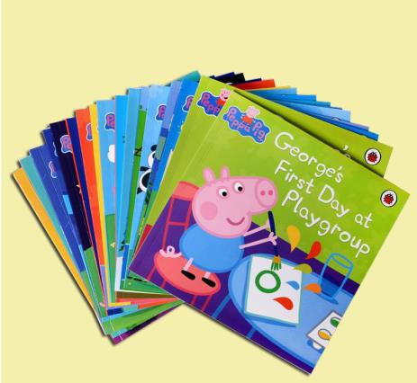
English dictionary
English storybooks

Slide 6
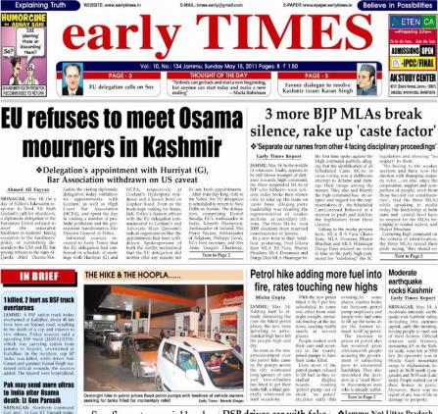
English magazine
English newspaper

Slide 7
Words and expression
Hong Kong
storybook
magazine
newspaper
mistake
silly
oops
香港(地名)
n. 故事书
n. 杂志
n. 报纸
n. 错误
adj. 愚蠢的；傻的
int. 哎哟；啊呀(摔倒或出
小差错时的用语)

Slide 8
look up
at the same time
write down
along with
in/after class
be afraid to do sth.
make mistakes
laugh at
thanks for
right now
查阅，查找
同时
写下；记下
和……一起
课上/后
害怕做某事
犯错误
嘲笑
因……而感谢
立刻；马上

Slide 9
Presentation
Culture Tip
Oops is something you say when you make a mistake. You can also say Uh­Oh or Whoops. Read Teresa's phone conversation above. What mistake does Teresa make?

Slide 10
Let’s Do It!
1. What tips does Teresa have for learning
English？Listen and tick the correct answers.
√
Speak English every day!
Speak to a foreign friend online twice a week.
Read a lot and use a dictionary!
Listen to English music!
Speak Chinese at home, but speak English at school.
Watch English TV shows and movies!
Make silly mistakes!
√
√
√

Slide 11
2. Read the lesson and answer the questions.
1. What grade is Teresa in?
2. What language does she speak at home?
3. What does she often read?
4. When does she watch English movies?
5. Where can you find the words for many English
songs?
Grade 7.
Chinese.
English storybooks, magazines and newspapers.
Every Sunday evening.
On the Internet.

Slide 12
3. Read Teresa and Susan's phone conversation
and fill in the blanks.
Teresa：Hello?
Susan：Hi. Is this Teresa?
Teresa：Yes, it is. Hi, Susan.Thanks for calling me
back. I want to go and watch a movie later. But I
don't want to go by ______. Do ________want to
come with ________？
myself
you
me

Slide 13
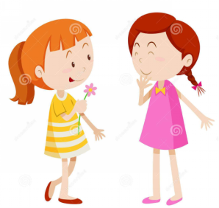
Susan：Sure.______ can come with ________. I will
meet you at the movie theatre. Can you get there
by ________？
Teresa：Of course I can. I'll meet you there at 3：00
p.m.
Susan：Great！See you later.
I
you
yourself

Slide 14
4. Work in groups. How do your classmates
learn English？Interview them and fill in
the table.
Name | How do you learn English？

Slide 15
Language points
1. I speak Chinese at home, but I speak English at
school every day.
【辨析】speak、talk、tell与say
① speak 意为“说，讲”。该词不强调说的内容，主要用来指人们对语言的掌握或使用以及说的动作。其后常接表示语言的名词或用于短语 speak to sb.(和某人说话)以及电话用语中。例：That woman can speak French.那位女士会说法语。

Slide 16
② talk 意为“谈论”，一般用作不及物动词，着重指连续地说话或与人交谈。常用短语：talk to/with sb.与某人交谈；talk about sth.谈论某事。例：What are you talking about？你们在谈论什么？
③tell 意为“告诉，讲述，吩咐”，经常用作及物动词，后面常跟双宾语和不定式的复合结构，即：tell sb. sth.＝ tell sb. about sth. 告诉某人某事；tell sb. (not) to do sth. 叫某人(不)做某事。

Slide 17
常用短语：tell a lie说谎；tell the truth说实话；tell a story 讲故事。此外，该词还可以表示识别或分辨事物。
例：He told us a story yesterday. 他昨天给我们讲了一个故事。
④say 意为“说”，是最普通的用语，着重指说的内容，通常作及物动词。其后可跟名词、代词或that从句。
例：What did you say just now？你刚才说了什么？

Slide 18
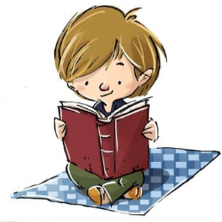
【中考链接】
1. —Hello！Is that Dave?
—Dave________.(贵州黔南州中考)
A．telling B．saying
C．speaking D．talking
2. His mother often tells him________too much
time playing games.(湖北十堰中考)
A．not to spend B．don't spend
C．spends D．spending
C
A

Slide 19
2. Here are some tips：
这个句子使用了完全倒装结构。当表示地点的副词如here、there等位于句首，主语是名词的时候，句子就要采用谓语放在主语前面的完全倒装结构，即：There/Here＋谓语＋主语(名词)。如果主语是代词时，则不用倒装，即：There/Here＋主语(代词)＋谓语。
例：Here you are.给你。(主语是代词，不用倒装) There comes the teacher.老师来了。(主语是名词，使用完全倒装)

Slide 20
3. Then I can sing along with the music.
along with意为“和······一起”，相当于together with。当along with后接名词或代词跟在主语之后时，谓语动词的数要跟along with前的主语在人称和数上保持一致。例：I like to go shopping along with my friends. 我喜欢和朋友一起购物。Our English teacher along with other teachers is working in the office. 我们的英语老师与其他老师正在办公室里办公。

Slide 21
4. Don't be afraid to make mistakes！
(1)afraid作形容词，意为“害怕的”。常用短语：be afraid to do sth.害怕做某事；be afraid of sth.害怕某物；be afraid of doing sth.害怕做某事；I'm afraid＋that从句 恐怕······；I'm afraid so/not恐怕是这样/恐怕不是这样。例：Are you afraid of learning math？你害怕学数学吗？I am afraid of snake very much. 我非常害怕蛇。I am afraid that your answer is wrong. 恐怕你的答案是错的。

Slide 22
(2)mistake作可数名词，意为“错误”。常用短语：make mistakes＝make a mistake犯错误；by mistake错误地。例：Sorry，I took your umbrella by mistake. 对不起，我错拿了你的雨伞。 Don't be afraid to make mistakes in learning anything.不要害怕学习东西时犯错。

Slide 23
5. Sometimes I make silly mistakes and I laugh at myself.
(1)silly作形容词，意为“愚蠢的，傻的”。它修饰人时，主要是指某人由于缺乏常识、判断等而做出令人觉得愚蠢的行为或者举止。例：Don't be silly. He is a dishonest man.别傻了。他是个不诚实的人。
(2)laugh作动词，意为“大笑”。常用短语：laugh at嘲笑；can't help laughing 情不自禁地大笑。例：
It's impolite to laugh at others. 嘲笑别人是不礼貌的。

Slide 24
Exercises
Ⅰ. 用所给词的适当形式填空。
1. Here ________ (be) some answers to your
questions.
2. I can enjoy _____ (me) by listening to
Beijing Opera.
are
myself

Slide 25
3. If he meets a new word, he can look it up in a
dictionary ________ (he).
4. I practice ________ (speak) English after class
every day.
5. —Can you ask her to come here _______ (late)?
—Sure. I’ll tell her.
himself
speaking
later

Slide 26
Ⅱ. 单项选择。
1. My father reads _______ because he likes
reading news.
A. storybooks B. magazines
C. newspapers D. dictionaries
2. When you don’t understand some words,
you can _______ in a dictionary.
A. look for them B. look them for
C. look up them D. look them up
C
D

Slide 27
3. It is of you to make the same mistake
again and again.
A. silly B. kind C. fun D. excited
4 . Do you speak English or Chinese ______?
A. on school B. at the home
C. after the class D. in class
A
D

Slide 28
Ⅲ.根据汉语意思完成句子，每空一词。
1. 你能帮我查个电话号码吗？
Can you help me _____ _____ a phone number?
2. 课后我们常说英语。
We often speak English ____ _____.
3. 不要嘲笑别人。
Don’t _____ _____ others.
4. 如果你想学好英语，就不要怕犯错。
If you want to learn English well, don't be afraid
of________ ________.
look up
after class
laugh at
making mistakes

Slide 29
Summary
Words & Phrases：Hong Kong, storybook, magazine, newspaper, mistake, silly, oops, look up, at the same time, write down, along with, in/after class, be afraid to do sth., make mistakes, laugh at, right now, thanks for
Sentences：
(1) Don't be afraid to make mistakes!
(2) Sometimes I make silly mistakes and I laugh at
myself.
...

Slide 30
Summary
Good ways to learn English
1.Speak English every day!
2.Read a lot and use a dictionary!
3.Listen to English music!
4.Listen to the teacher carefully in class and take
notes!
5.Keep writing English diaries!

Slide 31
Homework
1.Write a composition: How to
learn English well?
2.Finish the exercises of this lesson.

