Slide 1
Unit 5 I Love Learning English!
Online Phone Calls
WWW.PPT818.COM

Slide 2
Learning targets
1. Be able to use the words: Russia, reply,
competition, proud, such, speak English online,
win first place, the National English
Competition, thanks to, be proud of
2. Learn to speak English online
3. Learn some key sentences:
(1)They speak English online twice a week.

Slide 3
(2)Alicia does not hear a reply.
(3)I won first place at the National English Competition！
(4)It's all thanks to you.
(5)I am so proud of you.
(6)Talking with you is such a great help.

Slide 4
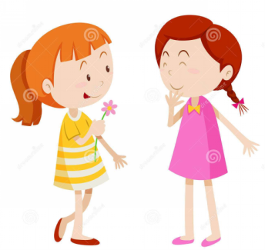
Lead in
Can you use a computer?
Can you speak English online?
What do you usually speak online?

Slide 5
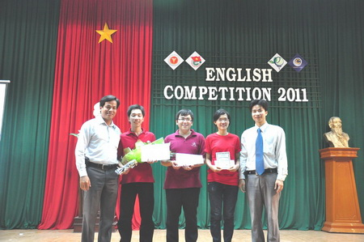
speak English online
PPT模板：www.1ppt.com/moban/ PPT素材：www.1ppt.com/sucai/
PPT背景：www.1ppt.com/beijing/ PPT图表：www.1ppt.com/tubiao/
PPT下载：www.1ppt.com/xiazai/ PPT教程： www.1ppt.com/powerpoint/
资料下载：www.1ppt.com/ziliao/ 范文下载：www.1ppt.com/fanwen/
试卷下载：www.1ppt.com/shiti/ 教案下载：www.1ppt.com/jiaoan/
PPT论坛：www.1ppt.cn PPT课件：www.1ppt.com/kejian/
语文课件：www.1ppt.com/kejian/yuwen/ 数学课件：www.1ppt.com/kejian/shuxue/
英语课件：www.1ppt.com/kejian/yingyu/ 美术课件：www.1ppt.com/kejian/meishu/
科学课件：www.1ppt.com/kejian/kexue/ 物理课件：www.1ppt.com/kejian/wuli/
化学课件：www.1ppt.com/kejian/huaxue/ 生物课件：www.1ppt.com/kejian/shengwu/
地理课件：www.1ppt.com/kejian/dili/ 历史课件：www.1ppt.com/kejian/lishi/
English competition

Slide 6
Words and expression
Russia
reply
competition
proud
such
speak English online
win first place
the National English Competition thanks to
be proud of
俄罗斯(地名)
n. & v. 回答；答复
n. 比赛；竞赛
adj. 自豪的；引以为荣的
adj. 那么的；这样的
在线说英语
获得第一名
全国英语竞赛
由于；多亏
以······为骄傲；为······自豪

Slide 7
Presentation
Alicia is from Russia. She is learning English. Ms. Bell is a Canadian teacher. They speak English online twice a week. Ms. Bell helps Alicia with her English.Today, Alicia has some good news for her teacher!
Alicia：Hi, Ms. Bell！Can you hear me?
(Alicia does not hear a reply.)
Alicia：Hello？Ms. Bell, are you there?
Ms.Bell：Hi, Alicia. Yes, I'm here!

Slide 8
Alicia：Oh good. I'm so excited today. I have some
good news!
Ms. Bell：Really？What is it, Alicia?
Alicia：I won first place at the National English
Competition!
Ms. Bell: Good for you, AliciaYou really improved a lot!
Alicia：It's all thanks to you.
Ms. Bell：No. I didn't do anything. You did all the hard
work yourself. I am so proud of you.

Slide 9
Alicia：I couldn't do it by myself. Talking with you is
such a great help. Thank you, Ms. Bell.And
guess what！I won a great prize!
Ms.Bell：That's great！What did you win?
Alicia：I won a trip to Canada！Next year, I will
visit Canada for two weeks. I can meet you in
Canada.
Ms.Bell：Wow！That is great news！You can stay
with me. I can't wait to see you!

Slide 10
Let’s Do It!
1. Listen and circle the correct words.
Alicia is from (Russia/Canada).
Ms. Bell is (a Canadian/an American) teacher.
They speak English online (three times/twice) a week.
Alicia is so (unhappy/excited) today.
Ms. Bell and Alicia will meet in Canada (this year/next year).

Slide 11
2. Read the lesson and answer the questions.
What is Alicia’s good news?
2. How does Ms Bell help Alicia with her English?
3. What did Alicia win?
4. How long will Alicia stay in Canada?
She won first place at the National English
Competition.
Ms. Bell talks with Alicia.
She won a trip to Canada.
She will stay in Canada for two weeks.

Slide 12
3. Number the phone conversation in the
correct order.
Everything is good with me. How is school?
OK. Sounds good. See you this weekend.
Hello? Dave, are you there?
OK. See you. Bye.
I’m good. How are things with you?

Slide 13
6. Yes. I’m here. How are you, Matt?
7. That’s great! Do you want to get together this
weekend?
8. School is good. I’m doing well this year.
9. Sure. Let’s go and see a movie.
The correct order is:____________________
3, 6, 5, 1, 8, 7, 9, 2, 4

Slide 14
4. Work in pairs. Do you have some good news
you would like to share? Have an online chat
about it with your partner.
Example：
A：Hello？Jack, can you hear me？
B：Yes. I can hear you. How are you？
A：I'm great！I have some good news.
B：Really？What is it？
A：...
B：Good for you！

Slide 15
Language points
1. They speak English online twice a week.
twice a week 一周两次。once a year 一年一次。三次以上需用“数词+ times”构成。例：four times a day 一天四次。Take this medicine three times a day.这药一天吃三次。

Slide 16
2. Alicia does not hear a reply.
reply既可作名词也可作动词，意为“回答，答复”。reply较正式，多指经过考虑而作出答复。其后除接 that从句时是及物动词外，一般只用作不及物动词。其后若接名词或代词作宾语，应加介词 to，即：reply to对······作出答复。例：The company didn't give me a reply.那家公司没有给我一个答复。He replied that he had changed his mind.他回答说他改变了主意。

Slide 17
【学以致用】
1.这些短信很无聊，不值得回复。
These short messages are so boring that they
_______________________.
2.请尽快给我回复。
Please give me your ________ as soon as possible.
are not worth replying to
reply

Slide 18
3. It's all thanks to you.
thanks to为固定短语，表示原因，意为“由于，多亏”。thanks不可以改为thank you，to后也不接动词原形，而要接感谢的对象。例：Thanks to the English language, we can learn a lot from other countries.由于英语这门语言，我们能从其他国家学到很多东西。

Slide 19
4. I am so proud of you.
proud是形容词，意为“自豪的；骄傲的”，常用短语: be proud of, 后可跟人、事物及动词-ing。
【拓展】pride 是proud的名词形式，意为“骄傲；自豪”，常用短语：take pride in， 后可跟人或物。例：I take pride in you/your success. 我为你（的成功）感到自豪。

Slide 20
5. Talking with you is such a great help.
(1)talking with you为动名词短语，在句中作主语。动名词(短语)作主语时，谓语动词用单数形式。例：Swimming is good for your health.游泳对你的健康有好处。
(2)such作形容词，意为“那么的，这样的”。它修饰名词。常用结构：such＋a(n)＋形容词＋可数名词单数＋that... 意为“如此······以至于······”。

Slide 21
【探究总结】such与so的用法辨析
such与so都可以用来表示程度，意思是“如此；这样”，但用法却不相同。
(1)such是形容词，用来修饰名词，名词前有无形容词都可以；so是副词，用来修饰形容词或副词，形容词后可以省略名词。
(2)单数名词前有不定冠词与形容词时，so和such的位置不同。前者为“so+形容词+冠词+名词”，后者为“such+冠词+形容词+名词”。

Slide 22
(3)so后即使有形容词，也不能修饰复数名词或不可数名词，而such则可以。
(4)名词前有表示“多少”意义的many, much, few, little等修饰词时，要用so, 不用such。
(5)当little表示“小”的意思修饰可数名词时，其前只能用such, 不能用so。

Slide 23
【学以致用】用so或such填空。
①Ye Shiwen is ______ good a swimmer; we all
like her.
②Ye Shiwen is ______ a good swimmer; we all
like her.
③It’s not good for you to eat many eggs a day.
so
such
so

Slide 24
Exercises
Ⅰ. 单项选择。
1. Hello, Jim! Can you hear _______?
A. I B. my C. mine D. me
2. My success is all thanks _______ you.
A. to B. for C. of D. by
3. Moscow is in _______.
A. Russia B. Russian
C. Canada D. Canadian
D
A
A

Slide 25
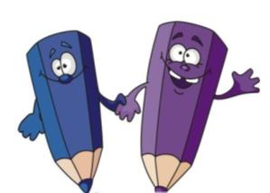
4. Listening to English songs is _______.
A. great a help B. so a great help
C. such a great help D. such great a help
5. It is ________ a beautiful garden ________ we
like to play in it. (四川宜宾中考)
A. so; that B. such; that
C. too; to D. very; that
C
B

Slide 26
Ⅱ. 根据汉语意思完成句子。
1. 我们大家都为莫言感到自豪。
We ______ all ______ ______ Mo Yan.
2. 我真的迫不及待去参观香港了！
I really ______ ______ ______ visit Hong Kong!
are proud of
can’t wait to

Slide 27
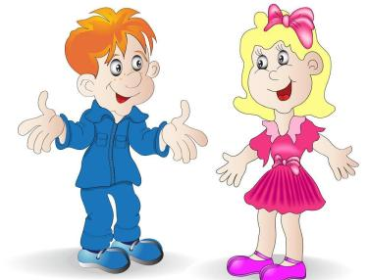
3. 汤姆在校汉语比赛中荣获一等奖。
Tom ______ ______ ______ at the School Chinese
Competition.
4. 你能听到回答吗？
______ you hear a ______?
5. 我认为我自己能做到。
I think I can do it ______ ______.
won first prize
Can reply
by myself

Slide 28
Summary
1. Learned some useful words and phrases in this
lesson: Russia, reply, competition, proud, such,
speak English online, thanks to, be proud of…
2. Some key sentences:
They speak English online twice a week.
Alicia does not hear a reply.
I won first place at the National English Competition！
It's all thanks to you.
...

Slide 29
Homework
1.Do you have some good news you
would like to share? Have an online
chat about it with your classmates in English.
2. Finish the exercise of this lesson.

