Slide 1

Unit 1 Part B
My classroom
WWW.PPT818.COM

Slide 2
第三课时
Read &write & Story time

Slide 3
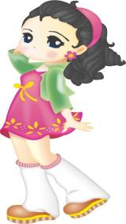

创设情境
We have a new classroom.
Really? That’s great!

Slide 4
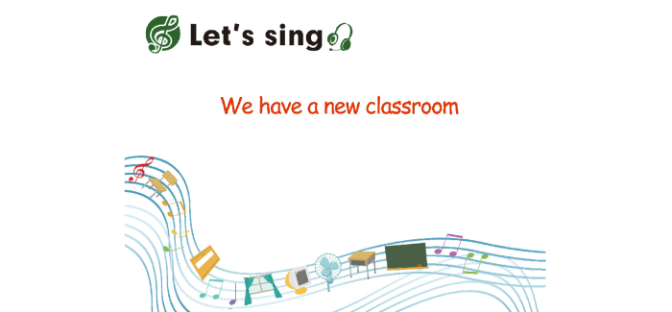
启发思考

Slide 5

Let's review

Slide 6

表示位置的介词——方位介词 (prep)
in
在里面
on
在上面
under
在下面
near
在旁边

Slide 7
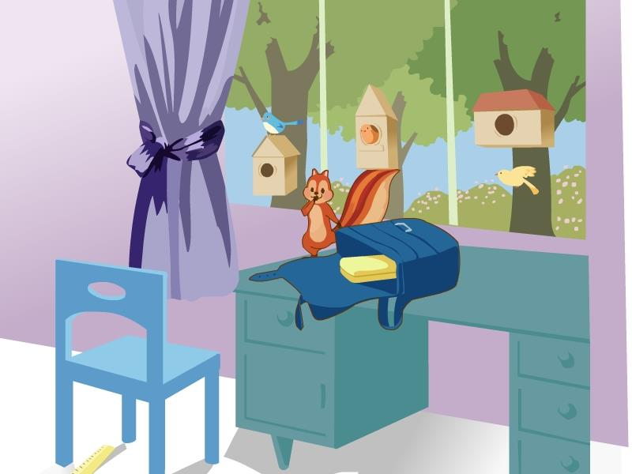
It's ......
Where is.....
schoolbag
chair
desk
ruler

Slide 8


自主或小组探究
Read and Write
×
√
×
√

Slide 9
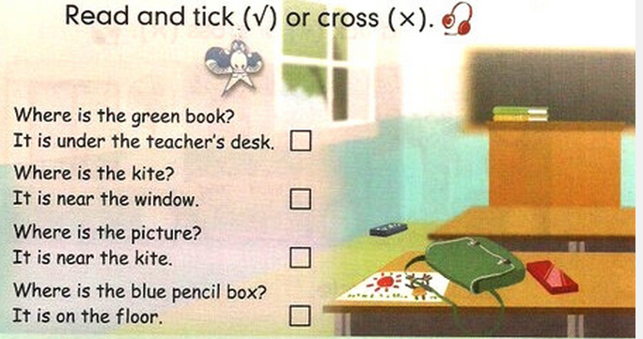
on
the bag.

Slide 10
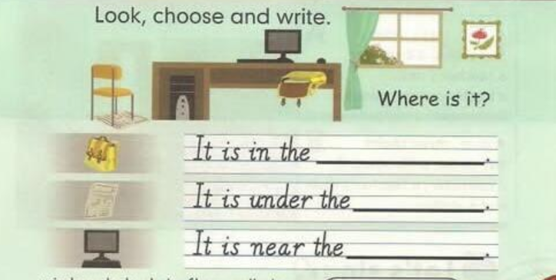
desk
chair
window

Slide 11
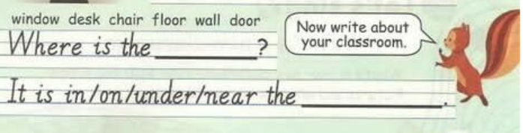

Slide 12

Let's check

Slide 13
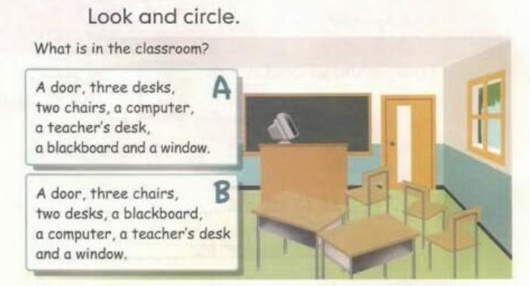

Slide 14

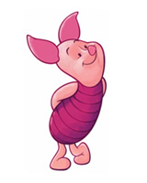
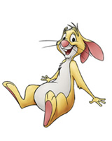
Story time

Slide 15


Look!
This is a bee.
Bee 蜜蜂

Slide 16
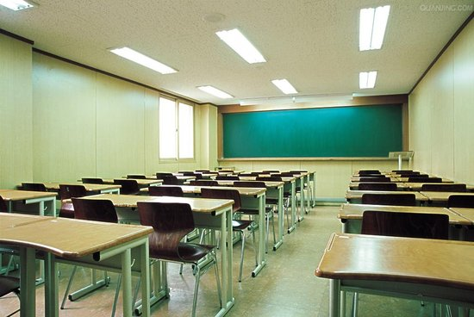

There is a bee in the classroom.

Slide 17

There is a bee on the desk.

Slide 18


Story time
①Who are they in the story？
They are Zoom ,Zip, rabbit and a sheep.
②Where are they?
They are in the classroom.
③Where is the bee at last?
It’s on the blackboard.

Slide 19
Story time

Slide 20

判断对错
①There is a cat in the classroom .
②The bee is on the teacher’s desk .
③The bee is on the board .

Slide 21
协作交流
Role paly
跟读录音，注意语音语调分角色表演对话内容。
老师评出最佳表演小组。

Slide 22



总结提高
Where is it? It's on light.
What's this? It's a bee.

Slide 23
Homework
1. Listen and tell the story to your parents. Then, make a new dialogue according to this story.
2.Finish the relevant workbook exercises.

