Slide 1
Unit 3
Would you like to come to my birthday
WWW.PPT818.COM

Slide 2
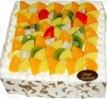
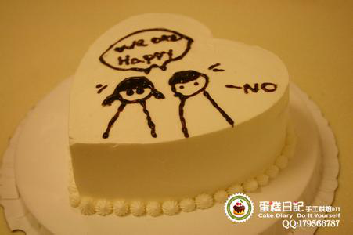
Here is a birthday cake for you.

Slide 3
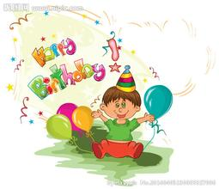
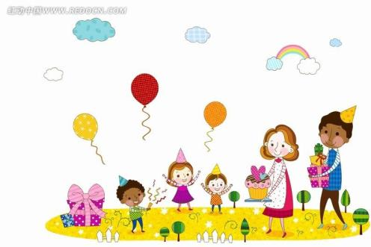
How do they celebrate the birthday cake.

Slide 4
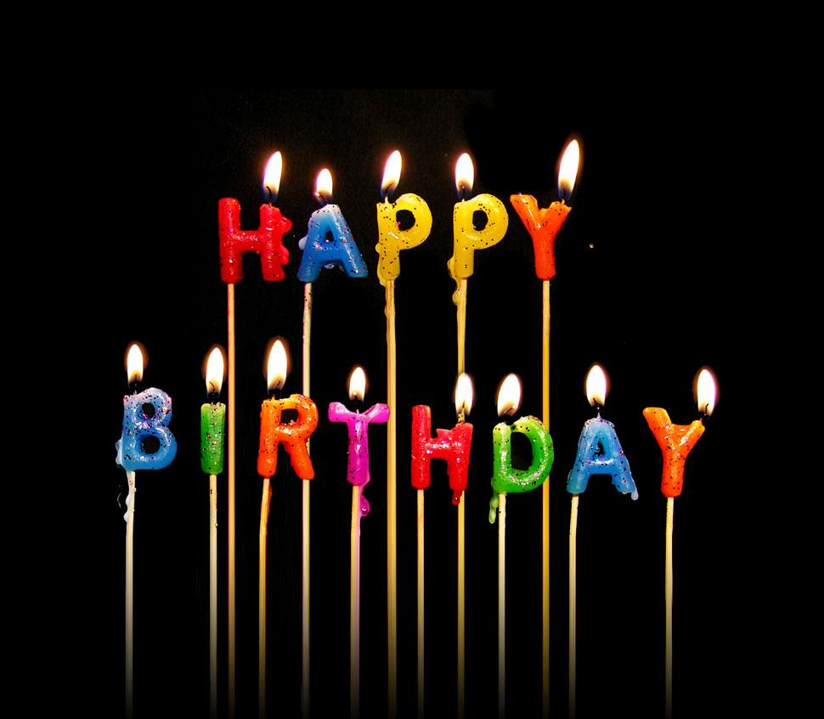
First

Slide 5
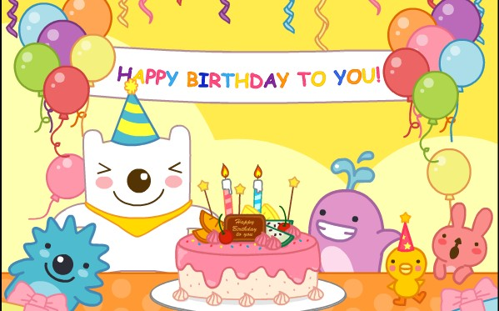
Then

Slide 6
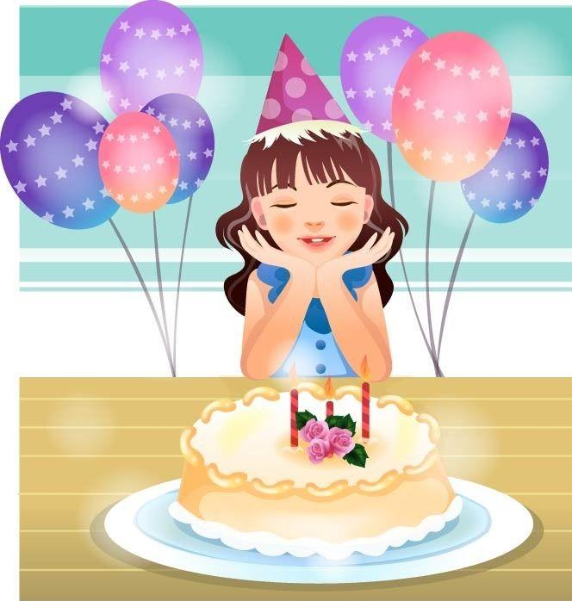
Next

Slide 7
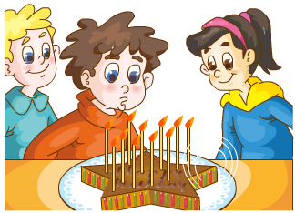
Next

Slide 8
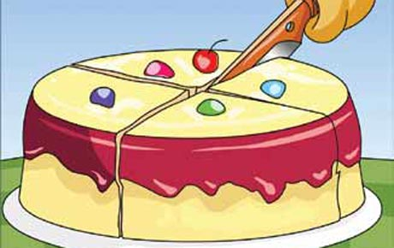
Next

Slide 9
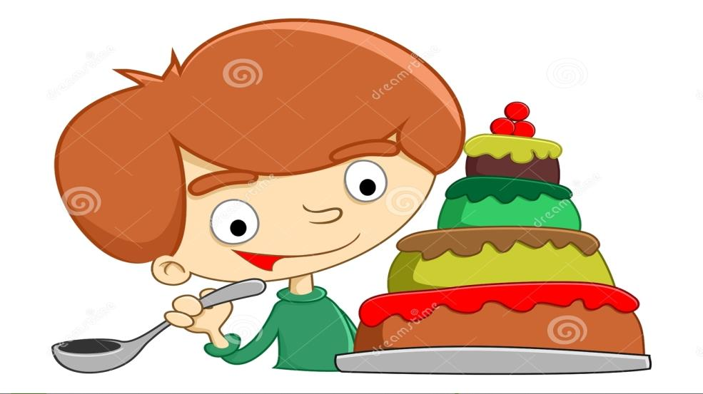
Next

Slide 10
Just practice

Slide 11
First, we light the candles on the cake and sing the birthday song．
Then I make a wish and blow out the candles．
After that, I cut the cake and give each one a piece．
At last, we also have fruit and candy．
We have a good time．

Slide 12
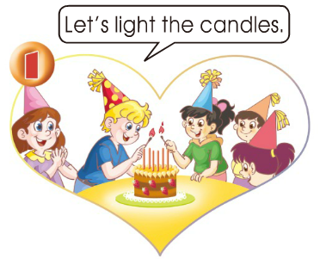

Slide 13
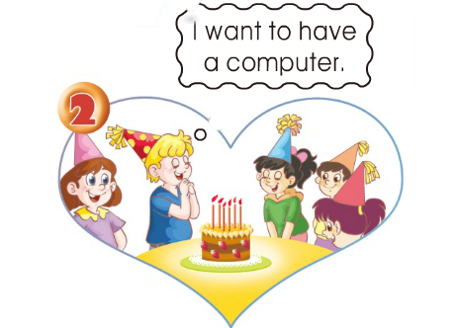

Slide 14
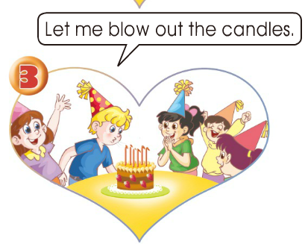

Slide 15
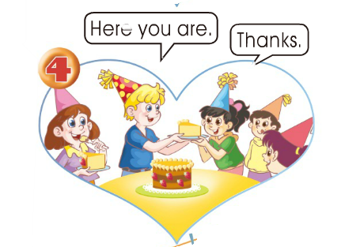

Slide 16
( 制定你的计划）
Tomorrow is my mother’s birthday . I’ll get some _______ for her . I’ll get some ____ __ for her. She’d like a ________cake. She’d like a _____________one. She will have a great party.
flowers
jelly
milk
heart-shaped

Slide 17
H
N
S
T
A
K
~
Notes:
17

