Slide 1
人教精通版四年级上册
This is my new friend
WWW.PPT818.COM

Slide 2
相 互 问 候
Good morning, boys and girls.
Good morning, Miss Green.
Nice to see you again!
Nice to see you, too!

Slide 3
Let’s sing: Nice to see you again.

Slide 4
假日期间我结识了两个新朋友，你们想认识他们吗?
This is my new friend.
Hello! I’m Panda. I’m from China.

Slide 5
China
I’m from China.

Slide 6
Hello! I’m Cat. I’m from England.

Slide 7
England
I’m from England.

Slide 8
新学期开始了，将有新同学、新朋友加入我们的学习。你们想认识他吗？看图，想一想下面的问题
Where are the children?
What are they talk about?

Slide 10
Hello! I’m Jim. I’m from America.

Slide 11
America
I’m from America.

Slide 12
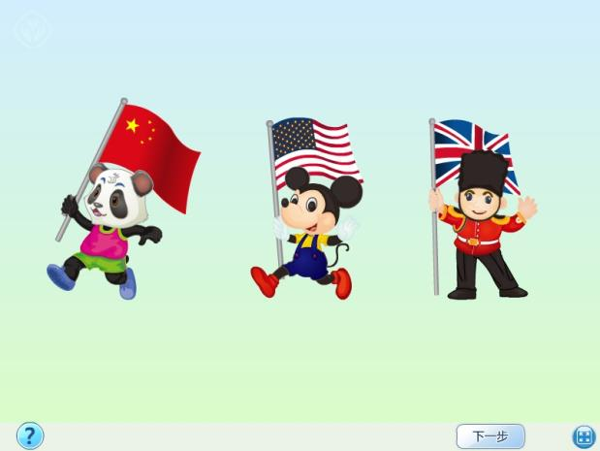

Slide 13
Practice
Role play
三人一组分别扮演Gao Wei、Peter和Jim，表演对话。
用到的句型：
This is +某人。“这是……”
主语+be动词+from+地点/国名。“某人来自……”

Slide 14
Practice
自编童谣
Peter, Peter. I am Peter.
I’m from England. How about you?
Jim, Jim. I am Jim.
I’m from America. How about you?
Gao Wei, Gao Wei. I am Gao Wei.
I’m from China, China, China, China!

Slide 15
Practice
自制卡片
同学们结合自己家乡地名或以A、BCDE字母开头的地名写在卡片上，练习:I’m from…
例如：
字母A开始的地名：Anhui, America…

Slide 17
做一做
根据表格信息，进行介绍
Student Card
Name: Candy Chen
Age: 9
Class: Class1, Grade4
Country: China

