Slide 1
Unit 3 Welcome to our school!
Reading
WWW.PPT818.COM

Slide 2
Period 2 Reading
课前自主预习
单 词 闯 关 | 1. 引，带，领 /ʃəʊ/________ 2. 到处，向各处 /ə 'raʊnd/________ 3. 建筑物，房子，楼房 / 'bɪldɪŋ/________ 4. 明亮的 /braɪt/________ 5. 现代的；新式的 / 'mɒdn/________ 6. 日记 / 'daɪərɪ/________
show
around
building
bright
modern
diary

Slide 3
Period 2 Reading
短 语 互 译 | 1. in front of ____________ 2. clean and bright ____________ 3. 带领某人参观 ____________ 4. 去礼堂____________ 5. 开会 ____________ 6. 教学楼________________
在……的前面
既干净又明亮
show sb around
go to the hall
have meetings
the classroom building

Slide 4
Period 2 Reading
句 型 在 线 | 1．My classroom is ________ ________ ________ ________. 我的教室在一楼。 2．________ ________， Mum. 妈妈，这边走。 3．________ that man ________ a white shirt？ 穿白色衬衫的那位男士是谁？
on the ground
floor
This way
Who's in

Slide 5
Period 2 Reading
课 文 初 探 | 判断正误：正确的写“T”，错误的写“F”。 ( )1. There are two computer rooms, two art rooms and a music room in Millie's school. ( )2. Millie's classroom is on the second floor. ( )3. The students have meetings in the school hall.
F
F
T

Slide 6
Period 2 Reading
课堂互动探究
词汇点睛
1 show sb around 带领某人参观
[观察] Let me show you around.让我带你参观吧。
Mr Li shows us around the factory.
李老师带领我们参观这家工厂。

Slide 7
Period 2 Reading
[探究] show用作及物动词，意为“引，带；出示，展示”，可以直接跟宾语。常用短语：__________________ 带领某人参观 show sb sth/____________________ 向某人展示某物
show sb around
show sth to sb
[拓展] show还可以作名词，意为“展览”。常用短语：on show展览，陈列 a fashion show时装秀 a flower show花展

Slide 8
Period 2 Reading
活学活用
2016·恩施 暑假期间我父母将带我去参观恩施高中。
My parents will ________ me ________ Enshi High School during the summer holidays.
show around

Slide 9
Period 2 Reading
2 in front of 在……的前面
[观察] We're now in front of the classroom building.
我们现在在教学楼的前面。
There are many trees in front of our classroom.
在我们教室的前面有许多树。

Slide 10
Period 2 Reading
[辨析] in front of 与 in the front of
词条 | 意义及用法
in front of | 意为“在……的前面”，指在某范围________(内/外)的前面。其反义词是 behind，意为“在……的后面”。
in the front of | 意为“在……的前部”，指在某范围________(内/外)的前部。其反义短语是at the back of，意为“在……的后部”。
外
内

Slide 11
Period 2 Reading
活学活用
用in front of或in the front of填空
There is a car __________ our classroom and two foreigners(外国人) are sitting __________ the car.
in front of
in the front of

Slide 12
Period 2 Reading
句型透视
1 This way, Mum. 妈妈，这边走。
[探究] this way意为“这边走”，其中way是名词，表示“路，道路”。常用短语：
the way to…去……的路 ____________________ 在某人去……的路上 all the way一路上，自始至终 by the way顺便问一下
On my way to the cinema, I met my old friend Jack.
在去电影院的路上，我遇见了我的老朋友杰克。
on one's way to…

Slide 13
Period 2 Reading
[拓展] way作名词，还可以表示“方法；方式；方面”。常用短语：____________________ 以这种方式 in some ways在某种程度上，在某些方面
It's easy for me to work out the Maths problem in this way.
对我来说，用这种方法算出这道数学题很简单。
in this way

Slide 14
Period 2 Reading
活学活用
2016·泰州—Excuse me, where's the meeting room?
—________. I will show you there.
A. This way, please B. That's right
C. I can manage D. In your dreams
A
【解析】考查情景交际。“This way, please.”意为“请这边走”；“That‘s right.”意为“那是正确的”；“I can manage.”意为“我能够对付”；“In your dreams.”意为“你妄想”。句意：“打扰了，会议室在哪儿？”“这边请。我将带你去那里。”故答案为A。

Slide 15
Period 2 Reading
2 Who's that man in a white shirt?
穿白色衬衫的那位男士是谁？
[探究] in为介词，后接表示衣服或颜色的名词，意为“穿着……”。in a white shirt 意为“穿着白衬衫”，是介词短语，在句中作定语修饰“that man”。对此类介词短语提问，用特殊疑问词which。

Slide 16
Period 2 Reading
活学活用
对画线部分提问
The girl in red is my sister.
________ ________ is your sister?
Which girl

Slide 17
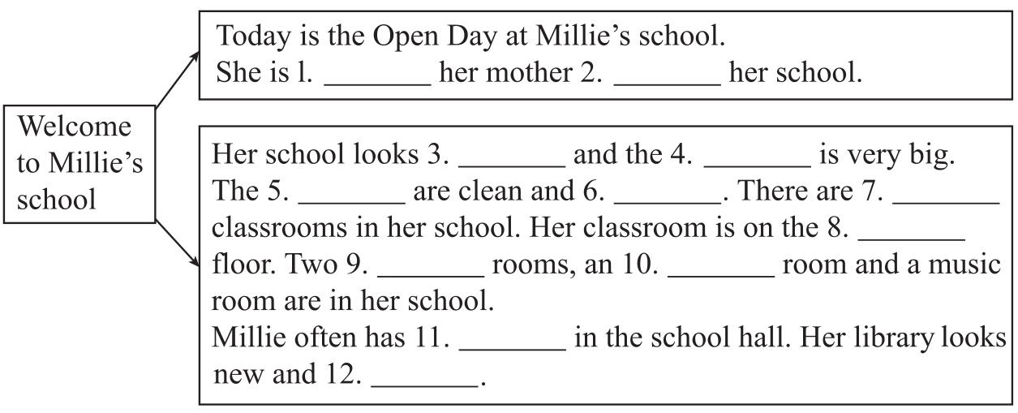
Period 2 Reading
课文回顾
showing
around
beautiful
playground
classrooms
bright
18
ground
computer
art
meetings
modern

