Slide 1
Unit 7
Teenagers should be allowed to
choose their own clothes.
Section B(第1课时)
WWW.PPT818.COM

Slide 2
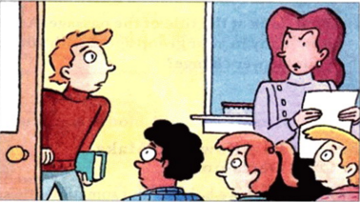
Read the questions. How often do you do these things? Write A for always, U for usually, S for sometimes and N for never. Then talk with a partner about other things you do.
1a

Slide 3
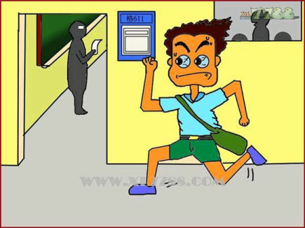
Do you ever get to class late?

Slide 4
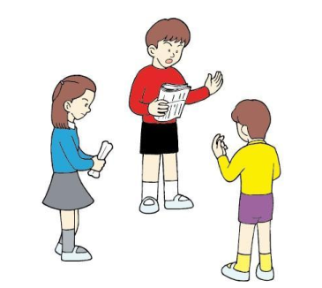
Do you ever study with friends?

Slide 5
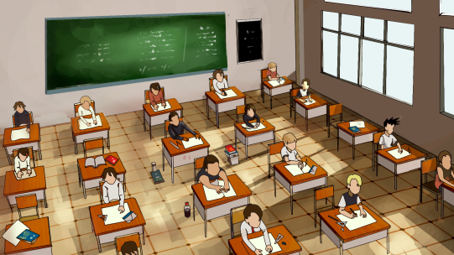
Do you ever finish a test early?

Slide 6
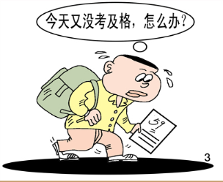
Do you ever worry about failing a test?

Slide 7
1b
Talk about your answers in 1a.
A: Do you ever get to class late?
B: Yes, I sometimes get to class late.

Slide 8
Listen and circle the things in 1a that Peter talks about.
1c
Do you ever ...
1. get to class late? __________
2. study with friends? __________
3. finish a test early? __________
4. worry about failing a test? __________
5. ...

Slide 9
1d
Listen again. Match these sentence parts.
e
a
b
d

Slide 10
Read the statements. Then discuss them with your group.
1e
1. Peter should be allowed to take the test later.
2. Students need strict rules.
3. Parents should not be too strict with teenagers.
A:I think Peter should ...
B:I don't agree.
C:I think ...

Slide 11
Are you allowed to make your own decisions at home?What kinds of decisions?
2a
Discuss the questions in your groups.

Slide 12
2b
First, look at the title of the passage. Answer “yes” or “no”. Find out how many in your group agree with you. Then read the passage. Does your answer change?
Should I Be Allowed to Make My Own Decisions?
Many teenagers have hobbies. But sometimes these can get in the way of their schoolwork, and parents might worry about their success at school. Teenagers often think they should be allowed to practice their hobbies as much as they want. Do you agree?

Slide 13
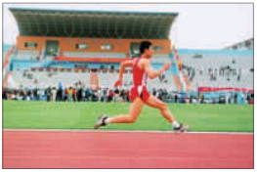
Liu Yu, a fifteen-year-old boy from Shandong, is a running star. He is on his school team and has always wanted to be a professional runner when he grows up. However, his parents won’t allow him to train so much. “Of course we want to see him achieve his dreams,” says Mr. Liu. “And we know how much he loves running. My wife and I have supported every one of his races. We have nothing against running! But we think our son needs to think about other possible jobs. He’s getting older now, so he needs to think about what will happen if he doesn’t end up as a professional runner.”

Slide 14
Liu Yu doesn't really agree. "Well, I think I should be allowed to decide for myself," he says. "My parents have always taught me how important it is to work hard at school and enter university. I understand this, but I'm serious about running. It's the only thing I've ever wanted to do." His parents believe that Liu Yu should study hard in the evenings so they don't allow him to practice running at night. "Maybe he thinks it's too strict or unfair,"says Mrs. Liu. "But we think we're doing the right thing. He needs to spend more time on his homework because it is difficult to become a professional sports star." But Liu Yu still disagrees. "I know my parents care about me. They always talk about what will happen if I don't succeed. But I will! I'm a quick runner! I think I should be allowed to make this choice myself. Only then will I have a chance to achieve my dream."

Slide 15
2c
Read the passage again and answer the questions.
1. What is Liu Yu’s hobby?
2. What does Liu Yu want to be when he grows up?
His hobby is running.
He wants to be a professional runner.
3. Why do Liu Yu’s parents not allow Liu Yu to practice his
hobby at night?
4. Do you think Liu Yu should be allowed to practice his hobby as
much as he wants? Why or why not?
Because they believe Liu Yu should study hard in the evenings, and spend more time on his homework.
Yes,I think so.Because only in his way he will have a chance to achieve his dream.

Slide 16
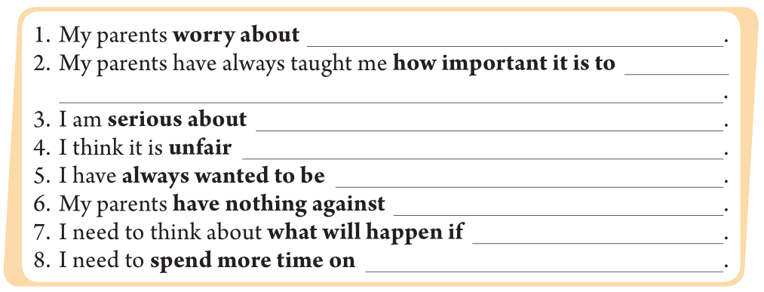
2d
Look in the passage for the words in bold. Then use them to complete sentences of your own.
my success at school
work hard
at school and enter university
running
that I shouldn't be allowed to make my own decisions
a professional runner
my hobbies
I don't succeed
my homework

Slide 17
2e
Discuss the questions with a partner. Use the information in the passage to support your opinion.
What is your dream job? Do your parents support your dream?

Slide 18
Language Points
1.late 的用法
（1）adj.迟的，晚的。常用作be late for...意为“……迟到”。反义词为early。
（2）adv. 迟地，晚地。其反义词也为early。
e.g.:She comes to school late every day.
【拓展】late adv.后来，稍后
2.be strict with
be strict with意为“对……严格要求”，宾语为人。
【拓展】be strict in “对……严格要求”，宾语为物。

Slide 19
3.fail
fail 是动词，意为“失败，不及格”，其反义词为pass。
fail(vt.) +n./pron./ to do sth.在（做）……方面失败
fail(vi.) +in+n./pron./doing sth. 在（做）……方面没有成功
【拓展】take a test 考试；pass a test 考试及格；fail a test 考试不及格；take a test later 补考。
e.g.:He failed (in) taking a test yesterday.

Slide 20
Exercise
一、用所给词的正确形式填空。
1.The boy failed _________(take) a test later.
2.The classroom should _________(keep) clean every day.
3.He is worrying about _________(get) to class late tomorrow.
4.We should not _________(allow) to drink.
5.I've called the person _________(late). He wasn't in then.
in taking
be kept
getting
be allowed
later

Slide 21
二、单项选择。
( )1.Eagle Father was so ______ with his son that
he kept the four-year-old son running in the snow.
A.pleased B.sorry C.strict D.careful
( )2.—I think students should have mobile phones to call their parents.
—______. They often use them to play games instead.
A.I hope so B.I don't agree
C.No problem D.Good idea
C
B

Slide 22
( )3.The boy usually takes the bus to get to school,but ______ he rides a bike.
A.ever B.usually
C.sometimes D.often
( )4.He spent most of his time playing outside and he ______ the math exam in the end.
A.fall B.fell
C.felt D.failed
C
D

Slide 23
Homework
Read the article and recite key words.

Slide 24
Thank you！

