Slide 1
Module 12 Save our world
Unit 2 Repeat these three words daily: reduce, reuse and recycle.
WWW.PPT818.COM

Slide 2
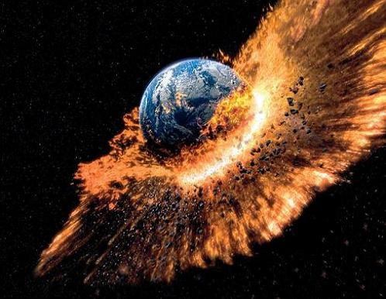
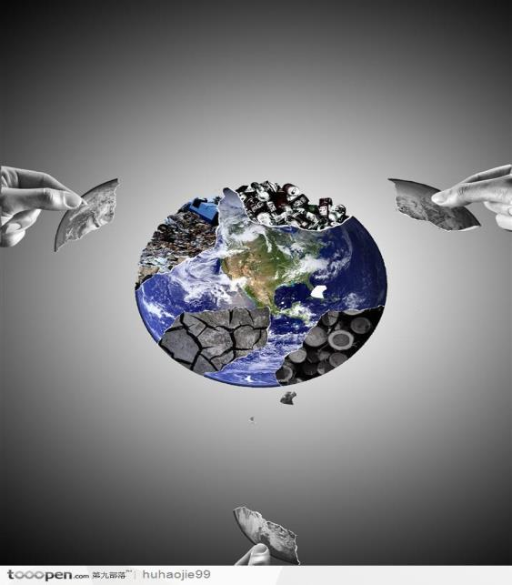
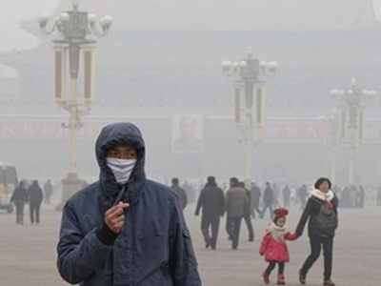
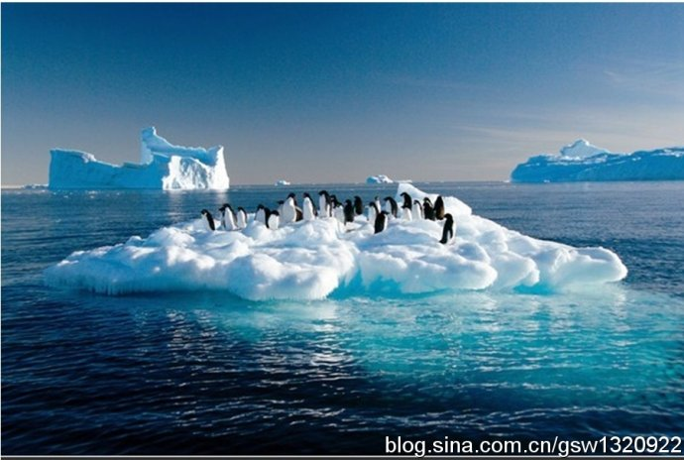
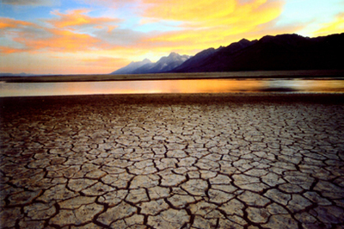

Slide 3
Green

Slide 4
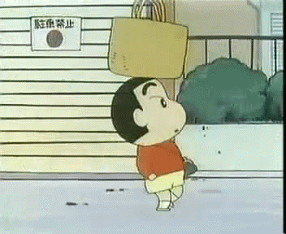
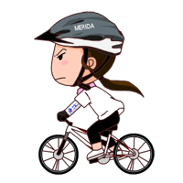
Do you walk or ride a bike to school ?

Slide 5
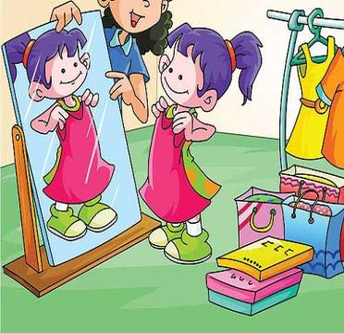
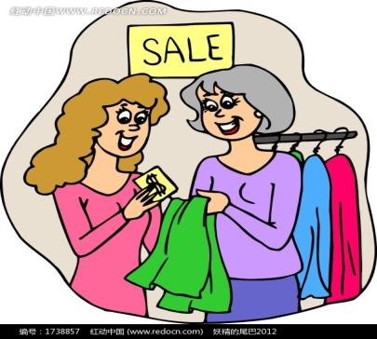
Do you buy new clothes just because they are modern?

Slide 6
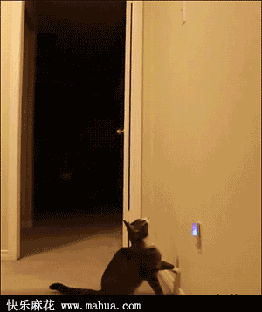
Do you turn off the lights
when you leave the room?

Slide 7
Reduce

Slide 8
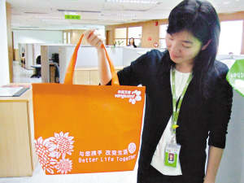
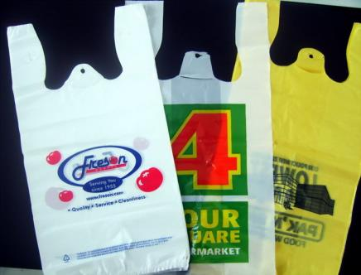
Do you take your own cloth bag when shopping and not ask for a plastic bag?

Slide 9
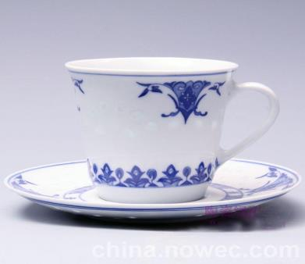
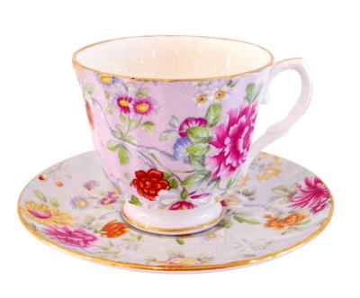
Do you use china cups?

Slide 10
Reuse

Slide 11
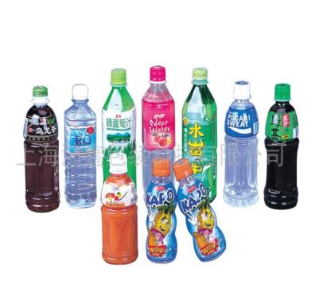
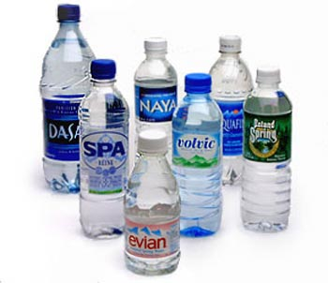
Do you buy drinks in bottles ?
And what do you do with(处理)
the bottles when they are empty ?

Slide 12
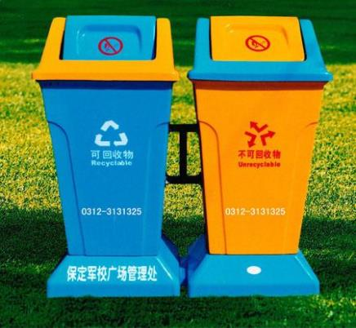
Recyclable
Other waste
Do you divide the waste into things to recycle and things to throw away?

Slide 13
Recycle

Slide 14
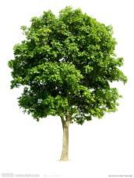
2
1
3
7
4
6
5

Slide 20
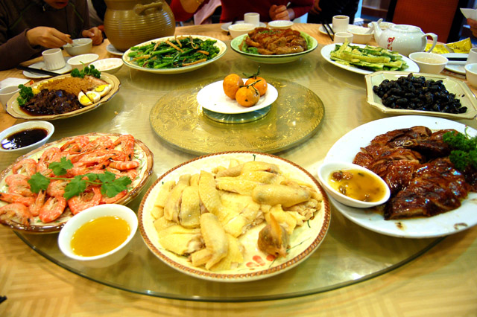

Slide 21
Lingling’s homework
use less
Reduce means “ ”.
use again
Reuse means “ ”.
change things
into something else
to be reused.
Recycle means “ ”.

Slide 22
Complete the table.
Paragraph | Main idea
Reduce
Reuse
Recycle
Do not waste things.
Use things for as long
as possible.
To change things into
something else.

Slide 23
Which suggestion is wrong in the passage?
A. Do not order more food than you can
finish.
B. Use less electricity at home.
C. Use paper cups and paper bags.
D. Develop a recycling policy for the whole community.

Slide 24
Difficult sentences
Do you divide the waste into things to recycle
and things to throw away?
Although it takes energy to change things into
something else, it is better than throwing things away or burning them.
We cannot hope for rapid change, but lets take these simple steps today so that we will save the world for our grandsons and granddaughters
tomorrow.

Slide 25
Language points
6. throw away 扔掉
7. change… into…
把…变成…
8. tons of 许多
9. hope for 希望
10. take steps 采取措施
find out 查明
turn off 关闭
ask for 要求
do with 处理
divide …into…
把……分类

Slide 26
Complete the sentences.
1.废弃物对我们的环境有害。
harmful
It ______ _________ _______ our environment.
is
to
2.不要点自己吃不完的食物。
order
Do not _______more food than you can finish.
3.在你买新东西之前，想一想是否有必要。
something
new
Before you buy____________ _______, think whether it is necessary.

Slide 27
4.使用物品时间尽可能长些。
Use things for ____ _______ ____ _________ .
as
long
as
possible
5.保养物品，以便能使用更长时间。
Look
after
so
that
last
_____ _____ them, _____ _____they will ____.
6.用瓷杯更好，因为它们可以重复使用许多次。
_____ _____ ______ ______use china cups
_______ they can be used many times.
It
is
better
to
because

Slide 28
7.我们每年扔掉很多垃圾。
throw
away
We _______ tons of rubbish ________ each year.
8.把垃圾分为塑料，玻璃，纸和橡胶。
Divide
into
_________ your rubbish _______ plastic, glass, paper and rubber.
9.为整个社区制定一个再循环方案。
_________ _________ _________ ________for
the whole community.
Develop
a
recycling
policy

Slide 29
Writing

Slide 30
Make our hometown greener
P1
Dear everyone,
As we all know, we all need a healthy environment, so it’s
our duty to protect the environment.
P2
First / Second / Third / … /Finally, …
P3
If everyone starts to act now, the world will be beautiful.
The Students’ Union

Slide 31
Show time

Slide 32
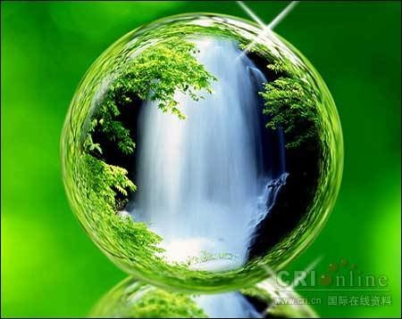
The beautiful earth is our home.
Do you love to live here?

Slide 33
Summary
We should repeat these three words daily:
Turn off the lights when you do not need them so we can save energy.
reduce
reuse
It is better to use china cups because they can be use many times.
recycle
Buy products such as recycled paper so that we can help to save trees.

Slide 34
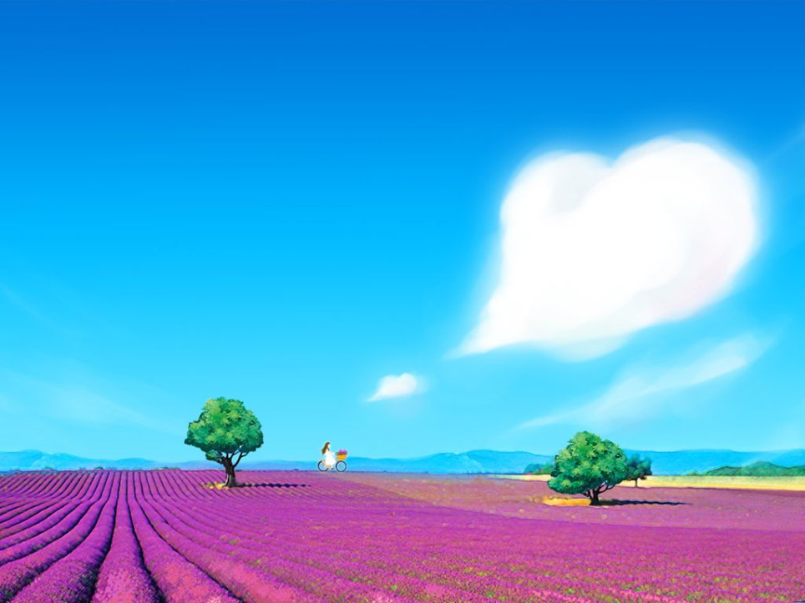
Homework
Read and retell the passage.
Finish this writing after class.

