Slide 1
Unit 5 Wild animals
Reading Ⅰ
WWW.PPT818.COM

Slide 2
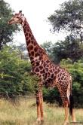
It has a long neck and long legs. It feeds on leaves.
giraffe
Which animal is large ,strong and heavy with thick fur ?
bear

Slide 3
It jumps with its baby in his pocket.
You can see it in Australia.
kangaroo
It is a sea animal and looks like a large fish.
It is very clever and often plays some games for us in the zoo.
dolphin

Slide 4
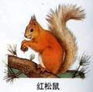
It is the largest animal on land and
its nose is very long.
elephant
It is small and lovely, but has a long tail.
It likes nuts（坚果).
squirrel

Slide 5
Millie found a report on giant pandas in a magazine.
Here is the report.

Slide 6
Skimming
1. What is the name of the panda?
What does it mean?
What will happen to giant pandas
if we do nothing?
Its name is Xi Wang. It means ‘hope’.
There may be none left.

Slide 7
Scanning
Match the part with the main idea
Part 1
(para1-3)
The problems Xi Wang may have in the future
Part 2
(para4)
The actions we can take to protect the giant pandas
Part 3
(para5-6)
The growth of Xi Wang

Slide 8
Listen and choose
1. Xi Wang weighed____________ when she was born
A. 1 kilogram B. 5 kilograms C. 0.1 kilogram
2. Xi Wang drinks her mother’s milk for _______hours a day at the very beginning.
A. 3 hours B. 8 hours C.14 hours
3. At ________months old, she can look after herself.
A. 12 months B. 20 months C 36 months

Slide 9
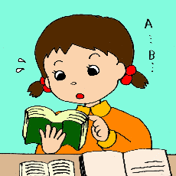
Read for details about Xi Wang:

Slide 10
The weight of Xi Wang
When she was born,
she weighed just .
100 grams
At four months,
she weighed about .
8 kilograms
Eight months later,
She weighed .
35 kilograms

Slide 11
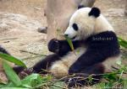
Things she eats
At the very beginning, Xi Wang drank her mother’s ____.
milk
When she was six months old,
she started to eat _______.
bamboo
When she was 20 months old, she had to __________.
look after herself

Slide 12
The growth of Xi Wang
c
d
e
10 days
4 months
b
6 months
1 day
a. She started to look after herself.
b. She was about 8 kilograms and started to go outside.
c. She looked like a white mouse.
d. She began to eat bamboo.
e. She weighed 100 grams.
f. She weighed 35 kilograms.
f
12 months
a
20 months

Slide 13
(1)At the age of 20 months old, what did she have to do?
When she was 20 months old, she had to look after herself.
(2)Why?
Because her mother had another baby.

Slide 14
The growth of XiWang
1 day
e
10 days
c
4 months
b
6 months
d
a She started to look after herself.
b She was about 10 kilograms and started to go outside her home.
c She looked like a white mouse.
d She began to eat bamboo shoots and leaves.
e She weighed 100 grams.
f She weighed 35 kilograms.
12 months
f
20 months
a

Slide 15
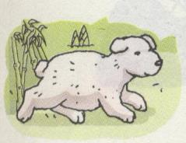
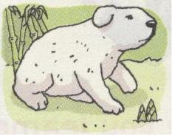
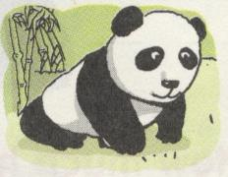
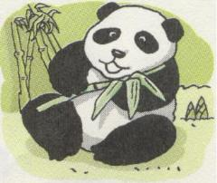
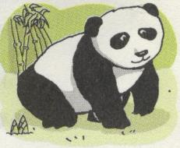
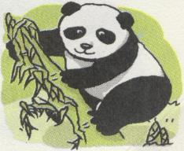
Suppose （假设）you are Xi Wang, say something about yourself, including（包括） your growth and problems you have.
at birth
10 days
4 months
100 grams
Like a white mouse
10 kg, go outside
6 months
12 months
20 months
Stop drinking…
Start to eat…
35kg, not…any more, grow into
Look after herself, because…

Slide 16
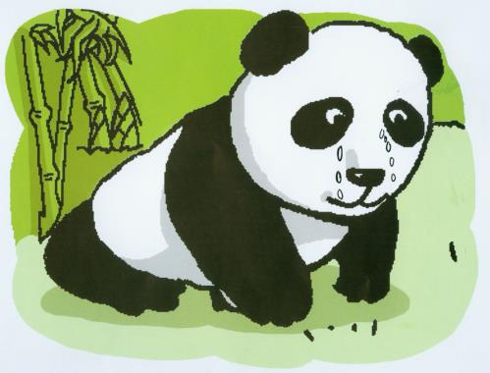
Why is Xi Wang crying?
There are many problems that Xi Wang may have in the future.

Slide 17
Read and try to find out the problems:
have babies
It’s difficult for pandas to ______________ , and many baby pandas ________when they are young.
2. Pandas may not ___________________ or
__________________.
die
have a place to live
food to eat

Slide 18
Read and fill in the table:
Taking the following actions
help pandas have more babies
build more new pandas reserves
make laws to protect pandas

Slide 19
True or false.
1. It is easy for giant pandas to have babies.
2. At four months old, she started to eat bamboo.
3. Giant pandas will have no place to live.
4. We should build fewer panda reserves.
5. Giant pandas are in danger now.

Slide 20
What’s the purpose of this report?
Encourage people to take actions to protect giant
pandas.

Slide 21
We can ...
1.build more reserves
2. encourage people to leave the reserves
3. donate money for wild animals
4. tell other people to protect wild animals
5. make some laws to protect them
6. keep the world clean…
We can't ...
1. work in the reserves
2.cut down the trees
3. keep wild animals as pets
4. kill them for their fur or meat
5. throw rubbish in the reverses…

Slide 22
Homework
Finish the exercises on P59-60.
Tell something about Xi Wang to your friend.

