Slide 1
Unit1 They touch noses!
WWW.PPT818.COM

Slide 2
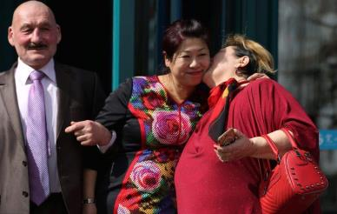
What do people do when they meet visitors?
kiss
v. & n. 吻，亲吻
n. 俄罗斯人
Russian usually kiss three times.

Slide 3
What do people do when they meet visitors?
smile
v. & n. 微笑
shake hands
握手
Chinese often shake hands and smile.

Slide 4
What do people do when they meet visitors?
nod heads
点头
印度
In India, people put their hands together and nod their heads.

Slide 5
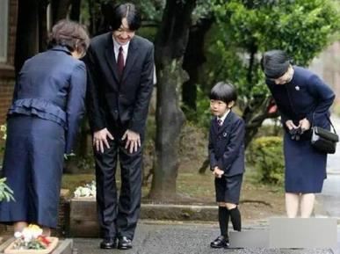
What do people do when they meet visitors?
bow
v. 鞠躬，弯腰
日本人
Japanese smile at each other and bow.

Slide 6
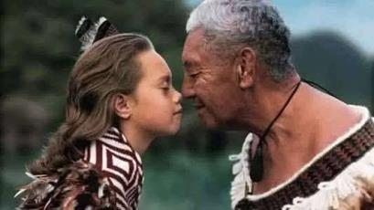
What do people do when they meet visitors?
touch noses
触摸鼻子
毛利人的
Maori people in New Zealand touch noses.

Slide 7
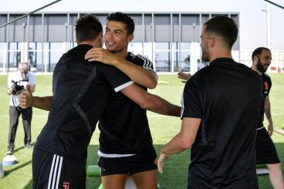
What do people do when they meet visitors?
hug
v. 拥抱
In the US some people shake hands, and some kiss or hug each other.

Slide 8
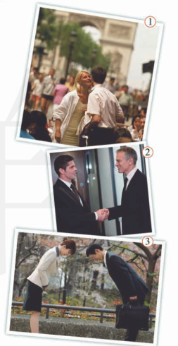
1
Match the pictures with the words and expression from the box.
1
2
4
bow
kiss
shake hands
smile
3
7
6
1
5
2
1/2/3

Slide 9
2
Listen and match the pictures with the nationality.
1
2
adj. 英国人的，英国的
British
French
German
Japanese
Russian
4
7
1
6
5
3
2

Slide 10
Now work in pairs and check.
— Are they Russian?
— Yes, they are.
— What are they doing?
— They’re shaking hands.

Slide 11
Are they French?
What are they doing?
Yes, they are.
They’re saying hello and kissing.

Slide 12
Are they Japanese?
What are they doing?
Yes, they are.
They’re smiling at each other and bowing.

Slide 13
3
Listen and read.
n. 游客，观光者
Lingling: We’re going to have some Russian teachers at school tomorrow, and I’m welcoming the visitors. How do I do that?
Betty: Lingling, you know, in Russia, people usually kiss three times, left, right, left.
Lingling : What! No, I didn’t know that. We Chinese often shake hands and smile when we meet visitors, and sometimes we nod our heads. But we never kiss. Only parents and children do that.

Slide 14
Betty: That’s because people do different things in different countries.
Lingling: So what do people in the US usually do when they meet?
Betty: In the US some people shake hands, and some kiss or hug each other. In India people put their hands together and nod their heads. And do you know what Maori people in New Zealand do when they meet?
Lingling : No. What do they do?
Betty: They touch noses!
互相，彼此
adv. 一起，共同

Slide 15
True or false.
( ) 1. In Russia, people usually kiss three times.
( ) 2. We Chinese often kiss and smile when we meet visitors.
( ) 3. People do difficult things in difficult countries.
( ) 4. Maori people in New Zealand touch hands when they meet.
T
F
T
F

Slide 16
Now work in pairs. Ask and answer the questions.
1. What do people in the US usually do when they meet?
In the US some people shake hands, and some kiss or hug each other.
2. Do Maori people in New Zealand touch nose when they meet?
Yes, they do.

Slide 17
Now complete the table with the correct form of the words from the box.
India kiss Russia together touch visitor
In China, people shake hands and smile | when they meet ______.
American people shake hands and sometimes _____
In ______, people put their hands_________ and nod their heads.
In ________, people kiss each other three times
Maori people _______noses.
kiss
India
together
Russia
visitors
touch

Slide 18
[观察1] She welcomed us with a smile. 她微笑着欢迎我们。
The baby is smiling at me. 这个婴儿正在朝我笑。

Slide 19
[探究] (1)smile作名词， 意为“微笑”， 常指无声的笑。____________意为“面带微笑”。若表示“一个……微笑”， 中间可加入其他修饰语。例如：a sweet smile 一个甜甜的微笑
(2)smile作动词， 意为“微笑”，为不及物动词。表示“对……微笑”时，后接at。
with a smile

Slide 20
活学活用
1．(1)他刚才冲我笑了笑。
He ________ at me just now.
(2)他微笑着问候学生们。
He said hello to the students with________ ________．
smiled
a smile

Slide 21
[观察2] Are they Germans? 他们是德国人吗？
The two Germans are from a town in Germany.
这两个德国人来自德国的一个城镇。
[探究] German作形容词时，意为“德国的；德国人的；德语的”；作名词时，意为“德国人；德语”。German作“德国人”讲时，其复数形式为________。Germany为名词，意为“________”。
Germans
德国

Slide 22
[拓展] (1)表示“某国人”的名词变复数形式一般可直接加­s。例如：American→Americans(美国人)；Australian→Australians(澳大利亚人)；Russian→Russians(俄罗斯人)；Canadian→Canadians(加拿大人)；
Austrian→Austrians(奥地利人)
(2)以­ese 结尾的表示“某国人”的名词单复数同形。例如：
Chinese(中国人), Japanese(日本人)

Slide 23
(3)以­man结尾的表示“某国人”的名词变复数时，将­man变成­men(German除外)。例如：
Frenchman→Frenchmen(法国人)；Englishman→Englishmen(英国人)

Slide 24
活学活用
2．—Are all the students from ________ in your class?
—No, there are only 3 ________ in our class. The others are from other countries.
A．Germany; Germen B．Germany; Germans
C．German; Germans D．German; Germany
B

Slide 25
[观察3] That’s because people do different things in different countries. 那是因为不同国家的人做法不同。
[探究] “That’s because…”意为“那是因为……”， 后接表示原因的句子。

Slide 26
[辨析] that’s because与that’s why
That’s because | 意为“那是因为……”， 后接表示原因的句子。 例如：That’s because I didn’t know about it. 那是因为我不知道此事。
That’s why | 意为“那是为什么……”， 后接表示结果的句子。例如：That’s why he came late. 那就是他来晚了的原因。

Slide 27
活学活用
1．用that’s because或that’s why填空
(1)Jim overslept this morning. ____________ he was late for school.
(2)Tony was late for school this morning. ____________ he overslept.
That’s why
That’s because

Slide 28
[观察4] And do you know what Maori people in New Zealand do when they meet?
你知道新西兰的毛利人见面时做什么吗？
[探究]该句中的“what Maori people in New Zealand do when they meet”作动词know的宾语，是宾语从句。注意该宾语从句是由疑问词what引导的且宾语从句要用陈述语序。

Slide 29
活学活用
2．—Do you know ________________________________ (为什么彼得没有去上学) yesterday?
—Yes. He went for the boat race.
why Peter didn’t go to school

Slide 30
4
Listen and repeat.
/tʃ/ Chinese each French teacher touch
/ʃ/ British shake
/pl / people
/fr/ French
/br / British

Slide 31
5
Work in groups. Talk about what you do and say when you meet:
your best friend’s parents
your favourite film star
a visitor to your school
an American
a Russian
your teacher
your head teacher
your parents after school
your best friend
—What do you do and say when you meet your teacher in the morning?
—I smile and say good morning.

Slide 32
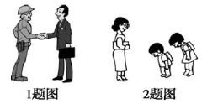
Exercise
根据句意及图片提示写出单词
1.Chinese people usually ____________
when they meet each other for the first time.
2.Japanese students usually ________ when they say hello to their teachers.
shake hands
bow

