Slide 1
（广州版）三年级英语上册课件
Unit 2 How are you
WWW.PPT818.COM

Slide 2
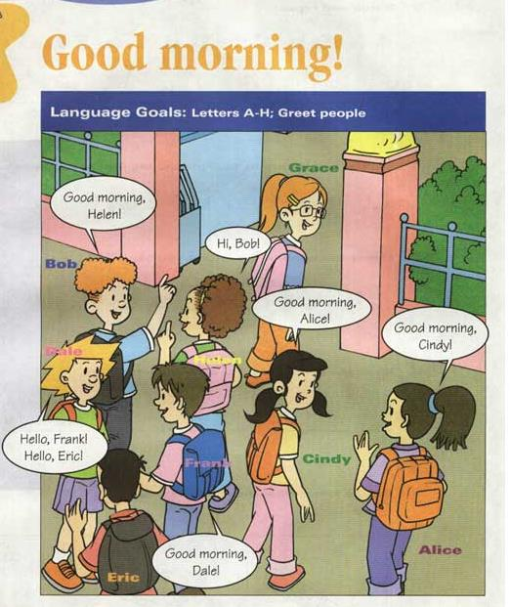

Slide 3
ABC song
A B C D E F G
H I J K L M N O P
Q R S and T U V
W X and Y and Z
( I’ve just said my ABCs ,
now it’s your turn , follow me! ) Happy happy all are we,
now we’ve learned our ABC

Slide 4
Spell and write
Aa Bb Cc Dd Ee Ff Gg Hh Ii
Jj Kk Ll Mm Nn Oo Pp Qq Rr
Ss Tt Uu Vv Ww Xx Yy Zz

Slide 5
Hi,Dale!
Hi,Grace!
Say “ Hi!”
to your partner !

Slide 6
Hello, Bob !
Helen
Hello, Helen!
Bob
1. A: Good morning , Tom!
B: __________________
Good morning, Bob.
Bob
Tom

Slide 7
Good morning, Alice!
Good morning, Cindy!
(They’re going to school !)

Slide 8
Can you answer my questions
1. What’s your English name?
My English name’s Helen !
(I’m Helen!)
2. Good morning, Helen!
Good morning, Miss Xu!
3. Hello, Frank!
Hello, Miss Xu!
4. Hi, Cindy!
Hi, Miss Xu!

Slide 9
1.A: Nice to meet you!
B:________________
Nice to meet you, too!
Good afternoon
2.A: ____________ , Mr Wang.
B: _____________ , Jack.
Good afternoon

Slide 10
Good morning
Good afternoon
Good evening
Good night
Match :
晚间告别的用语(晚安!)
凌晨至上午12:00
下午4-5点之前
太阳落山(黄昏)到入睡

Slide 11
A: Good morning, I’m Jim!
B: Good morning, I’m Cindy!
A: nice to meet you ,Cindy.
B: Nice to meet you , Jim!
Make the dialogue:

Slide 12
知识扩充
1．Good morning /afternoon /evening：
适用于比较正式客气的场合，
双方都应说Good morning /afternoon /evening!
e.g.： A：Good morning，Miss Zhao． B：Good morning，Mr. Wang．
2．Morning：
适用于比较熟悉的朋友之间或比较繁忙的情况下。

Slide 13
3．Hello：
是最广泛、最简单的打招呼语，显得亲切自然。
例如： A：Hello，Kate．
B：Hero，Li Lei．
4．Hi：在现代英语中，
Hi比Hello用得更多，显得更随和。
例如： A：Hi，Han Meimei．。 B：Hi，Lucy．

Slide 14
Hello,Franck! Hello, Eric!

Slide 15
Can you find (找到）their names?
Bob
Helen
Eric
Cindy
Franck
Alice
Grace
Dale

Slide 16
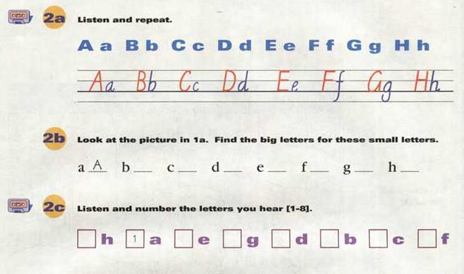
8
5
7
4
2
3
6

Slide 17
HB:（铅笔芯）硬黑
CD：激光唱片
BBC：
英国广播公司

Slide 18
Today’s Homework:
1. Copy 抄写本
2.作业本1
３.背诵26个字母及其音素归类,

Slide 19
Goodbye!!

