Slide 1
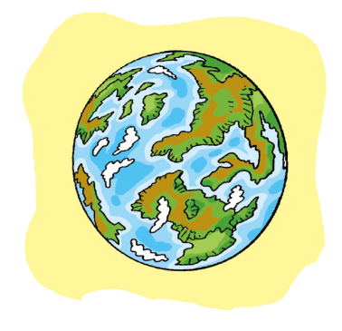
12
The Earth
WWW.PPT818.COM

Slide 2
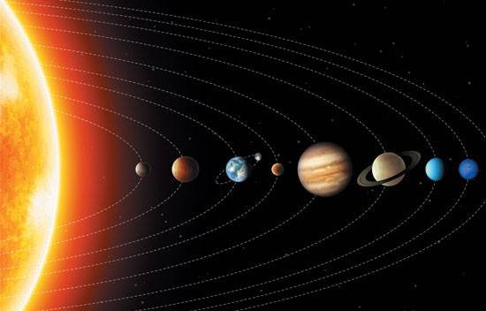
Can you find the Earth?

Slide 3
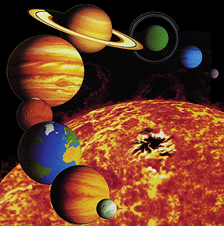
Mercury (水星)
Venus (金星)
the Earth (地球)
Mars (火星)
Jupiter (木星)
Saturn (土星)
Uranus (天王星)
Neptune (海王星)

Slide 4
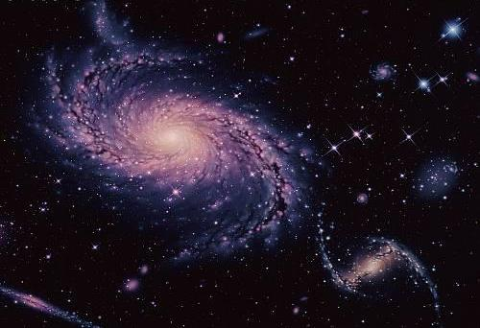
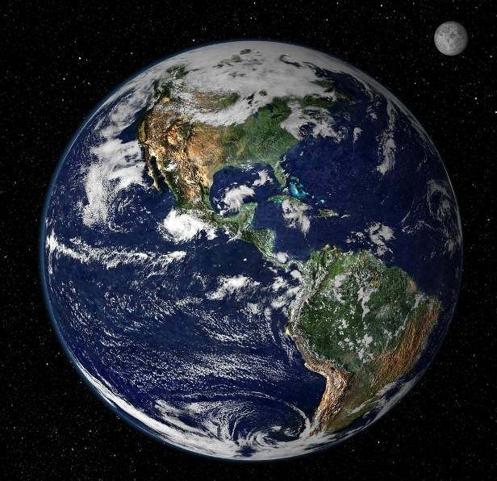
The Earth

Slide 5
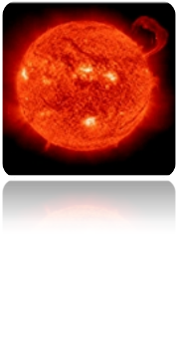
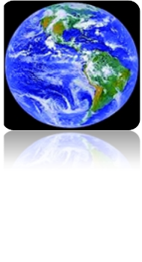
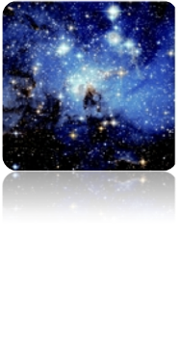
What do you know about …?
Write the correct words in the blanks.
the Sun
the Moon
the Earth
stars
____________
____________
____________
____________

Slide 6
Do you want to know about the Earth?

Slide 7
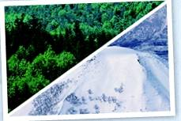
Places on the Earth
The Earth is a beautiful place.
There are forests and rivers, mountains and fields. Some parts of the Earth are very hot, and some are very cold.
Notes:
7

Slide 8
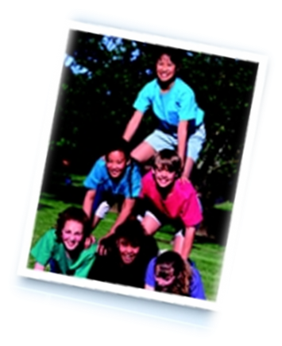
People on the Earth
There are also many people like you and me on the Earth. The Earth provides us with air, water and food. It is our home.
Notes:
8

Slide 9
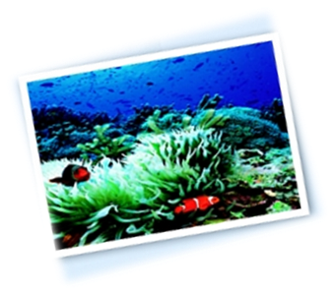
Plants and animals
There are many different plants. Some are large. Some are small. All plants need light and water. There are different animals on the Earth too. Some live on the land. Some fly in the sky. Some live under the water.
Notes:
9

Slide 10
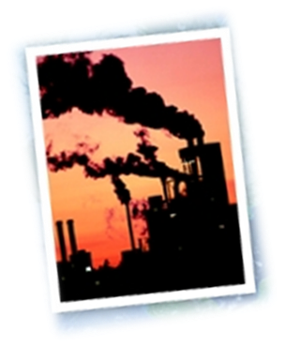
Pollution
Today, there is a lot of pollution. We burn things to make energy. This pollutes the air. We put our rubbish into the sea and under the ground. This pollutes the Earth and kills animals and plants.
Notes:
10

Slide 11
Do you know anything else about the Earth?

Slide 12
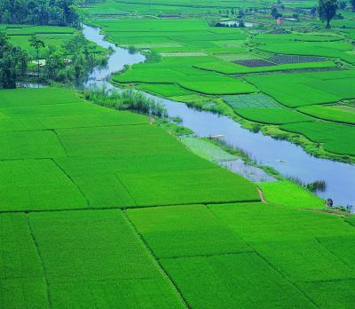
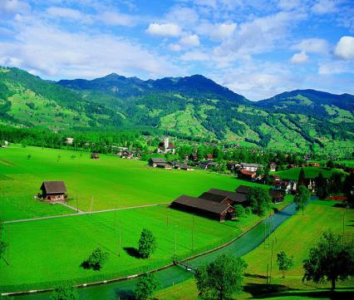
There are a lot of beautiful fields on the Earth.

Slide 13
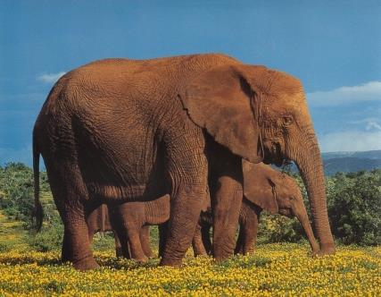
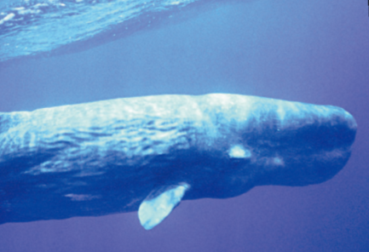
Some large animals live on the Earth.

Slide 14
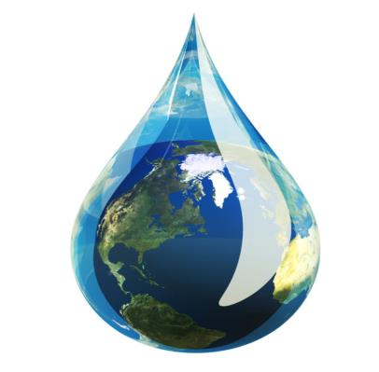
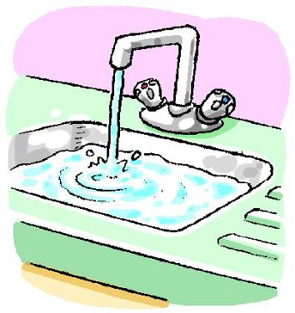
The Earth gives us water.

Slide 15
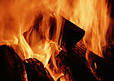
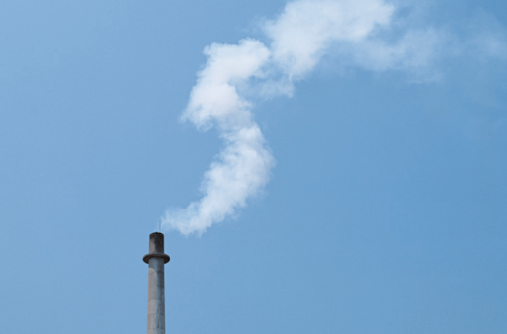
We burn things to make energy.

Slide 16
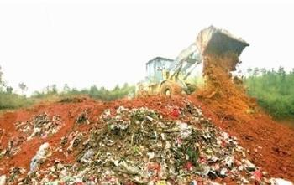
We put our rubbish under the ground.

Slide 17
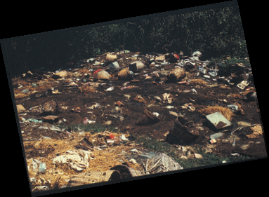
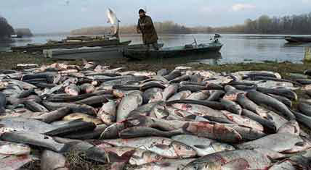
Rubbish pollutes the rivers.
Pollution kills fish and animals.

Slide 18
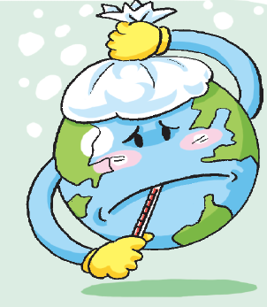
It is important for us to protect the Earth.

Slide 19
True or false.
F
1. All parts of the Earth are warm.
2. All plants need light and water.
3. People can get air, water and food from the Earth.
4. People make the Earth dirty. It is pollution.
T
T
T

Slide 20
Do you know the meanings of the words in red?
Circle the correct answers.
1. The Earth provides us with air, water and food.
A. gives B. shows
2. We burn things to make energy.
A. set … on fire B. make … strong
3. This pollutes the air.
A. makes … clean B. makes … dirty
4. This pollutes the Earth and kills animals and
plants.
A. cleans B. makes … die
5. It is important for us to protect the Earth.
A. keep … safe B. change

Slide 21
Protect the Earth
We must stop pollution.
It is important for us to protect the Earth.
Notes:
21

Slide 22
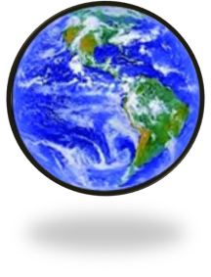
What do you know about the Earth?
In pairs, discuss the questions below.
1 What are the blue parts?
______________________
2 What are the green and brown parts?
______________________
3 What are the white parts?
______________________
They are oceans.

Slide 23
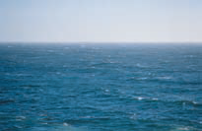
ocean

Slide 24
Can you name the oceans?
请教师自行插入世界五大洋的示意图
Pacific Ocean, Atlantic Ocean,
Indian Ocean, Arctic Ocean, Antarctic Ocean

Slide 25
What do you know about the Earth?
In pairs, discuss the questions below.
1 What are the blue parts?
______________________
2 What are the green and brown parts?
______________________
3 What are the white parts?
______________________
They are oceans.
They are forests and land.

Slide 26
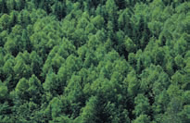
forest

Slide 27
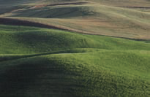
land

Slide 28
What do you know about the Earth?
In pairs, discuss the questions below.
1 What are the blue parts?
______________________
2 What are the green and brown parts?
______________________
3 What are the white parts?
______________________
They are oceans.
They are forests and land.
They are clouds.

Slide 29
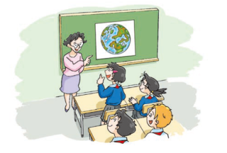
Ms Guo: Look at this picture. What is it?
Kitty: It’s the Earth.
Ms Guo: The green and brown parts are forests and land.
What are the blue parts?
Joe: I think they’re oceans.
Ms Guo: Yes, they are. The Earth was very clean and
beautiful in the past, but now some parts are dirty.
Can we do anything to help the Earth?
Alice: Yes. We should stop throwing rubbish into rivers.
Peter: We should stop cutting down so many trees.
Kitty: We should stop using plastic bags.

Slide 30
Ms Guo:
Kitty:
Ms Guo:
Joe:
Ms Guo:
Alice:
Peter:
Kitty:

Slide 31
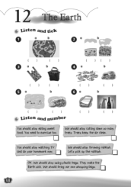
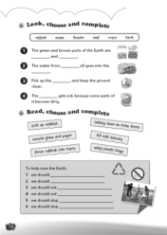
Homework
1. Listen to and read Student’s Book pages 80 and 81.
2. Search for more information about how to protect the Earth.
3. Finish Workbook pages 68 and 70.

