Slide 1
Unit 2
Going to school
WWW.PPT818.COM

Slide 2
I can because I think I can.
我行，因为我相信我行！

Slide 3
[bi:]= [b]+ [i:]
[si:]= [s] + [i:]
[di:]= [d]+ [i:]

Slide 4
Ff Gg Hh
[ef ] [dʒi: ] [ei tʃ ]
Ii Jj Kk
[ai] [dʒei] [kei]

Slide 5
[b]
[f ]
[s]
[ tʃ ]
[e ]
[k]
[d]
[i:]
[dʒ]
[ai]

Slide 6
transport
[trænspɔ:rt] 运输
car
bike
bus
plane
boat
by
walk
=
on foot

Slide 7
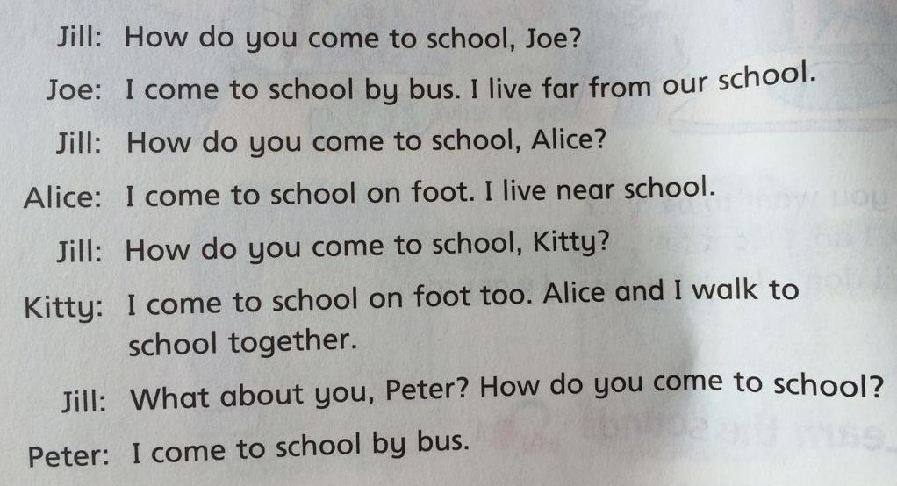

Slide 8
Complete Jill’s notes
Joe comes to school________.
Alice comes to school_______.
Kitty comes to school_______.
Peter comes to school_______.
by bus
on foot
on foot
by bus

Slide 9
Ms Guo’s journey to work
[dʒɜ:rni] 旅行
Ms Guo is a teacher at Primary School. She lives on
Green Street.
[praɪməri]
[lɪvz ]
[strit] n.大街，街道

Slide 10
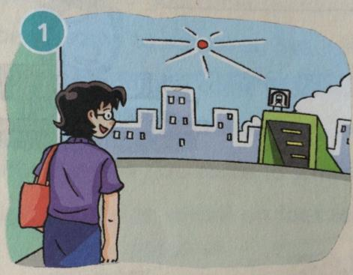
subway
[ʌndərgraʊnd]
under+ground
There is an underground station near Ms Guo’s home. Ms Guo walks to the station and takes the train.
[steɪʃən]
[treɪn]

Slide 11
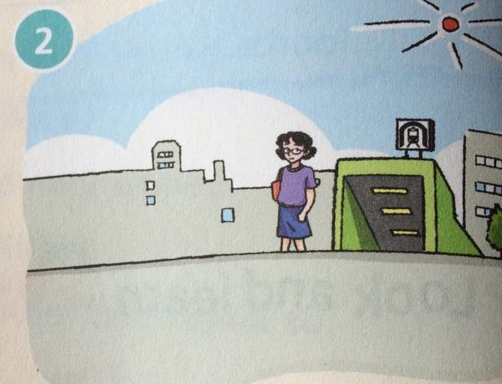
She gets off the train
at Park Street Station.

Slide 12
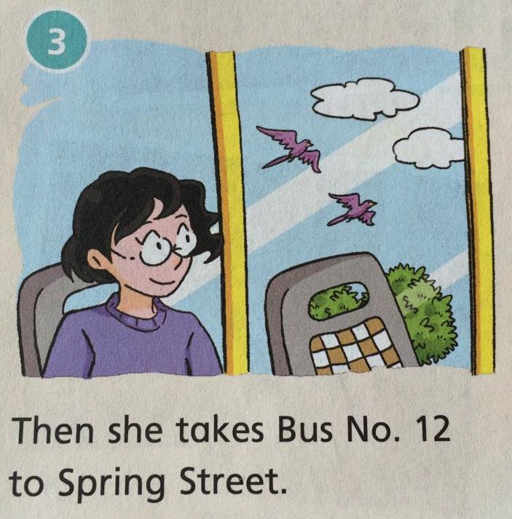

Slide 13
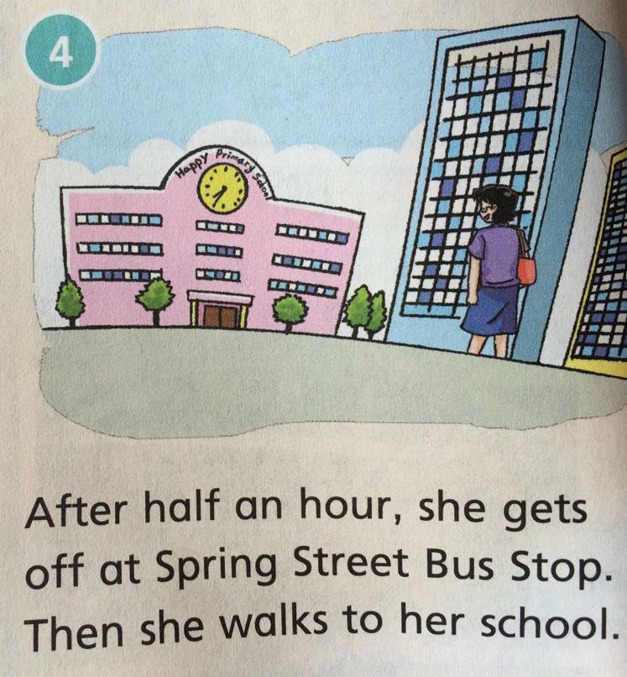
[hɑ:f]
[ aʊə(r)]

Slide 14
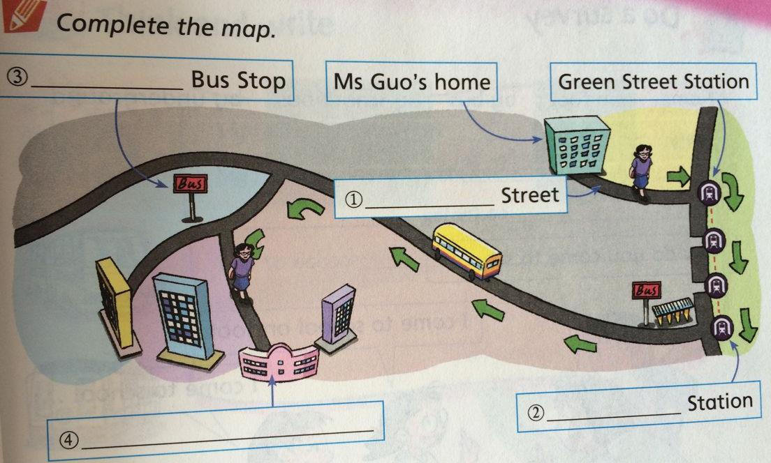
Spring street
park
underground
Happy Primary School

Slide 15
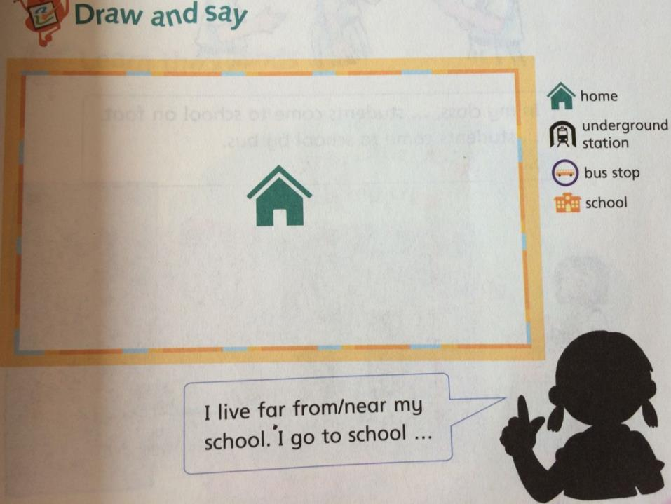

Slide 16
Think and write
My father goes to work__________.
My mother goes to work___________.
_________go(es) to_____________.
I go to school ____________.
by car
by bike
My sister
school on foot
by school bus

Slide 17
Sounds
Sp--- [sp]
Listen, little wasp!
This is my crisp.
Please go away.
It’s not a good day for a wasp
To play on my crisp
[lɪsən]
[wɑ:sp]黄蜂
[krɪsp]薯片

