Slide 1
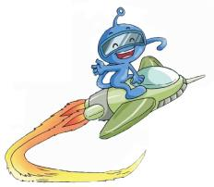
Unit 10
Then and now
WWW.PPT818.COM

Slide 2
Learning aims
1.我能听懂课文内容，并回答问题。【Task 1】
2.我能在课文中划出问题的答案。【Task 2】
3.我能复述课文的内容。【Task 3】
4.我能运用本课学习的句型，说说我生活中
的一些变化。【Task 4】 【Task 5】

Slide 3
Let’s check
was
were
lived
worked
is are live work
have has go take
eat play
had
had
went
took
ate
played
When I was only years old, I .
But now I .

Slide 4
Let’s sing
I was a short child when I was five, but now I am a tall and handsome boy.
When I was young, I cried a lot, but now I always smile.
I liked watching TV before, but now I like reading books.

Slide 5
Let’s choose
far away
office
most
ago
village
nearby
department store
nearby
My home is , so I can go to school on foot. But my father works . He has to go to work by car.
2. A life is a healthy life.
3. Ten years , I was a little boy. But now
I am strong.
4. Of my family like eating fish.
5. Many people go to work in that tall
building.
6. There is a big in this city, we can buy all kinds of things there .
far away
village
ago
Most
office
department store

Slide 6
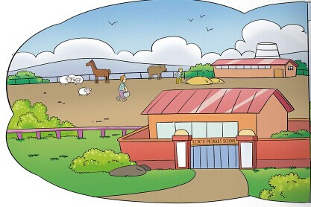
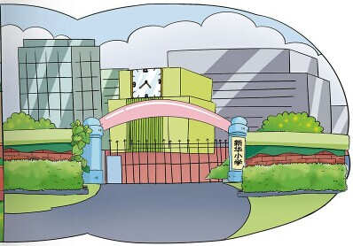
school 1
school 2
three years ago
today
then
and
now

Slide 7
Listen and answer.
Where did Ben live before?
2. Where does Ben live now?
England
He lived in a in .
small village
big city
China
He lives in a in .

Slide 8
Read and answer
When did Ben come to China?
How did Ben go to school before?
Where do many people work in the city?
Why does Ben like the city?
He came to China 3 years ago.
He went to school on foot.
They work in modern office buildings and department stores
Because there are many things to do and he has lots of friends.

Slide 9
Let’s recite.
Ben lived in England before. But three years ago , he came to live in China with his parents. There are many differences between the two cities.
First, the living places are different. Before then, Ben lived in in the countryside. It had only . But now ,he lives in . There are many people, and in it.
a small village
two shops
a big city
cars
tall buildings

Slide 10
Second, people work in different places. In the village, people worked . But in the city, people work in modern office buildings and .
Third, the schools are different. Ben’s village school was very . There were only pupils in it. But it was Ben’s home. So Ben went to school . But now ,the city school is very . There are more than pupils in it. But it is from Ben’s home. So Ben to school every day.
on farms
department stores
small
150
nearby
on foot
big
1000
far away
takes a bus

Slide 11
Listen and choose “T” or “F”.
1. I lived in a small house before. ( )
2. There was a car in my house 20 years
ago. ( )
3. I played computer games every
weekend 20 years ago. ( )
T
F
F

Slide 12
Listen read.
Twenty years ago, I was a little girl and I lived in a small house with my parents. I studies at a small school. There were only 200pupils in my school. We didn’t have any cars or computers. There was only a motorbike in my family. I kept a lovely cat before. I played with the cat every day.
But now, I am pretty and tall. I live in a big house with my husband and daughter. I work at a school, I like the lovely pupils. We have a car and 2 computers at home now, so every weekend I play computer games. But I don’t keep a cat any more.

Slide 13
The changes in my life
years ago, I was and I lived in .My father was
and my mother was
. My school was .
I liked .
I .
But now, I am .

Slide 14
living place
住处
I lived in…but now…
I kept a …before , but now…
appearance
外貌
pet 宠物
I was…before, but now I am…
My life
transports
交通工具
We didn’t have…
We have… we don’t have..
family member
家庭成员
school
学校
My father/mother was …before , but now he/she…
It was…before , but now it is…

Slide 15
That’s all ! Thank you!

