Slide 1
Section Ⅱ Reading and Thinking
WWW.PPT818.COM

Slide 7
教材原句
Going from junior high school to senior high school is a really big challenge.
从初中到高中真是一项巨大的挑战。
句式解构
句中“Going from junior high school to senior high school”为动名词短语作主语。
佳句背诵
Going to a British high school for one year was a very enjoyable and exciting experience for me.
在英国上了一年的中学对我来说是一段非常令人愉快和兴奋的经历。

Slide 8
教材原句
I'll find a way to improve on my own so that I can make the team next year.我会自己想办法提高自己，这样我明年就能进入球队了。
句式解构
so that引导目的状语从句，意为“以便……”。
佳句背诵
Bring it nearer so that I may see it better.
拿近一点，以便我能看得清楚些。

Slide 9
教材原句
I'm a bit worried about keeping up with the other students in my advanced course, and it'll be quite difficult to get used to all the homework.
在高级课程中要跟上其他学生让我有点担心，而且习惯所有这些家庭作业也有很大的困难。
句式解构
“It is＋adj.＋(for sb.)＋to do sth.”表示“(对某人来说)做什么事是……”。
佳句背诵
It is quite easy for him to finish the maths problems.
对他来说完成这些数学题是很容易的。

Slide 10
教材原句
Whenever I'm facing a difficulty, I always tell myself, “Don't let anything stop you.Don't ever quit.”无论什么时候面对困难，我总是告诫自己：“不要让任何事情阻止你。不要放弃。”
句式解构
whenever意为“无论什么时候”，在句中引导让步状语从句。
佳句背诵
You can ask for help whenever you need it.
你如果需要帮助随时可以提出来。

Slide 11
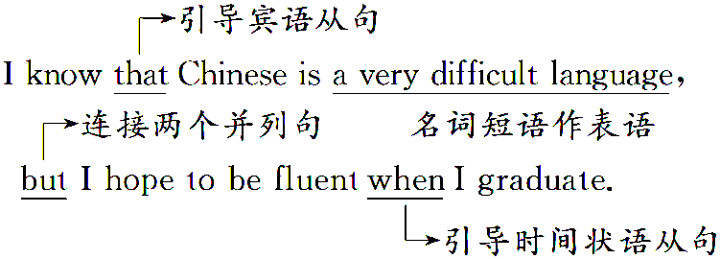

Slide 12
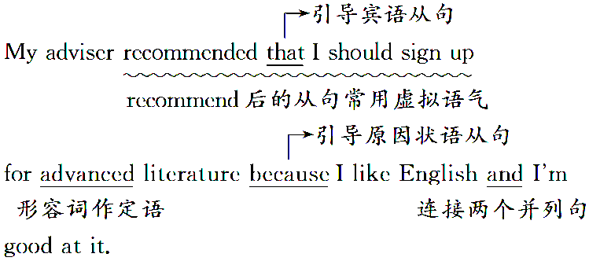

Slide 22
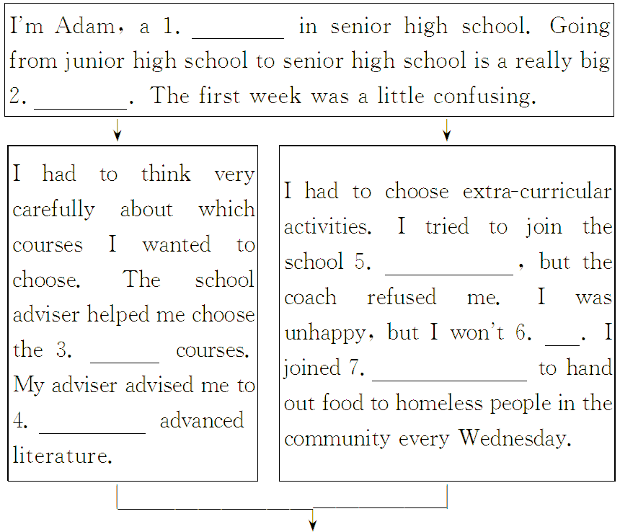

Slide 23
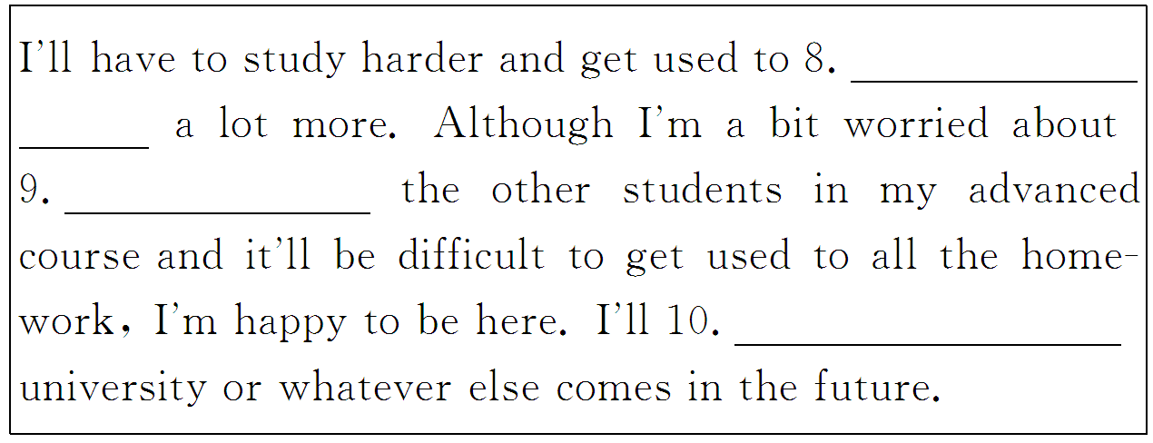

Slide 38
