Slide 1
Unit 5 Lesson 1
Is this your classroom?
WWW.PPT818.COM

Slide 3
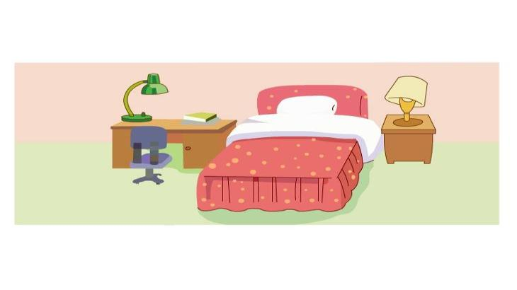
Is this the bedroom?
Yes, it is.

Slide 4
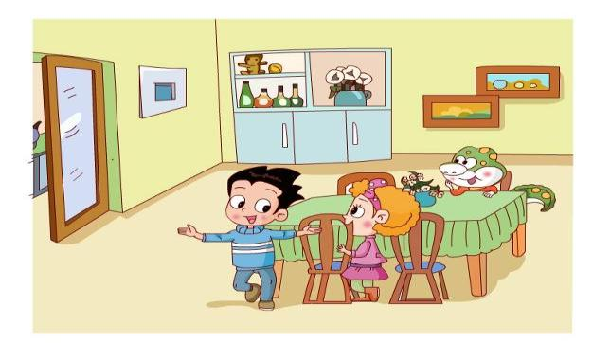
Is this the living room?
dining room
No. It’s the ___________.

Slide 5
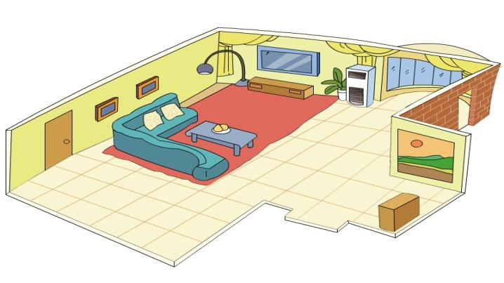
Is this the living room?
Yes, it is.
It’s_____.
big

Slide 6
Welcome to my home.

Slide 7
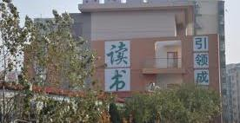
Welcome to our !
school

Slide 8
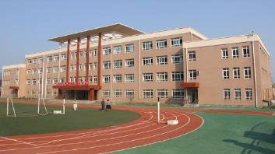
cool
tool
pool

Slide 9
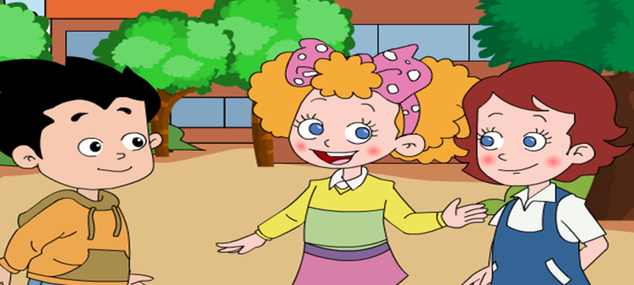
This is my friend,______.
Lucy

Slide 10
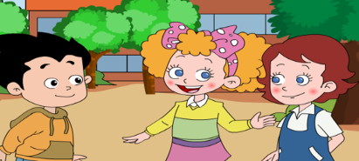

Slide 11
Jenny, Jenny, this is Jenny.
Friend, friend, she’s my friend.
Lucy, Lucy, this is Lucy.
Friend, friend, she’s my friend.
Welcome, welcome to my home.
Welcome, welcome to our !

Slide 12
Welcome to our school!

Slide 13
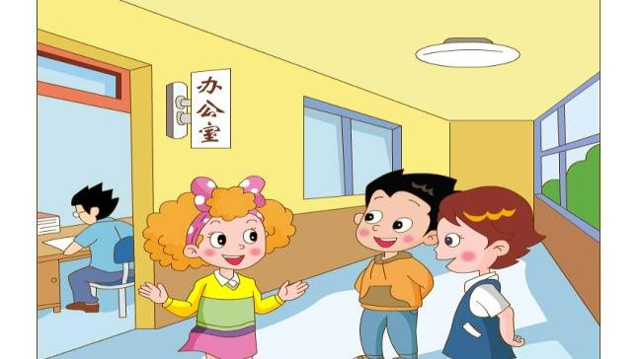
o
ffice
offer
orange
opera
teachers
Is this the ’office?
Yes, it is.

Slide 14
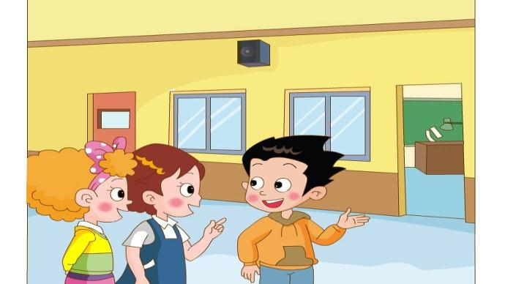
Is this your classroom?
No.
lab
It’s the ___.

Slide 15
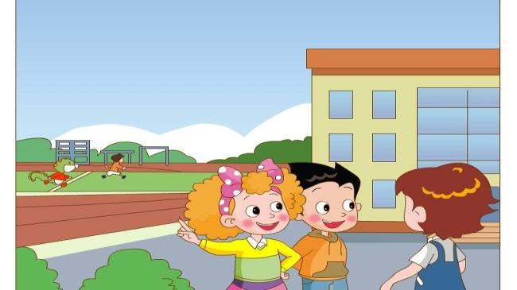
playground
That’s the _____________.
It’s_____.
big

Slide 16
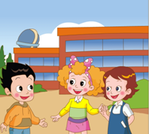
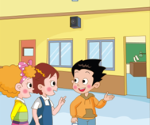
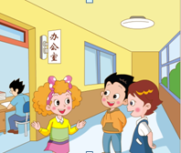
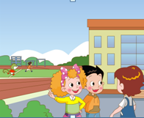
（组内分角色朗读，然后配音）
Aa

Slide 18
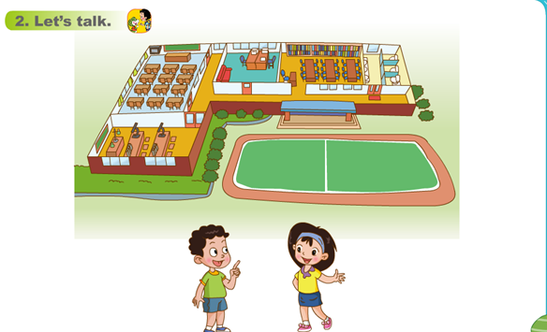
Yes, it is./
No. It’s the…
Is this the…?

Slide 19
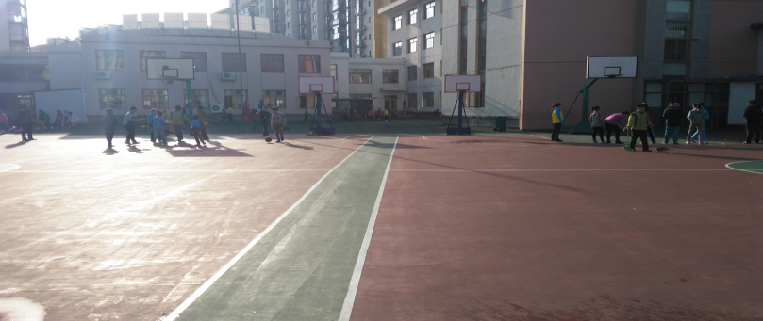
This is the playground.

Slide 20
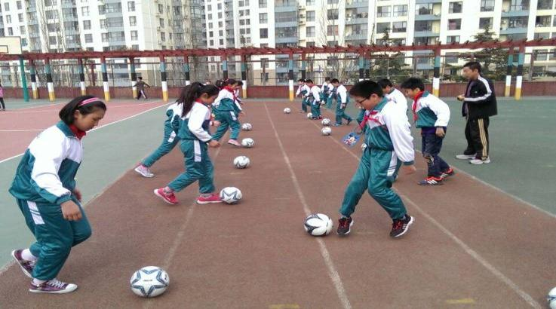
It’s not big, but we like it!

Slide 21
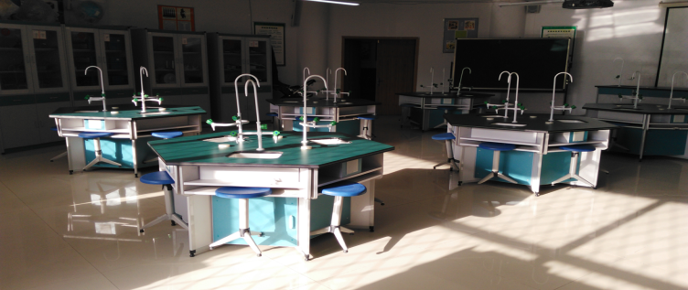
This is the lab.

Slide 22
It’s cool!

Slide 23
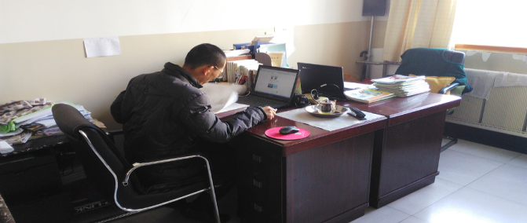
This is the teachers’ office.

Slide 24
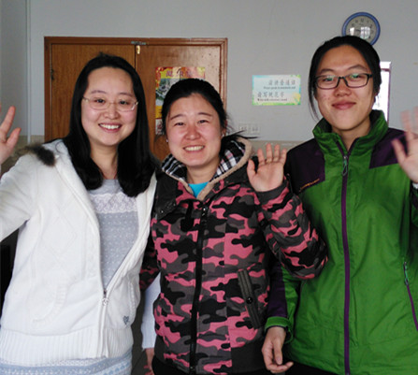
We like our teachers!

Slide 25
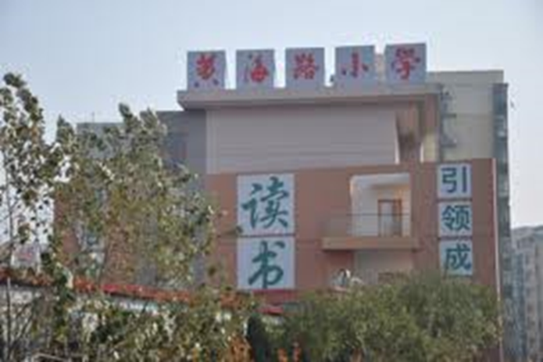
We like our school!

Slide 27
read the text for 3 times, then imitate.（ 读，模仿课文）
2.Copy the letters and find more letters. (抄写字母并按发音找出更多字母）

