Slide 1
Unit 8 Countries around the world
单元主题写作
WWW.PPT818.COM

Slide 2
单元主题写作
话题分析
本单元围绕“Countries around the World”这一话题展开。要求同学们在与人交往的过程中学会谈论方向、国家等，并且能用简单的语言介绍某个国家的地理位置、语言、首都、国旗、国家象征等。

Slide 3
单元主题写作
典 型 例 题
请根据本单元所学知识写一篇介绍中国的短文，可以从位置、首都、语言、国旗、名胜等方面来介绍，70词左右。

Slide 4
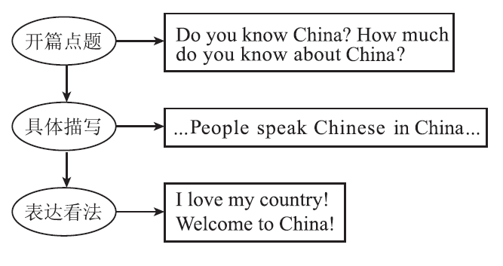
单元主题写作
思 路 点 拨

Slide 5
单元主题写作
素材积累
常用单词：
1．国家________
2. 城市________
3．首都________
4. 建筑________
country
city
capital
building

Slide 6
单元主题写作
5．语言________
6. 汉语________
7．历史________
8. 讲(语言)________
9．著名的________
10. 伟大的________
language
Chinese
history
speak
famous
great

Slide 7
单元主题写作
常用短语：
1．因……而闻名________________
2．全世界____________________________
3．了解____________________
be famous for…
all over the world/around the world
learn about/know about

Slide 8
单元主题写作
常用句型：
1．How much do you know about this country?
关于这个国家你了解多少？
2．Beijing is the capital city of China. 北京是中国的首都。
3．People in Australia speak English.
在澳大利亚，人们讲英语。
4．Big Ben is famous around the world. 大本钟在全世界闻名。

Slide 9
单元主题写作
高分模板
Do you know China? How much do you know about China? Let me tell you more about it.
China is west of the U．S. Beijing is the capital city of China. People speak Chinese in China. China's flag is red. It has five yellow stars. In China, you can see many interesting places. You can visit Tian'anmen Square, the Great Wall and the Palace Museum.
I love my country! Welcome to China!

Slide 10
单元主题写作
名师点评
1．文章前两句话用问句引出话题，形式新颖；
2．短文结构总—分—总，层次分明；
3．包含了所有要点，句子简单却表达准确。

Slide 11
单元主题写作
小试身手
现在越来越多的人选择出国旅游，你想去哪个国家？那个国家有什么特色？请写一篇英语短文。提示；可以写国家的位置，语言或者著名景点等。
要求：1.包含所有要点， 可适当发挥。
2．词数：40－60。

Slide 12
单元主题写作
One possible version：
Next summer holiday I will travel to Australia with my parents. I'd like to know more about this country. As we know, Australia is southeast of China. In Australia, the kangaroo is one of the national animals. I love animals. So I hope to see the kangaroos there. I also like the beautiful building—the Sydney Opera House. It's famous all over the world. I want to speak English with Australians.

