Slide 1
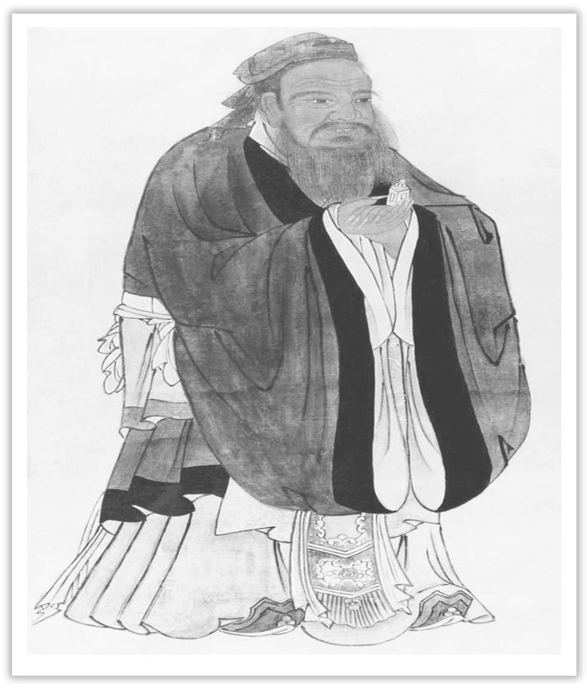
Unit 4 History and Traditions
Section Ⅲ Reading and Thinking(2)
WWW.PPT818.COM

Slide 2
Ⅰ.单词语境记忆——根据英汉提示写出单词的适当形式
1.If you wish for any further explanation, you had better apply in person to the ____________ (首领) of police.
2.Is there life on Mars? It is still a ____________ (迷) to us.
3.We paid a visit to the ____________ (附近的) nursing home last Saturday for the Double Ninth Festival.
chief
puzzle
nearby

Slide 3
4.I’m writing to tell you something about the adjustment of our ____________ (法律的) holidays.
5.Steve arrived and sat in the front row，____________ (围绕) by his family.
6.The full extent of the damage only became ____________ (明显的) the following morning.
7.So, whatever I meet, I have confidence to ____________ (征服) it.
8.You may choose either one as ____________(港口) of shipment.It makes no difference to us.
9.The discovery of new ____________ (evident) led to the thief’s being caught.
legal
surrounded
evident
conquer
port
evidence

Slide 4
10.Her ____________ (achieve) in the 100m surprised us all.
11.If you publish your ____________ (locate) to the public, then, well, everyone can know where you are.
12.With the famous pyramids, various temples and some ____________ (fascinate) museums, Cairo is a fantastic choice if you can come to the city.
achievement
location
fascinating

Slide 5
Ⅱ.短语语境填空——根据汉语提示写出适当的短语
1.The island ________________ (被连接起来) the mainland by a bridge.
2.Nobody can entirely ________________ (逃脱) this competitive world.
3.The house ________________ (属于) my aunt, but she doesn’t live here any more.
4.The pencil-box on the desk ________________ (和) the bookmarks belongs to my little sister.
5.When travelling in a foreign country, you had better ______________________ (留意) the local history and tradition.
is joined to
break away from
belongs to
as well as
keep your eyes open for

Slide 6
Ⅲ.句式语境仿写
1.Getting to know a little bit about British history will help you solve this puzzle.
了解一点英国历史将帮助你解决这个难题。
[仿写] 掌握基本的急救技能将有助于你在遇到紧急情况时迅速做出反应。
________________________________________ will help you respond quickly to emergencies.
Knowing basic first-aid techniques

Slide 7
2.Almost everywhere you go in the UK, you will be surrounded by evidence of four different groups of people who took over at different times through history.几乎在英国的任何地方，你都会被四个不同的人群留下来的证据所包围，这些人在不同的历史时期接管了英国。
[仿写] 无论走到哪里，她都受到热烈欢迎。
_____________________________________________, she receives a warm welcome.
Everywhere she goes

Slide 8
3.They had castles built all around England，and made changes to the legal system.
他们在英格兰各地修建了城堡，并对法律制度进行了修改。
[仿写] 我的车在路上抛锚了，因此我们不得不找人把它修好。
My car broke down on the way, so we had to _____________________________.
4.Studying the history of the country will make your visit much more enjoyable.
学习这个国家的历史将使你的访问更加愉快。
[仿写] 这种独特的写作风格使得这部书很受我们的欢迎。
The unique writing style ____________________________________________.
have it repaired
makes/made the book popular with us

Slide 9
记单词
Ⅰ.一言串记多义词
1.The chief is responsible for the chief work and the others carry out the daily routine.
这位酋长负责最重要的工作，其他人在执行日常事务。
2.There was a puzzled look on the little girl’s face because the puzzle puzzled her.
在这个小女孩的脸上有一种困惑的表情，因为这个智力游戏使她困惑。

Slide 10
Ⅱ.词缀助记派生词
1.名词后缀：-dom，-ment，-ion
①king(n.)→kingdom
②achieve(v.)→achievement
③locate(v.)→location
2.形容词后缀：-ing
fascinate (v.)→fascinating

Slide 11
Ⅲ.词族联记一类词
含后缀-ence的名词集锦
1.evident→evidence 证据
2.consequent→consequence 结果
3.convenient→convenience 便利；方便
4.absent→absence 缺乏；缺席
5.competent→competence 能力；胜任

Slide 12
句型公式
1.动名词短语作主语。
2.everywhere作连词，意为：无论什么地方。
3.have＋宾语＋过去分词(短语)作宾语补足语。
4.make＋宾语＋宾语补足语。

Slide 13
Understanding in context
WHAT’S IN A NAME
The United Kingdom, Great Britain, Britain, England—many people are confused by what these different names mean.So what is the difference between them, if any? Getting to know a little bit about British history will help you solve this puzzle.

Slide 14
In the 16th century, the nearby country of Wales was joined to the Kingdom of England.Later, in the 18th century, the country Scotland was joined to create the Kingdom of Great Britain.In the 19th century, the Kingdom of Ireland was added to create the United Kingdom of Great Britain and Ireland.Finally, in the 20th century, the southern part of Ireland broke away from the UK, which resulted in the full name we have today：the United Kingdom of Great Britain and Northern Ireland.Most people just use the shortened name：“the United Kingdom” or “the UK”.People from the UK are called “British”， which means the UK is also often referred to as Britain or Great Britain.

Slide 15
[文化视窗]
爱尔兰人属于凯尔特人，是欧洲大陆第一代居民的子嗣，1169年开始遭到英格兰入侵，1541年起英王成为爱尔兰国王，1916年都柏林爆发了反抗大英帝国殖民统治的复活节起义，1921年12月6日，双方签订《英爱条约》，英被迫允许爱南部26郡成立爱尔兰自由邦，但北部6郡仍属英国，成为现在的北爱尔兰。

Slide 16
1.puzzle n.迷；智力游戏；疑问vt.迷惑；使困惑 puzzling adj.令人迷惑的 puzzled adj.困惑的
[合作探究] 体会puzzle的用法和意义
I’m in a puzzle as to how to get along with him. 对于如何和他相处我感到困惑。
Where the missing plane has gone still remains a puzzle to us.
失联飞机去了哪儿对我们来说仍是个谜。
These scientists have been puzzling about/over how to solve the environmental problem.如何解决这个环境问题科学家们一直苦思。
The student was puzzled about what to do next.
这个学生对下一步做什么感到迷惑。

Slide 17
[自主发现]
①____________ 感到困惑；不知如何是好
②(be) a puzzle ____________ sb... ……对某人来说仍是个谜
③puzzle ____________ 冥思苦想；苦苦思索
④be puzzled ____________ 对……迷惑不解
in a puzzle
to
about/over
about

Slide 18
[一言串记]
The puzzled look on her face suggested she was puzzling over the puzzling math problem.
她困惑的表情暗示了她正在思考那个令人困惑的数学问题。
[巩固内化] 补全句子
①Their reason for doing it ________________________________.
他们为什么干那件事对我来说仍然是个谜。
②______________________________ was why they didn’t take his advice.
最让我困惑的是他们为何不接受他的忠告。
is still a puzzle to me
What puzzled me most

Slide 19
2.break away (from sb/sth) 脱离；背叛；逃脱
①The boy was so angry that he broke away from his mother and ran away.
这个男孩如此生气以至于他挣脱开母亲跑开了。
[短语记牢] 记牢下列短语
break down 损坏；发生故障；衰弱
break in 打断；插嘴说；闯入
break into 闯入……；爆发
break out (战争)爆发；(火灾)突然发生
break up 分解；解散；破裂

Slide 20
②No sooner had he stepped on the stage than the audience broke into thunderous applause.他一走上舞台，观众就爆发出雷鸣般的掌声。
③When the news came that the war broke out, he decided to serve in the army.
当战争已爆发的消息传来时，他决定到军队中服役。

Slide 21
[巩固内化] 介、副词填空
①Modern music like jazz has broken away ____________ the old traditional rules.
②The elevators in that building are always breaking ____________， which makes the residents quite annoyed.
③Two friends have an argument that breaks ____________ their friendship forever.
④The boy broke ____________ the room, which surprised everyone.
from
down
up
into

Slide 22
3.Getting to know a little bit about British history will help you solve this puzzle.
了解一点英国历史将帮助你解决这个难题。
【句式解读】 动名词短语Getting to know a little bit about British history在句中作主语。
【用法总结】
(1)动名词作主语往往表示经常性、习惯性的动作。
①Seeing is believing.眼见为实。
(2)动名词作主语时谓语动词常常使用第三人称单数。
②Travelling along the old Silk Road is an interesting and rewarding experience.
沿着古老的丝绸之路旅行是既有趣又有益的经历。

Slide 23
③Helping her is my duty.帮助她是我的责任。
(3)动名词作主语可以用it作形式主语，常见句型有：
·It is no use/no good/no fun/a waste of time doing sth做某事没有用/没有好处/没有意思/是在浪费时间。
·It is useless/worth/worthwhile doing sth做某事是没有用的/是值得的。
④It’s no use crying over spilt milk.覆水难收。

Slide 24
[思考] 动名词作主语和不定式作主语有哪些区别？
________________________________________________________________________
________________________________________________________________________
________________________________________________________________________
________________________________________________________________________
[巩固内化] 补全句子
①_____________________________ is a pleasure.
和你一起工作是一种乐趣。
②________________________ during the rush hour ____________.
在交通高峰期开车是很累人的。
动名词作主语往往表示经常性、习惯性的动作，而不定式作主语则表示具体的一次性的动作。如：
To finish the task will take a long time.
要完成这项任务将要花费很长的时间。
Working with you
Driving a car
is tiring

Slide 25
Understanding in context
The four countries that belong to the United Kingdom work together in some areas.They use the same flag, known as the Union Jack, as well as share the same currency and military defence.However, they also have some differences.For example, England, Wales, Scotland, and Northern Ireland all have different education systems and legal systems.They even have their own football teams for competitions like the World Cup！

Slide 26
[文化视窗]
英格兰在金雀花王朝开始就不断侵入威尔士公国，最终完全掌握了威尔士的大公位，而苏格兰的斯图亚特王朝国王詹姆斯六世凭借着母系血统继承了英格兰王位成为詹姆士一世，从而使英格兰、苏格兰成为一个联邦。

Slide 27
4.belong vi.应在(某处)；适应 belongings n.财产；所有物；相关事物
[合作探究] 体会belong的用法和意义
Where does this file belong？这个文件应该放在哪里？
The time belonging to the children should be returned to them by the teachers.
＝The time which belongs to the children should be returned to them by the teachers.
老师应归还属于孩子们的课余时间。
[自主发现]
____________ 属于；是……的一员
belong to

Slide 28
[思考] “belong to”中的to是介词，该短语既不能用于被动语态，也不能用于进行时态。小组讨论，试着列举其他不能用于进行时态和被动语态的动词。
①_____________________________________________________________________
②_____________________________________________________________________
③_____________________________________________________________________
stay, keep, remain (依然；保持)等系动词
meet (遇到), weigh (称重), open (店铺开门营业)等动词
sell, wash, write, last等动词后接well或easily时

Slide 29
[巩固内化]
(1)补全句子
①In my opinion, you’d better put the book _______________________.
依我看来，你最好把书放回应放置的地方。
(2)一句多译
②众所周知，中国属于发展中国家。
→As is known to us, China is a country ________________________________.
(现在分词作后置定语)
→As is known to us, China is a country ________________________________.
(定语从句)
where it belongs
belonging to developing countries
which belongs to developing countries

Slide 30
5.as well as同(一样也)；和；还
[合作探究] 体会as well as的用法和意义
She is a talented musician as well as being a photographer.
她不但是个摄影师而且还是个天才音乐家。
English，as well as Chinese and maths, is of great importance.
同语文和数学一样，英语也非常重要。
Da Shan speaks Chinese as well as a native speaker.
大山汉语说得同本地人一样好。

Slide 31
[自主发现]
①as well as在功能上相当于________(连词/介词)，后接名词或动名词，尤其位于句首时，相当于besides, in addition to。
②as well as在功能上相当于________(连词/介词)，连接两个相同的成分。连接两个并列的主语时，谓语动词应与________________________保持一致。
③as well as用于同级比较，意为：________________。
介词
连词
前面的主语在人称和数上
和……一样好

Slide 32
[巩固内化]
(1)单句语法填空
①The famous musician, as well as his students, ____________(invite) to perform at the opening ceremony last month.
(2)补全句子
②We can know more about the life of great people _______________________________ of other countries.
我们不仅可以更多地了解伟人的生活而且可以了解其他国家的历史和文化。
was invited
as well as history and cultures

Slide 33
Understanding in context
The United Kingdom has a long and interesting history to explore, which can help you understand much more about the country and its traditions.Almost everywhere you go in the UK, you will be surrounded by evidence of four different groups of people who took over at different times throughout history.The first group, the Romans, came in the first century.Some of their great achievements included building towns and roads.Next, the Anglo-Saxons arrived in the fifth century.They introduced the beginnings of the English language and changed the way people built the houses.The Vikings came in the eighth century, left behind lots of new vocabulary, and also the names of many locations across the UK.The last group were the Normans.They conquered England after the well-known Battle of Hastings in the 11th century.They had castles built all around England，and made changes to the legal system.The Normans were French, so many French words slowly entered into the English language.

Slide 34
[文化视窗]
英国历史上的四次文化入侵揭示了语言与社会文化之间的互动关系。萨丕尔说过：“一种语言对另外一种语言最简单的影响是词的‘借贷’。只要有文化借贷，就可能把有关的词借过来。每一个文化浪潮都在英语上沉积下一层借词。”正是这样，英语吸取了包括拉丁语、北欧语、法语等外来词汇，词汇总量达到一百万，成为名副其实的世界语言。

Slide 35
6.surround vt.围绕；包围 surrounding adj.周围的 surroundings n.环境
[合作探究] 体会surround的用法和意义
The professor likes to surround himself with his students.
那位教授喜欢和他的学生们在一起。
The small village is surrounded on all sides by/with green mountains and clear rivers，attracting visitors from every corner.
青山绿水环抱着村寨，吸引八方来客。
[自主发现]
①__________________ 以……包围……
②________________________ 被……包围
surround...with...
be surrounded by/with...

Slide 36
[巩固内化]
用surround的适当形式填空
Once upon a time，a king who was polite to①____________ countries lived in a castle ②____________ by a large forest and having wonderful ③____________.
surrounding
surrounded
surroundings

Slide 37
7.They had castles built all around England，and made changes to the legal system.
他们在英格兰各地修建了城堡，并对法律制度进行了修改。
【句式解读】 had castles built是“have sth done”结构，castles与build之间为被动关系，故用过去分词作宾补。
【用法总结】 have/get sth done属于“have/get＋宾语＋宾语补足语”结构，它表示两种意义：
(1)使某事被做(主语有意识的行为，可能是主语自己做，也可能是让别人做)
①The patient is going to have his temperature taken.
这个病人准备请/叫/让人给他量体温。
②I usually have my clothes washed on Sundays.我通常在星期天洗衣服。

Slide 38
(2)遭遇某种不幸的事情
③She had her wallet stolen on her way home yesterday.
昨天在回家的路上她的钱包被偷了。

Slide 39
[思考] 写出下面结构的意义
①have sb do______________
②have sb/sth doing_______________________
③have sth to do____________
[巩固内化] 补全句子
①I must _____________________________ before going to bed.
睡觉前我必须做完作业。
②Unfortunately, he _________________________ during the training.
不幸的是，他在训练中把右腿弄伤了。
让某人做……
让某人/某物一直做……
有某事要做
have my homework done
had his right leg injured

Slide 40
Understanding in context
There is so much more to learn about the interesting history and culture of the United Kingdom.Studying the history of the country will make your visit much more enjoyable.The capital city London is a great place to start, as it is an ancient port city that has a history dating all the way back to Roman times.There are countless historic sites to explore, and lots of museums with ancient relics from all over the UK.The UK is a fascinating mix of history and modern culture, with both new and old traditions.If you keep your eyes open, you will be surprised to find that you can see both its past and its present.

Slide 41
[文化视窗]
大英博物馆(British Museum)，又名不列颠博物馆，位于英国伦敦新牛津大街北面的罗素广场，是世界上历史最悠久、规模最宏伟的综合性博物馆，也是世界上规模最大、最著名的世界五大博物馆之一。

Slide 42
8.Studying the history of the country will make your visit much more enjoyable.
学习这个国家的历史将使你的访问更加愉快。
【句式解读】 句中make your visit much more enjoyable为“make＋宾语＋宾语补足语”结构。
【用法总结】
“make＋宾语＋宾补”结构有以下几种形式：
(1)make＋宾语＋形容词
(2)make＋宾语＋名词(职务名词充当宾补时其前不要加冠词)
(3)make＋宾语＋介词短语
(4)make＋宾语＋省略to的不定式(被动语态中to不能省略)
(5)make＋宾语＋过去分词(不用现在分词充当宾补)

Slide 43
①Praise makes good men better and bad men worse.
表扬能使好人更好，坏人更坏。
②We made him monitor of our class.我们选他当我们的班长。
③She made her children wash their hands before eating.
她要孩子们在吃东西前洗手。
④The speaker raised his voice in order to make himself heard.
发言人提高了嗓音以便别人听到他说的话。

Slide 44
[巩固内化]
(1)单句语法填空
①You should make your views ____________ (know).
(2)补全句子
②The summer training school will _________________________________________.
暑假培训学校会让英语学习更简单、更有趣。
(3)同义句转换
③Every day my parents make me have an egg.(变为被动语态)
→____________________________________________________________________
known
make learning English easier and more interesting
Every day I am made to have an egg by my parents.

