Slide 1
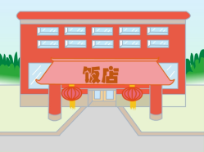
Unit2 There is a park near my home.
人教精通版六年级下册
WWW.PPT818.COM

Slide 2
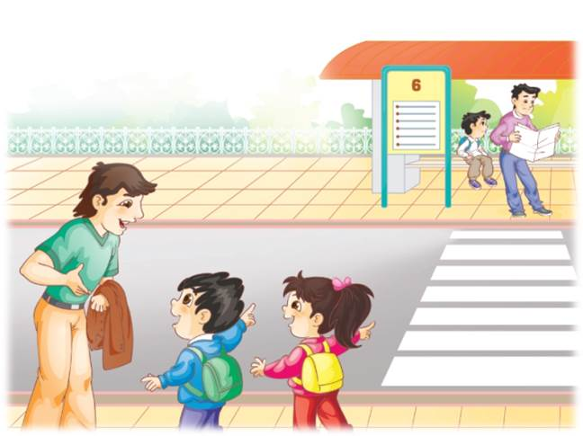
>>Review
Think and say
How can the man get to the City Library?

Slide 3
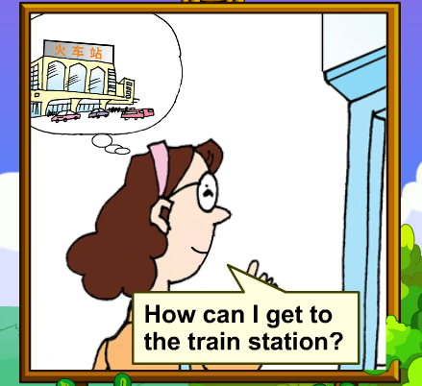
>>Lead-in
Let’s watch

Slide 4
>>Presentation
Think and say
How can the woman get to the train
station?
She can get there by bus.
How do you usually get to school?
I get to school …

Slide 5
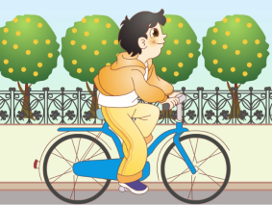
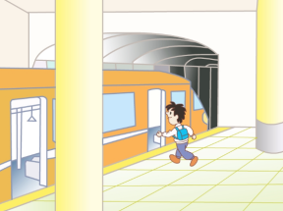
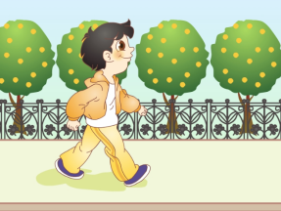
>>Presentation
Look and say
I can get to school …
by bike
by subway
on foot

Slide 6
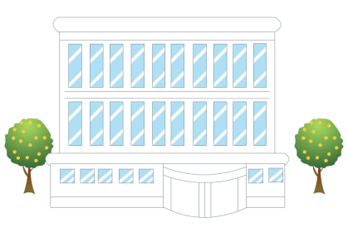
>>Presentation
Look and say
This is our City Library.
How can we get to the
City Library?
City Library
We can get there by bus.

Slide 7
>>Presentation
Look and say
This is a famous restaurant
in our city.
Do you know it?
How can we get to the
restaurant?
restaurant
We can get there by subway.

Slide 8
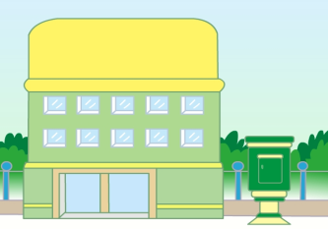
>>Presentation
Look and say
This is a post office near our
school.
How can we get to the post
office?
post office
We can get there on foot.

Slide 9
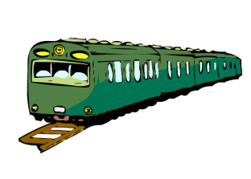
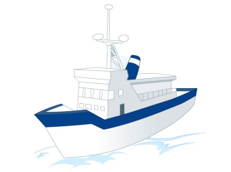
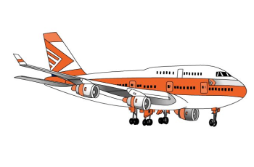
>>Presentation
Discussion
What other ways to travel(其他出行方式)do we
often choose in our daily life?
by train
by ship
by plane

Slide 10
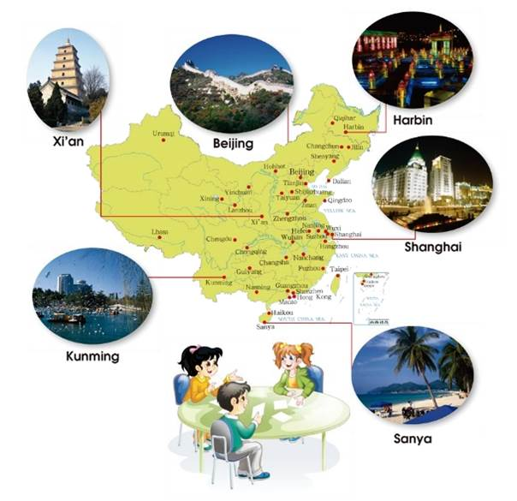
>>Practice
Do a survey
I can get there
by…
How can you get to …?

Slide 11
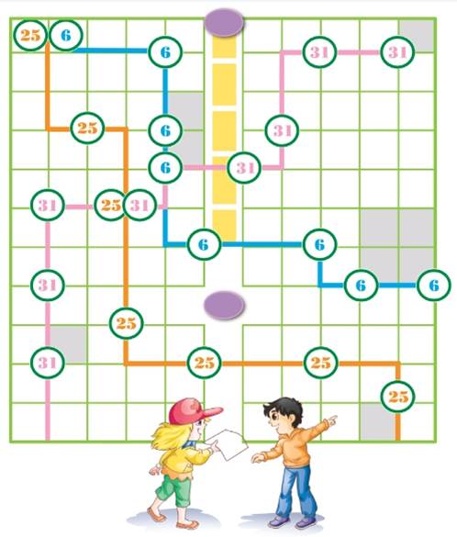
>>Practice
Let’s play
I’m in the park now. How can I get to the City Library?
You can go there by No.6 and No.31 buses.

Slide 12
>>Practice
Let’s chant

Slide 13
>>Summary
本课的重点词汇有哪些？
City Library
restaurant
post office
by bike
by subway
on foot
2.本课的重点句型是什么？
How can I get to the City Library?
You can get there by bus.

Slide 14
>>Homework
1.观看课文动画，按照正确的语音、语调朗读课文。 2.在四线三格中正确抄写本课的新单词和短语，不少于5遍。
3.预习 Lesson12。

