Slide 1
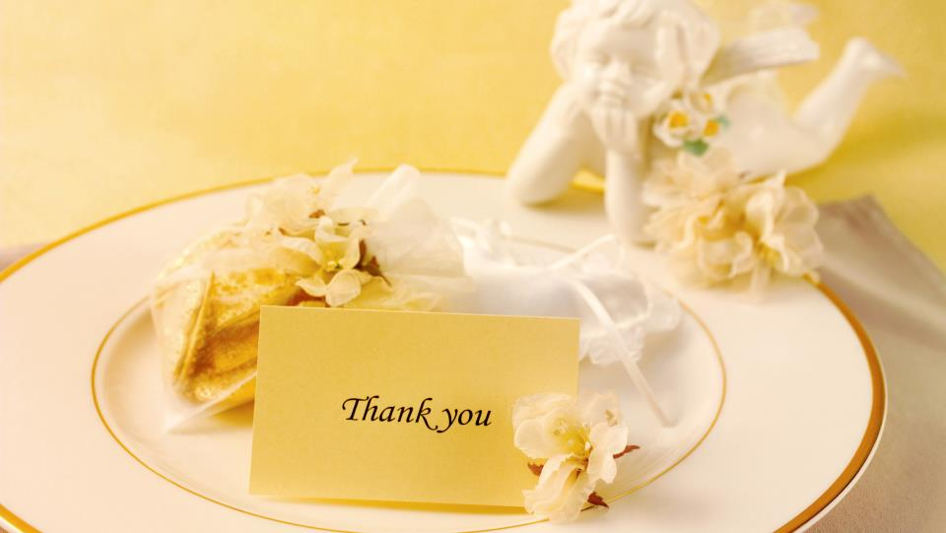
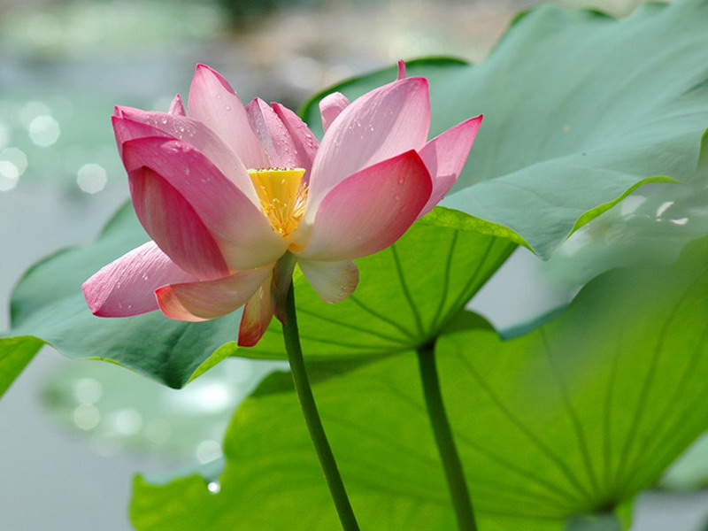
Starter Module 4
My everyday life
Unit 1 What day is it today?
WWW.PPT818.COM

Slide 2
Teaching objectives
1. To learn days of the week.
2. To learn: What day is it today?
What day is it tomorrow?
3. To learn how to answer the questions.

Slide 3
What day is it today?
星期日
星期一
星期二
星期三
星期四
星期五
星期六
Sunday
Monday
Tuesday
Wednesday
Thursday
Friday
Saturday
Mon.
Tue.
Wed.
Thu.
Fri.
Sat.
Sun.
缩
写

Slide 4
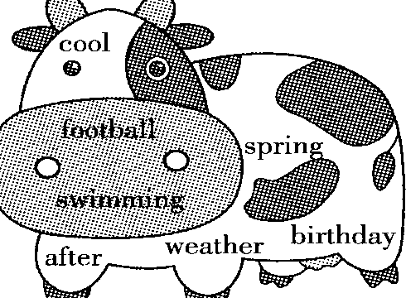
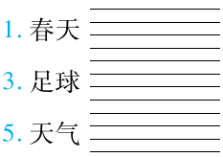
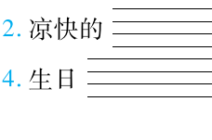
从图片中找出与汉语对应的单词

Slide 5
怎样提问今天是周几？
What day is it today? 今天是星期几？
Today is Friday. = It is Saturday today.
What day is it tomorrow?
Tomorrow is Sunday.=
It is Sunday tomorrow.
怎样提问明天是周几？

Slide 6
[tə'dei]
['tju:zdei]
['θə:zdei]
['sætədei]
['feivərit]
['mʌndi]
['wenzdei]
['fraidei]
['sʌndei]
['bɜ:θdei]
today
Tuesday
Thursday
Saturday
favourite
Monday
Wednesday
Friday
Sunday
birthday

Slide 7
Chant
Monday, Tuesday, Wednesday,
Thursday, Friday, Saturday, Sunday
What day is it today? It’s Monday.
What do you do? I go to school.
What day is it tomorrow?
It’s Tuesday.
What will you do?
I’ll go to school, too.

Slide 8
完成下面的两个对话
A: ___ ____ is it today ?
B: It’s Monday.
A: What day is it tomorrow?
B: It’s _______.
A: What day is it today ?
B: It’s Friday.
A: What day is it tomorrow?
B: It’s ________.
What day
Tuesday
Saturday

Slide 9
Game
A: What day is it today?
B: It’s Monday?
C: What do you do?
D: I go to school
E: What day is it after Monday?
F: It’s…

Slide 10
What do you do on different days?
Hello, everyone.
Today is ….
I …..
Tomorrow is…
I’ll do….

Slide 11
Recite
today tomorrow yesterday
the day after tomorrow(后天）
yesterday
tomorrow
the day after tomorrow
today

Slide 12
Recite
一年
一个月
一周
一天
一小时
一分钟
一秒钟
a year
a month
a week
a day
an hour
a minute
a second

Slide 13
Ask and answer
How many months are there in a year?
There are 12 months in a year.
How many weeks are there in a month?
There are 4 weeks in a month.
How many days are there in a week?
There are 7 days in a week.

Slide 14
Ask and answer
How many hours are there in a day?
There are 24 hours in a day.
How many minutes are there in an hour?
There are 60 minutes in an hour.
How many seconds are there in a minute?
There are 60 seconds in a minute.

Slide 15
Listen and read.
Miss Zhou: Good morning, class.
What day is it today?
Students: It’s Monday.
Miss Zhou: Yes, It’s Monday.
Write it in your book.
Students: M-O-N-D-A-Y, Monday.
Miss Zhou: What day is it tomorrow?
Students: Tuesday.
Miss Zhou: Yes, tomorrow is Tuesday.

Slide 16
Listen and repeat.
a calendar[‘kælində]日历
 |  | 1 | 2 | 3 | 4 | 5
6 | 7 | 8 | 9 | 10 | 11 | 12
13 | 14 | 15 | 16 | 17 | 18 | 19
20 | 21 | 22 | 23 | 24 | 25 | 26
27 | 28 | 29 | 30
Sunday
Monday
Tuesday
Wednesday
Thursday
Friday
Saturday

Slide 17
Read and match.
1. Today is Wednesday.
What day is it
tomorrow?
2. Today is Friday.
What day is it
tomorrow?
3. Today is Monday.
What day is it
tomorrow?
4. Today is Saturday.
What day is it
tomorrow?
c) Thursday.
b) Tuesday.
d) Saturday.
a) Sunday.

Slide 18
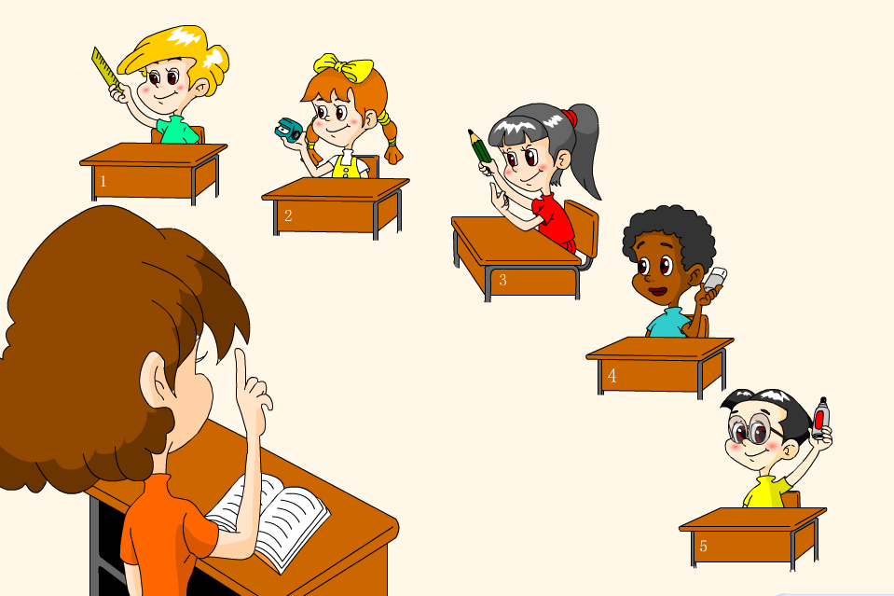
Work in pairs. Ask and answer.
It’s …
Today is …
What day is
it tomorrow?

Slide 19
Listen and write.
1.
2.
3.
4.
Monday
5.
6.
7.
Friday
Tuesday
Saturday
Wednesday
Sunday
Thursday

Slide 20
Let's read
[u] | [u:] | [θ]
[ə] | [з:] | [ h ]
[ɔ] | [ɔ:] | [ l ]
[ʌ] | [ɑ:] | [w]
[æ] | [iə] | [ju:]
[ei] | [ai]

Slide 21
/ʃ/ /ʒ/
shy sure short shoe should shout
usually, decision, pleasure, treasure
1. She sells seashell on the seashore.
2. He usually measures the television
in the garage.

Slide 22
/ h/ / r/
house hill hot hat half home
room rice rock right worry sorry
She hated her husband bought
her high heels.
2. A rat rusked rushing the room to
carry the rice.

Slide 23
Write.
day
1. What _____ is it today?
2. Today is Tuesday. Tomorrow is
__________.
3. Thursday, Friday, ________.
4. _______, Monday, Tuesday.
5. It’s Wednesday today.
Tomorrow is ________.
Wednesday
Saturday
Sunday
Thursday
Now listen and check.

Slide 24
要点：
1 询问今天星期几：
--What day is it today ?
--It’s…
2 询问明天星期几：
--What day is it tomorrow?
--It’s…
3 周一到周日单词首字母要大写

Slide 25
1. --What _____ is it today? --It’s Monday.
A. day B. date C. age
2. Write it ____ your book.
A. on B. in C. of
3. Today is Thursday, tomorrow is _____.
A. Wednesday B. Monday C. Friday
4. It’s _____ today. Tomorrow is Monday.
A. Sunday B. Saturday C. Tuesday
5. --What’s the last day of a week?
-- It’s ______.
A. Monday B. Saturday C. Sunday
ABCAB
Key
学.科.网

Slide 26
6. He can play ________ table tennis.
A. a B. an C. the D. /
7. —I like ________ football. —I like it too.
A. play it B. play C. playing D. plays
8. —____ the weather ____ today? —Hot.
A．What's; / B．What's; like
C．How's; like D．How; is
9. —________？ —It's Monday.
A．What's this B．What's the date
C．What day is it D．Is it Monday
D
C
B
C

Slide 27
Homework
Review new words and sentences.
To finish the exercises in the Workbook.
Notes:
27

Slide 28
Thank you for listening
Notes:
28

