Slide 1
外研版（三起点）六年级下册
Moudle 3 Unit1
The sun is shining.
WWW.PPT818.COM

Slide 2
学习目标
认读单词cry, just, shine, everyone, fly away。
2. 听、说、读、写句子：
The sun is shining.
The birds are singing in the tree.
The ducks are eating our sandwiches!
3. 熟练应用现在进行时描述图片并会做检测题。
Notes:
2

Slide 3
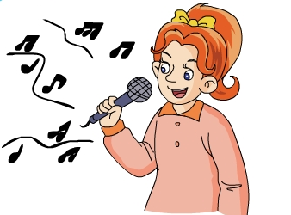
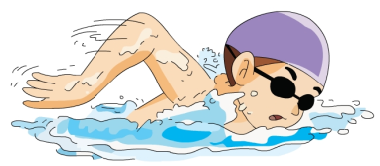
Lead-in
Ask and answer.
1. What is he doing?
2. What is she doing?
He is swimming.
She is singing.
Notes:
3

Slide 4
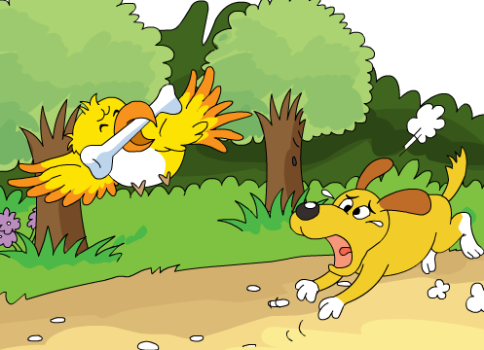
Lead-in
Listen and chant.
What’s in the picture? What is it doing?
There is a bird in the picture. The bird is flying.
There is a dog in the
picture. The dog is crying.
（单击图片可播放动画）
Notes:
4

Slide 5
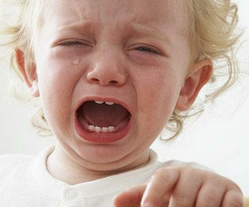
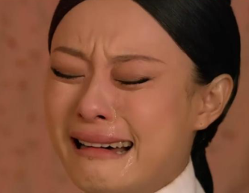
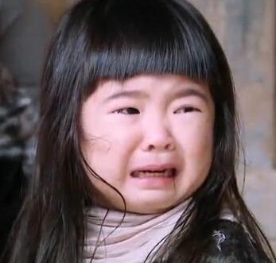
Lead-in
Listen and chant.
加ing
cry
crying
crying.
Notes:
5

Slide 6
自学指导一
请同学们自读part2里的这封信，边读边找出不认识的单词。
3分钟后，比一比谁读的最好!
要求：不会读的单词问老师或同桌
Notes:
6

Slide 7
Answer the questions:
1.Did Daming have a very interesting day
on Saturday?
Yes, he did.
2.What did they do?
They had a picnic in the park.
3.What is he sending?
He is sending some photos.
Notes:
7

Slide 8
自学指导二
请同学们认真看part2的三幅图片和图下的英语表达，找出含有“ing”的句子并划下来。
5分钟后，比一比谁能读得最流利！

Slide 9
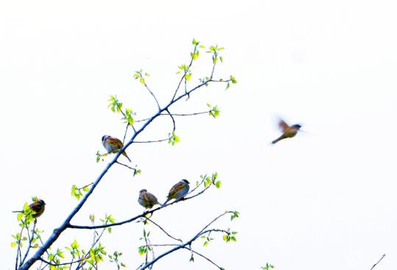
Let’s learn.
加ing
fly away
flying away
The bird is flying away.
Notes:
9

Slide 10
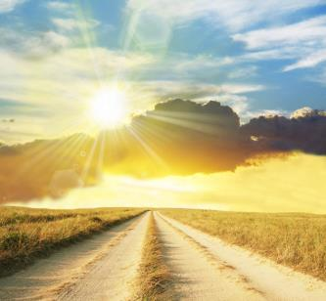
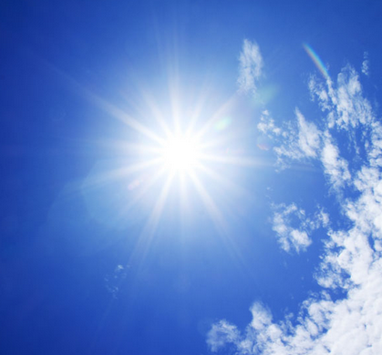
Let’s learn.
去e加ing
shine
shining

Slide 11
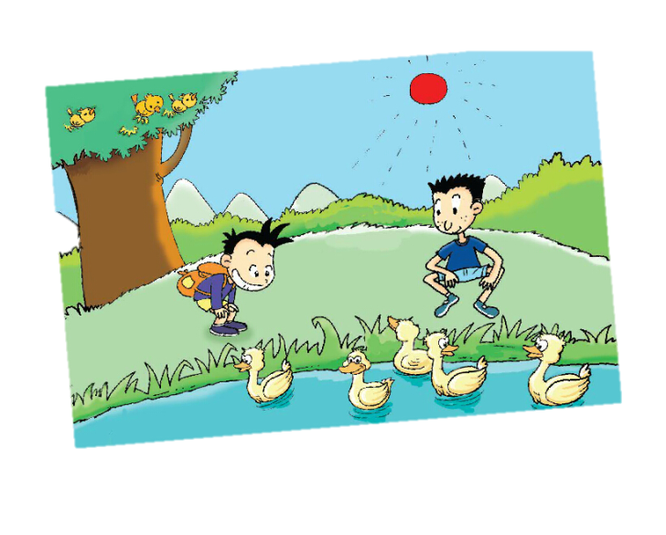
Picture1
The sun is shining.
The birds are singing in the tree.
We are looking
at some ducks.
The ducks are swimming.
Notes:
11

Slide 12
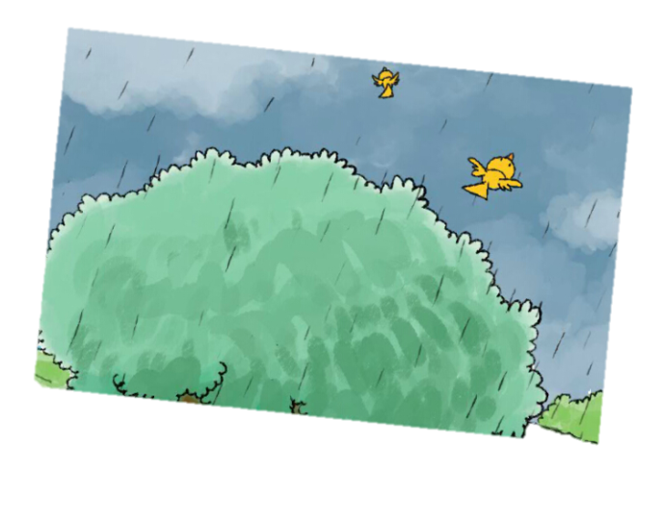
Picture2
It’s starting to rain and the birds are flying away.
Notes:
12

Slide 13
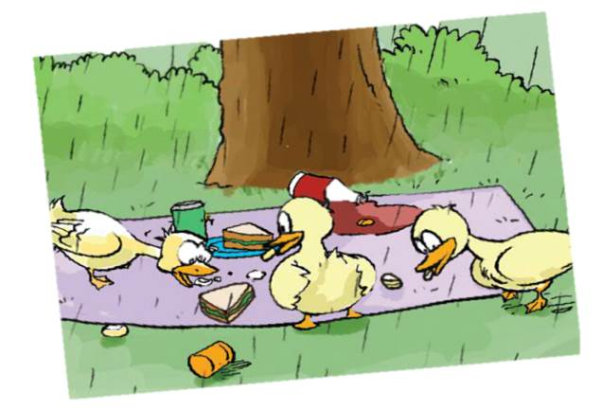
Listen and read.
The ducks are eating our sandwiches!
Notes:
13

Slide 14
Let’s learn.
规则 | 例词
直接在动词末尾加ing | fly-flying cry-crying work-working
以不发音的e结尾的动词，去e加ing; | shine-shining write-writing dance-dancing
以单个辅音字母结尾的重读闭音节动词，先双写末尾的辅音字母，再加-ing | run-running sit-sitting shop-shopping
以ie结尾的动词，把ie变成y，再加-ing | tie-tying lie-lying die-dying
Notes:
14

Slide 15
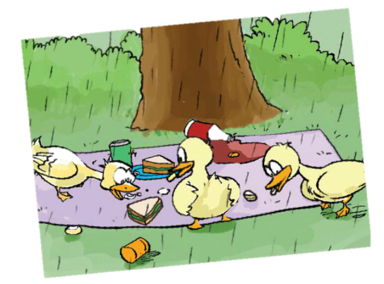
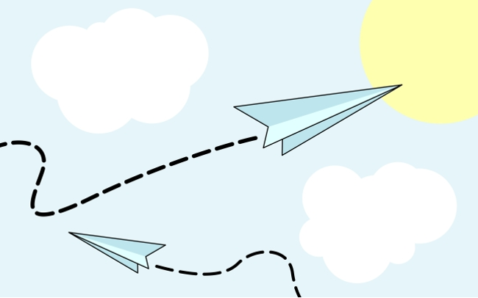
Practice
Read and try to describe it.
3
1
2
Notes:
15

Slide 16
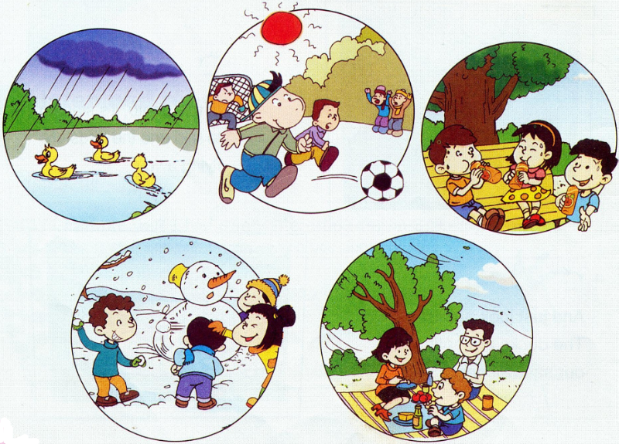
Practice
In this photo, it’s raining.
The ducks are swimming on the pond.
随机应变
Notes:
16

Slide 17
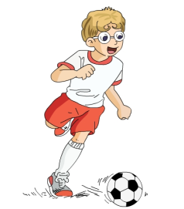
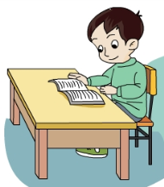
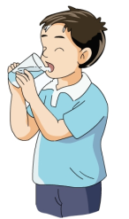
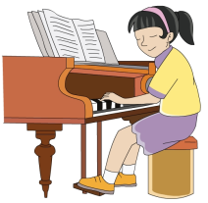
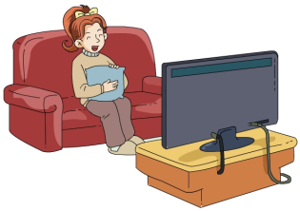
Practice
I show you say
Notes:
17

Slide 18
课堂检测
用下列词的正确形式填空。
1.I am _______(swim)now.
2.He _____(be)doing homework now.
3.We are _______(look)at some ducks.
4.They _______(have)a birthday party.

Slide 19
句型转换。
1. I’m watching TV.（就画线部分提问）
What are you doing?
2. Mike often plays football.(用现在进行时改写句子）
Mike is playing football.
3. A boy is running on the playground.(变一般疑问句）
Is a boy running on the playground?
They are dancing.(变否定句）
They aren’t dancing.

Slide 20
Summary
1. 运用句型“主语 + be动词 + v-ing.” 描述照片或图片中的情景。
2. 动词的现在分词变化的规则。

Slide 21
Homework
1.按照正确的语音、语调朗读课文对话。 2.找出3张家庭成员在一起参加活动的照片，模
仿课文写句子，每张照片至少一句话。

