Slide 1
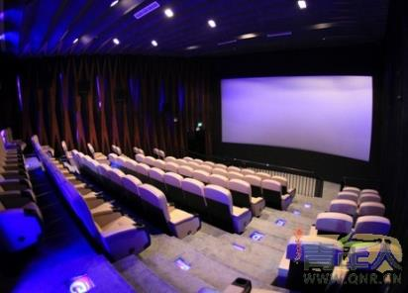
人教版八年级上册
Unit4
What’s the best movie theater?
Section A（第1课时）
WWW.PPT818.COM

Slide 2
学习目标
能熟练拼写和运用下列词汇:theater, comfortable, seat, screen, close, ticket, worst, cheaply, song, choose, carefully, reporter。
学习进行简单的比较并表达自己的喜好。
掌握一些形容词的比较级和最高级形式。

Slide 3
自学互研
新词自查
根据句意及首字母提示完成句子
1. They live close to the station.
2. There are 50 students in my class, so there are 50 seats in our
classroom.
3. There are many kinds of clothes. Which one do you want to c hoose ?
4. The best movie theater has c omfortable seats.
5. You can see her on the TV s creen quite often.
6. —What can I do for you?
—I want to buy a t icket to a ball game.
7. —What do you think of the singer?
—He is good, and I like his s ongs.
8. Welcome to the clothes store. The clothes are at a very good
price. You can buy them c heaply.

Slide 4
情景导入
Free talk
Do you like watching movies?
Where do you watch them?
How do you feel?

Slide 5
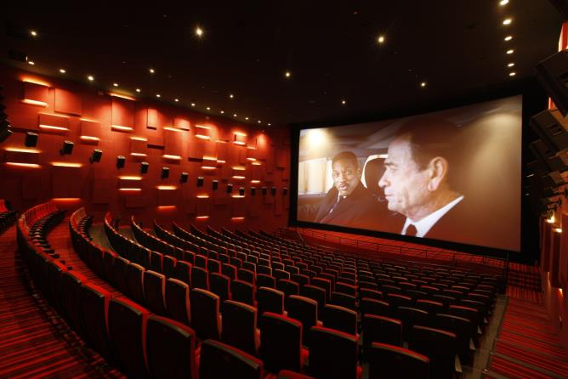
Presentation
comfortable seats

Slide 6
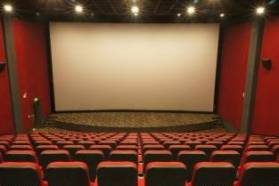
big screen

Slide 7
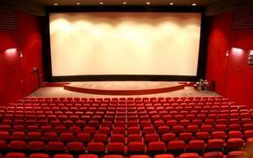
new movies

Slide 8
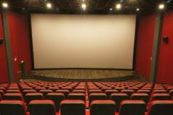
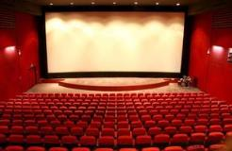
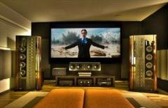
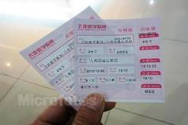
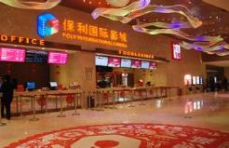
1a
How do you choose which movie theater to go to?
comfortable seats
big screen
new movies
best sound
cheap
buy tickets quickly

Slide 9
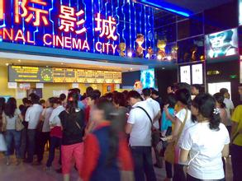
close to home
popular

Slide 10
Free talk
What is the most important for you in a movie theater?
A: I think comfortable seats are the most important for
me .
B: For me, …and … are the most important in a movie
theater.
C: But I think …is the most important.
D: In my opinion, I think … is the most important

Slide 11
1b
Listen and match the statements with the movie theaters.
Qualities | Movie Theater
It has the biggest screens.
It’s the most popular.
It’s the closest to home. | Town Cinema
It has the shortest waiting time.
It has the best sound.
It has the most comfortable seats.
Movie World
Screen City
Town Cinema
Screen City
Movie World

Slide 12
Talk about the movie theaters you know.
A: What’s the best movie theater?
B: Sun Cinema. It’s the cheapest.
C: But I think Moon Theater has the most
comfortable seats.
It has the biggest screens.
It’s the most popular.
It’s the closest to home.
It’s the cheapest.
It has the friendliest service.
It has the most comfortable seats.

Slide 13
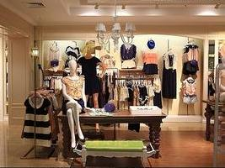
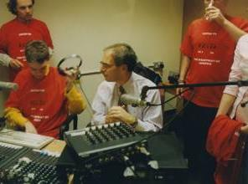
clothes store
radio station

Slide 14
2a
Listen to a reporter interviewing a boy.
Circle the boy’s answer.
Green City Survey
1.Which is the best clothes store?
a. Miller’s b. Blue Moon c. Dream Clothes
2.Which is the best radio station?
a. 970 AM b. 97.9 FM c. 107.9 FM

Slide 15
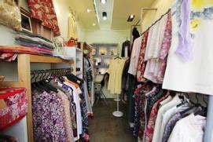
2b
Listen again. Write the correct store or radio station next
to each statement.
Miller’s
Blue Moon
Dream Clothes
Clothes Stores
___________It’s the most expensive.
___________It has the best clothes.
___________It’s the worst store.
________You can buy clothes the most
cheaply there.
Blue Moon
Miller’s
Dream Clothes
Miller’s

Slide 16
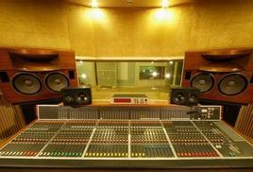
2b
Listen again. Write the correct store or radio station next
to each statement.
970 AM
97.9 FM
107.9 FM
Radio stations
___________ It has the worst music.
___________ They play the most boring songs.
___________ The DJs choose songs the most carefully.
___________ It’s the most popular.
970 AM
97.9 FM
107.9 FM
97.9 FM

Slide 17
Role play a conversation
Hello! I’m a reporter. Can I ask you some questions?
Sure.
What’s the best clothes store in town?
I think Miller’s is the best.
Why do you think so?
Well, Miller’s has …

Slide 18
2d
Task1: Listen and answer.
1) What is Greg’s problem?
He doesn’t really know his way around.
2) What does Helen tell him about the town?
The best supermarket and the newest cinema.

Slide 19
2d
Task2: Role-play the conversation. 分角色表演对话
Greg: Hi, I’m Greg. I’m new in town.
Helen: Hi, I’m Helen. Welcome to the neighborhood! How do you
like it so far?
Greg: It’s fantastic, but I still don’t really know my way around.
Helen: Well, the best supermarket is on Center Street. You can buy
the freshest food there.
Greg: Oh, great. Is there a cinema around here? I love watching
movies.
Helen: Yes, Sun Cinema is the newest one. You can sit the most
comfortably because they have the biggest seats.
Greg: Thanks for telling me.
Helen: No problem.

Slide 20
2d
Task3: Fill in the blanks.
Greg: Hi, I’m Greg.____________________.
Helen: Hi, I’m Helen. Welcome to the ____________! How do
you like it_________?
Greg: It’s_________, but I still don’t really know______________.
Helen: Well, __________________is on Center Street. You can buy
the freshest food there.
Greg: Oh, great. ________________________? I love watching
movies.
Helen: Yes, Sun Cinema is the newest one. You can sit __________________because they have _______________.
Greg: Thanks for telling me.
Helen: No problem.
I’m new in town
neighborhood
so far
fantastic
my way around
the best supermarket
Is there a cinema around here
the most comfortably
the biggest seats

Slide 21
Do a survey
我们最喜欢的餐馆/商店
四人一组，分别说出自己最喜欢的餐馆或商店及喜欢的理由。
可能用到的语言：
…restaurant is the cheapest one.
I like…restaurant best because it is the cheapest and the most convenient.
I don’t think…restaurant is a good one because it doesn’t have friendly service.
I agree with you. I don’t like… restaurant either.

Slide 22
问题探究
▲辨析sound/ voice
sound指发出来的各种各样的声音。
voice指喉咙里发出来的声音.
▲ choose
点拨：choose的过去式为chose，过去分词为chosen。
短语归纳：choose to do 选择做某事；choose…as…选…..作…;choose…for….如：You can choose three from these books.你可以从这些书中选三本。

Slide 23
▲最高级的常用结构：
1）“The+最高级（+名词）+表示范围的短语或从句”意为“….中最…的”如：Jack is the tallest student in his class杰克是他班上最高的学生。
2）“one of +the/ 物主代词/ 名词所有格+形容词最高级+可数名词复数”意为“最…之一”如：Jim is one of Mike’s best friends.吉姆是迈克最好的朋友之一。
3）“the+序数词+形容词最高级+名词”意为“第几个最…的”如：
The Yellow River is the second longest river in China.黄河是中国的第二长河。

Slide 24
课堂评价
根据汉语意思完成句子，每空一词。
1.到目前为止我不喜欢住在这儿。
I don’t like living here ______
2.镇上最好的服装店是哪一家？
____ __ ___ _____clothes store in town.
3.在这家超市你能够买到最新鲜的蔬菜和水果。
You can buy___ _____vegetables and fruit in this supermarket.
4.哪家电台播放最无聊的歌曲？
Which radio station ________________songs?
5.它有最大的座位，坐着最舒服。
It has the ___________ and you can sit _______
so far
Which is the best
the freshest
plays the most boring
biggest seat
most comfortably

Slide 25
Homework
Remember the vocabulary and the target language.
Review the superlative form of adjectives.

