Slide 1
Unit 7
Abilities
Revision
WWW.PPT818.COM

Slide 2
Try our best,
we are the best!

Slide 3
He can play basketball.
Playing basketball is his ability.

Slide 4
He can sing.
Singing is his ability.

Slide 5
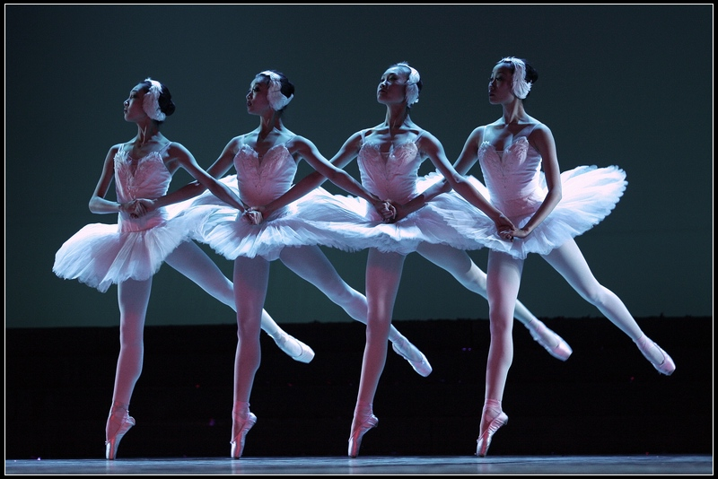
They can dance.
Dancing is their ability.

Slide 6
ability
abilities
What ability do you have?
= What can you do?

Slide 7
Revision : the use of ‘can’/’could’
1. We use ‘can’or ‘could’ to say that we are or were able to do something
我会跳舞。
他过去会唱这首歌。
I can dance.
He could sing the song in the past.
2. We use ‘can’or ‘could’ to say that
something is possible.
如果我们不小心的话，火可能是很危险的。
在那个时候，任何事都可能发生在他身上。
Fire can be very dangerous if we aren’t careful.
Anything could happen to him at that moment.

Slide 8
Revision:
Expressions with ‘ what ‘ and ‘ how’
(感叹句)

Slide 9
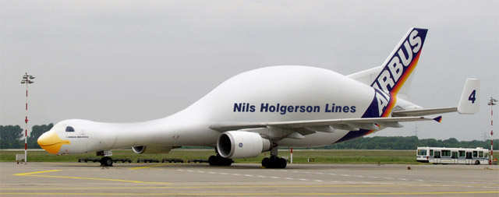
strange
How
strange the plane is !
What
a strange plane it is !

Slide 10
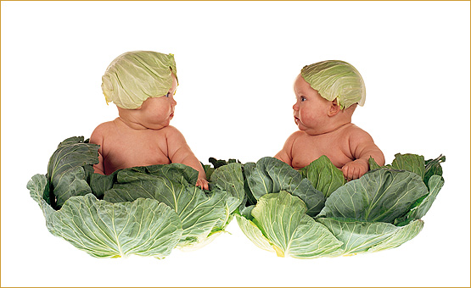
lovely
How
lovely the babies are !
What
lovely babies they are !

Slide 11
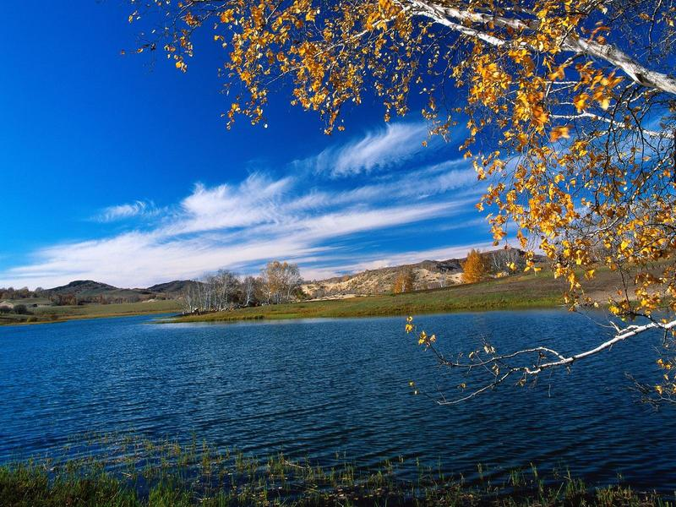
good weather
How
What
good the weather is !
good weather it is !

Slide 12
感叹句：How + adj./ adv. + 主语+ 谓语！
a)他跑的多么快！
b)他作业做得多么认真啊！
c)那个女孩多么高啊！
d)今天天气多么热啊！
How fast he runs!
How carefully he does his
homework!
How tall the girl is!
How hot it is today!

Slide 13
What a/an+ 形 + 可数名词单数+ 主语+ 谓语！
What +形 + 可数名词复数+ 主语+ 谓语！
What + 形 + 不可数名词+ 主语+ 谓语！
他是个多么聪明的男孩啊！
b) 多么好的天气！
c) 这是本有趣的书啊！
d) 这些是多么漂亮的画！
What a clever boy he is!
What fine / good weather (it is)!
What an interesting book this is!
What beautiful flowers these are!

Slide 14
常考到的不可数名词有：
weather, information, news, food, work
advice等
如：
它是多么令人激动的消息啊！
What exciting news it is!
多好的天气啊！
What good weather ！

Slide 15
把下列各句变成感叹句
（ 可以用两种方法的用两种方法变）
He is listening to the teacher so
carefully.
b) This room is very empty.
c) The food is very delicious.
d) These problems are so difficult.
How carefully he is listening to the teachers!
How empty the room is!
What an empty room this is!
How delicious the food is!
What delicious food it is!
How difficult these problems are!
What difficult problems these are!

Slide 16
Revision: Words
hurt
hurt
受伤________(过去式)_______
安全的 adj.______ n._______
危险的 adj. _________ n.___________
粗心的 adj.________ adv._______
（反义词）________ ________
safe
safety
dangerous
danger
careless
carelessly
careful
carefully

Slide 17
terrible
可怕的 adj._________ adv.__________
感激的（1）__________ (2)__________
（反义词） ________
有礼貌的 ______ (反义词)_____ ______
失去 v._______ (过去式) _______
adj._______
terribly
thankful
grateful
ungrateful
polite
impolite rude
lose
lost
lost

Slide 18
比赛 火柴
匹配
match n._______ _______ v._________
单独，独自_________ 孤独_________
燃烧______ (过去式) _______
年老的，年长的 _____ _____ 老人们_______
save ⑴ 挽救
⑵ 节约
alone
lonely
burn
burned/burnt
old elderly
the old/elderly
save the people in danger
挽救那些处于危险中的人
节约用水
save water
省钱
save money

Slide 19
quick
fast
quickly fast
快的 adj.(1)______(2)______adv._____ _____
（反义词）________ ________
勇敢的___________ (反义词)__________
考虑 v. _______(过去式)______ adj.________
友好的_____________ ____________(反义词)
slow slowly
afraid/ frightened
brave
think
thought
thoughtful
kind/friendly
unkind/
unfriendly

Slide 20

competition
1
2
3
4
5
6

Slide 21
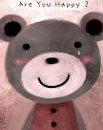
用所给单词的适当形式填空
1.We must be (care )with fire because
it can be very (danger)
2.Did you do anything (safe)
to keep yourself .
3.Be careful with (match).
★ ★
careful
dangerous
safe
matches

Slide 22
根据中文写单词
★
terrible
What ________(可怕的) news it is !
He is not a good boy. He is always ______
(粗鲁的) to the elderly.
rude

Slide 23
★ ★
单项选择
B
Don’t leave the baby at home ___. It’s ___.
A. lonely; dangerous B. alone; dangerous
C. lonely; danger D. alone; danger
The elderly were grateful___ us ___ our help.
A. to; for B. to ; with
C. on; for D. on; with
A

Slide 24
★ ★ ★
句子翻译
去年他在森林里迷路了。
保罗以前做事总是很粗心，
但是现在他考虑一切很周到。
He lost his way in the forest last year.
Paul was careless before, but now he is
thoughtful.

Slide 25
动词填空
★ ★
fell
hurt
Jim ____( fall ) off the bike and ____
(hurt) himself just now.
2.The fireman rushed into the house____
(save) the little baby.
to save

Slide 26
★ ★
句子翻译
大部分老年人都是独自在家，他们感到很孤独。
他迅速地跑回公寓去拿钥匙。
the elderly
alone
Most of ____ ____ are at home ____ ,
they all feel ____.
lonely
back
quickly to
He ran ____ to the flat ____ ____
get the key.

Slide 27

You are so great!

Slide 28
Revision: Phrases
1.当心
be careful/ look out
2.小心火柴
be careful with matches
3.老年公寓
a home for the elderly
4.用一个毯子灭火
put out the fire with a blanket
5.把……倒在……上
pour…over
6.迷路
lose one’s way get lost

Slide 29
7. 先考虑别人
think of others first
8. 尽力
do/try one’s best ( to do sth)
9. 一个5岁的女孩
a 5-year-old girl
10.那个女孩5岁
The girl is 5 years old.
11.清理公园
clean up the park
12.使长发远离火源
keep long hair away from fire

Slide 30
13.家长会
parents’ meeting
14.摔倒了 从……摔倒
fall down fall off…/fall down from…
15.推荐某人获得
recommend sb. for sth.
16.处于危险
be in danger
17.进行一场戏剧表演
have a drama show

Slide 31
18.对中国历史了解的多
know a lot/much about Chinese history
19.教我怎样跳舞
teach me how to dance
20.期待快点收到你的来信
look forward to hearing from you soon
21.有不同的能力
have different abilities
22.冲进她的厨房
rush into her kitchen
23.在车上让座给某人
give a seat to sb. on the bus

Slide 32
24.住院 在医院里
be in hospital in the hospital
25.帮助他的邻居从火中出来
help his neighbour out of a fire
26.感激某人 感激某事
be grateful to sb. be grateful for sth.
27.很好地组织班级活动
organize class activities well
28. 着火
be on fire
29.计划好一切
plan everything well

Slide 33
30.记忆力好
have a good memory
31.更经常的使用英语
use English more often
32.在……有好的成绩
have good grades in…
33.在……取得更好的成绩
get better results in…
34.在去某地的路上 on one’s way to sp
在他去上学/ 电影院/ 回家的路上
on his way to school/to the cinema/ home
在去游泳的路上
on the way to swim

Slide 34
Revision :Sentences
1.不要把热东西放到垃圾桶里
Don’t put anything hot into the rubbish bin.
2.别让火炉开着
Don’t leave the stove on.
3.当他从自行车上摔下时,他摔伤了胳膊.
He hurt his arm when he fell off his bike.

Slide 35
4.如果你尽力,你就能在英语上取得更好的成绩.
You can get better results in English if you try/do your best.
5.Suzy记性好并且擅长写作。
Suzy has a good memory and is good at writing.
6.当他们进行水上运动时，她常告诉年幼的学生要当心。
When they play water sports, she often tells younger students to be careful.

Slide 36
7. 我一点儿也不会跳舞。
I can’t dance at all.
8.在那个时刻任何事情都可能发生在她身上。
Anything could happen to her at that
moment.
9.你做了什么来使你自己安全 。
____ ____ you do ____ ____ ____ _______ ？
What did
to keep yourself safe

Slide 37
Revision : Reading
( A brave young man ! )
Who is the brave young man ?
What did he do ?
Zhang Hua.
He helped his neighbour out of a fire.

Slide 38
Zhang Hua, a 25-year-old boy saved his _______ out of a fire. That day, he was at home_____. Suddenly he heard someone _______ “Fire”. He ran outside and saw a lot of ______from the _____door.
Zhang Hua ______water over his jacket and _____ into the kitchen to _____ her. He ____ ____ the fire ____ a blanket and helped Mrs Sun _____.
The fire _____his neck, arms and face, so he had to stay in hospital _____ about two months. Many visitors _______flowers and presents to see him. He said, “We should help each other.” he also said, “It’s important to be ______ with fire.”
neighbour
alone
shouting
smoke
next
poured
rushed
save
put
out
with
out
burnt
for
brought
careful

Slide 39
Homework:
Review the whole unit by yourself
and prepare for the test!

Slide 40
Thank you

