Slide 1
Unit 4 Lesson 23
Good-bye!
WWW.PPT818.COM

Slide 2
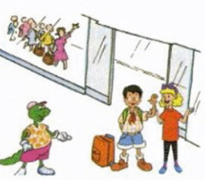
Warm-up
Li Ming is leaving for China.
The plane for Beijing will leave soon.

Slide 3
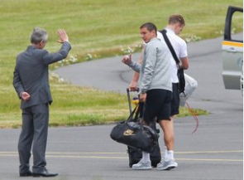
Let’s read
It's time for me to go.

Slide 4
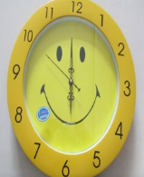
What time is it?
It is…
It's time for me to ...

Slide 5
Let’s read
the Chinese kite
I have something for you.
a little, red dragon

Slide 6
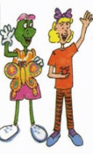
Let’s read
Don't forget to write!
Have a good trip!
Good-bye!

Slide 7
Circle the key words you learn.
forget leave
good-bye hear
dragon airport

Slide 8
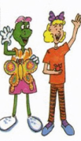
Ask and answer
1. Does Li Ming have a surprise for Danny?
Yes, he does.
2. What's the surprise?
It's a kite.
3. Why does Li Ming give Danny the surprise?
It's a good Chinese kite. Danny fly it.

Slide 9
Ask and answer
4. Does Li Ming hove a surprise for Jenny?
Yes, he does.
5. What's the surprise?
It's a little, red dragon.
6. Why does Li Ming give Jenny the surprise?
He wants Jenny to remember China.

Slide 10
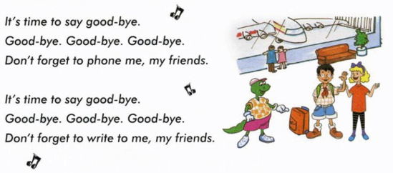
Let’s sing

Slide 11
Summary and Evaluation
What have you learned in this class?
A excellent B good C adequate D need improvement
内容 | 学生自评 | 小组互评
我能认真听老师讲课，听同学发言
遇到我会回答的问题主动举手了
活动中坚持使用英语来交际
我能积极参与小组讨论活动，能与他人合作。

Slide 12
Homework
Finish the exercise book Lesson 23.

