Slide 1
Unit6 Is this your skirt?
人教精通版三年级下册
WWW.PPT818.COM

Slide 2
Review
Let’s sing

Slide 3
Lead-in
Look and say
你能看出下列图形是什么字母吗？

Slide 4
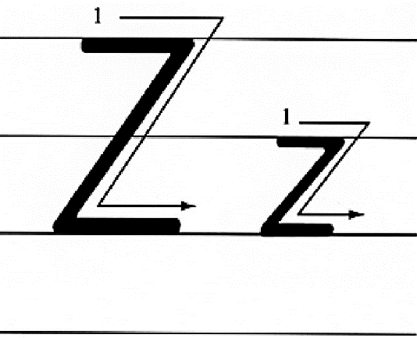
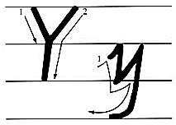
Presentation
Let’s learn

Slide 5
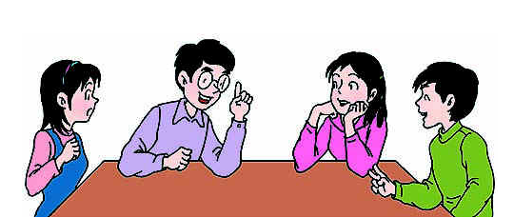
Presentation
Discussion
你都知道哪些含有字母y或z的单词呢？
boy, honey, candy, zoo …

Slide 6
Presentation
Let’s learn
yacht
yellow

Slide 7
Presentation
Let’s learn
zip
zebra

Slide 8
Practice
Game1
Magic fingers
yacht
yellow
zip
zebra

Slide 9
Practice
Game2
What’s missing?

Slide 10
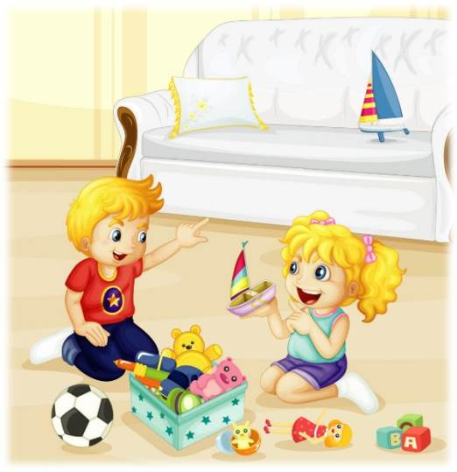
Presentation
Listen and say
Is that the girl’s yacht?
No, it isn’t.
What’s this?
This is a yacht.

Slide 11
Presentation
Let’s learn
Is that your yacht?
No, it isn’t. This is my yacht.

Slide 12
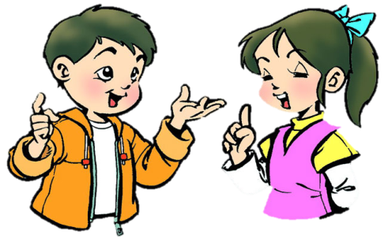
Practice
Role-play
分角色朗读对话，注意模仿语音语调。
两人一组，试着表演出来吧。

Slide 13
Presentation
Key points
Is this a zip?
No, it isn’t. This is a watch.

Slide 14
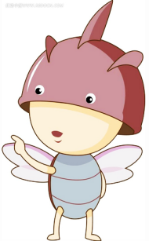
Presentation
Key points
Is that a tiger?
No, it isn’t. This is a zebra.

Slide 15
Practice
Let’s do
yacht
That is a _____.
A: Is that a taxi?
B: No, _____.
it isn’t

Slide 16
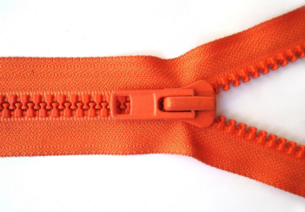
Practice
Let’s do
zip
That is a _____.
A: Is that a yacht?
B: No, _____.
it isn’t

Slide 17
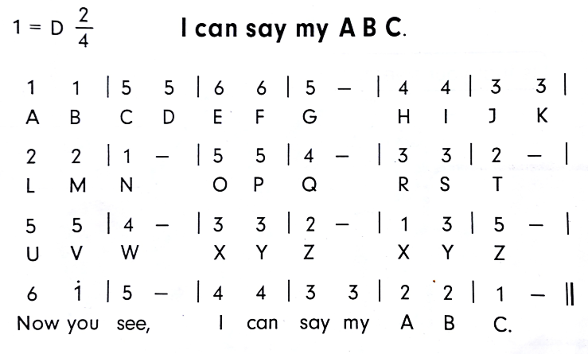
Practice
Let’s sing

Slide 18
Summary
本课学到的重点单词：
yacht
yellow
zip
zebra

Slide 19
Summary
询问那是否是某人的东西并作出否定回答，该如何表达？
—Is that your …?
—No, it isn’t.

Slide 20
Homework
1. 观看Just talk部分的课文动画，跟读对话并注意语音、语调。
2. 学会唱 Let’s sing部分的歌曲，并唱给自己的家人听。
3. 预习Lesson 35。
Close

