Slide 1
陕旅版小学英语三年级上册
Unit3 Good Morning! 第1课时
WWW.PPT818.COM

Slide 2
教学目标
1．能听懂、会说Good morning／afternoon／evening／night!并能在日常生活中灵活运用。
2．能在每天的不同时段正确使用相应 的问候语。

Slide 3
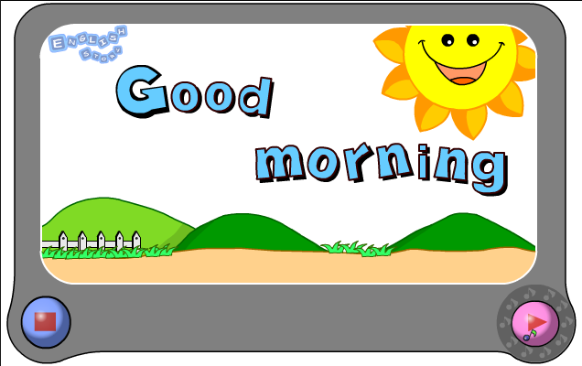
Let’s sing---Good morning!

Slide 4
Let’s read
a b c d
e f g h
i j k l m n

Slide 5
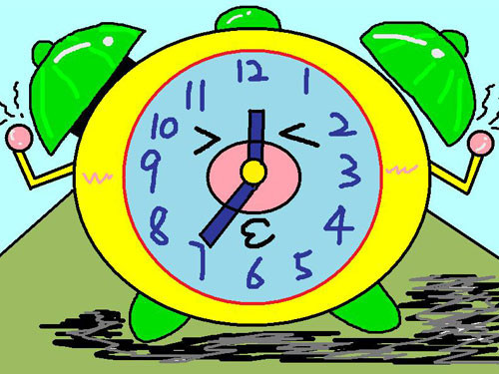
早上好！
It’s 7:00 a.m.
Good morning, boys and girls!

Slide 6
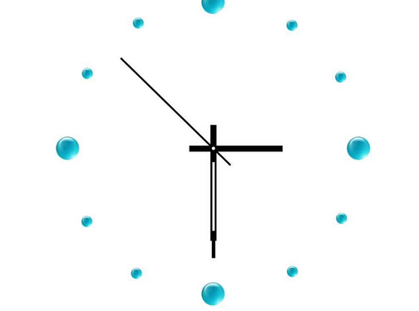
下午好！
It’s 3:30 p.m.
Good afternoon, boys and girls!

Slide 7
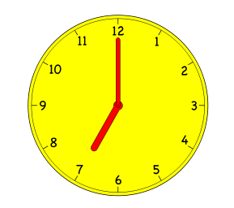
晚上好！
It’s 7:00 p.m. Good evening, boys and girls!

Slide 8
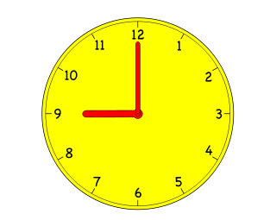
It’s 9:00 p.m. I’m very tired.
Good night, boys and girls!
晚安！

Slide 9
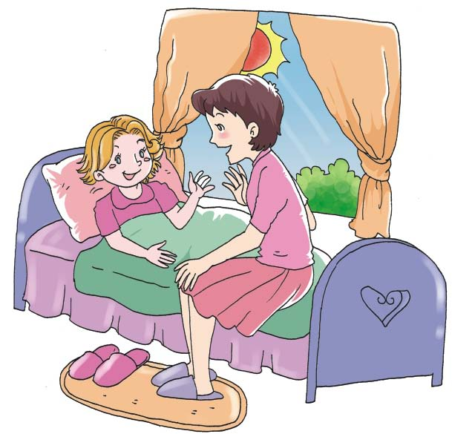
Let’s talk
Good morning, Mom!
Good morning!

Slide 10
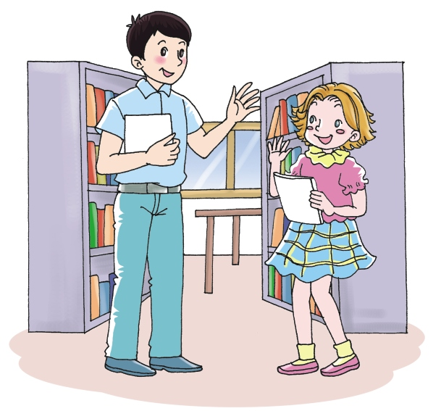
Good afternoon， Mr. Zhao!
Good afternoon!

Slide 11
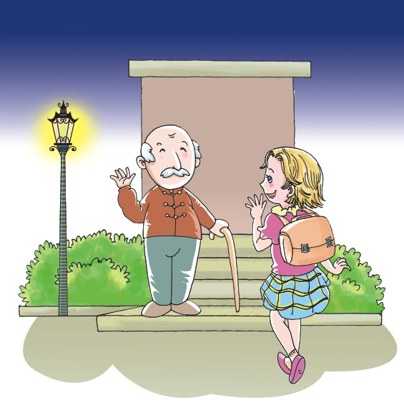
Good evening!
Good evening!

Slide 12
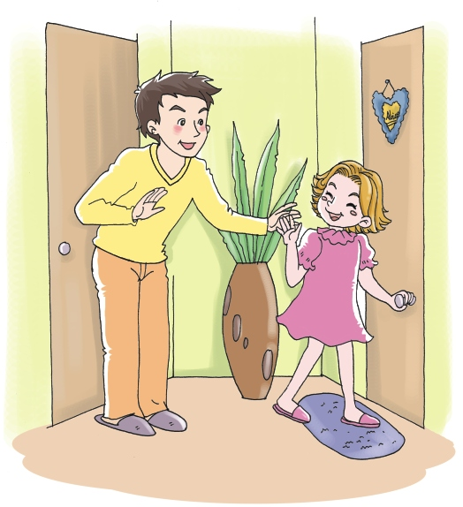
Good night, Dad!
Good night!

Slide 13
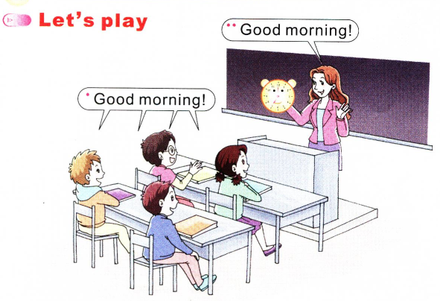

Slide 14
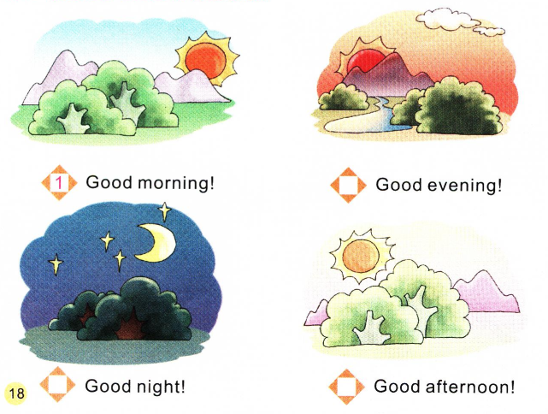
Read and number
按照从早到晚的时间为所给的图片和问候语标上正确的序号。
3
4
2

Slide 15
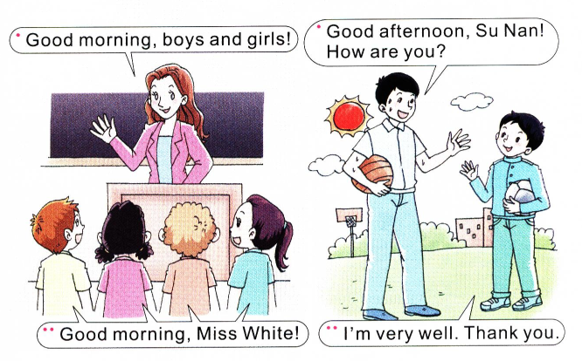
Look and say

Slide 16
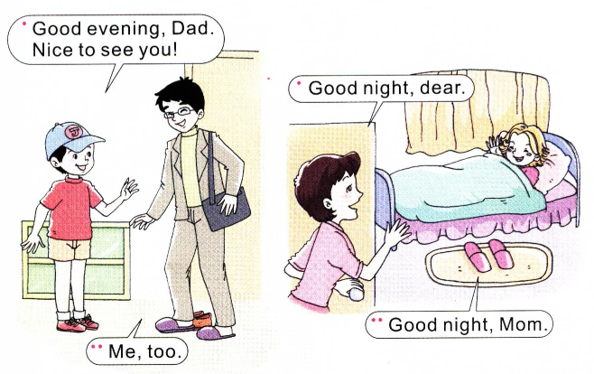
Look and say

Slide 17
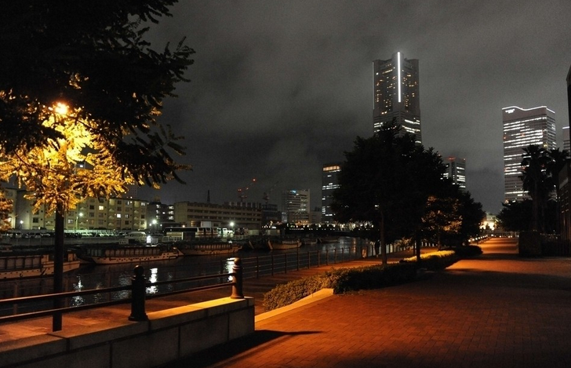
Role play演一演
morning
afternoon
evening
Good night!

