Slide 1
At school
7
第一课时
WWW.PPT818.COM

Slide 2
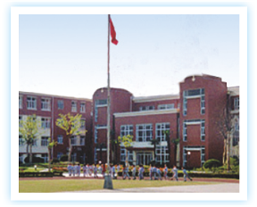
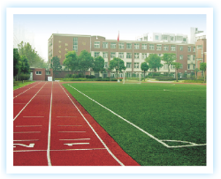
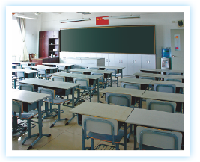
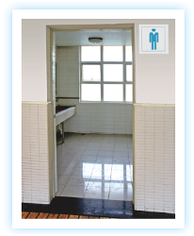
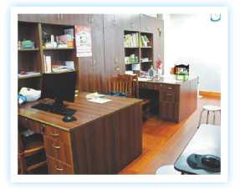
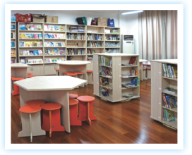
Look and say
playground
classroom
school
office
library
toilet

Slide 3
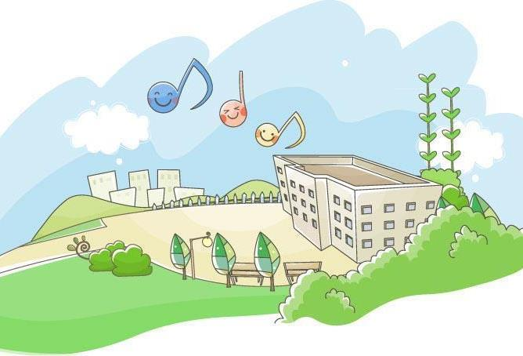
Listen and say
Welcome to our school .

Slide 4
This is the teacher’s office.
Look! Miss Fang is busy now.

Slide 5
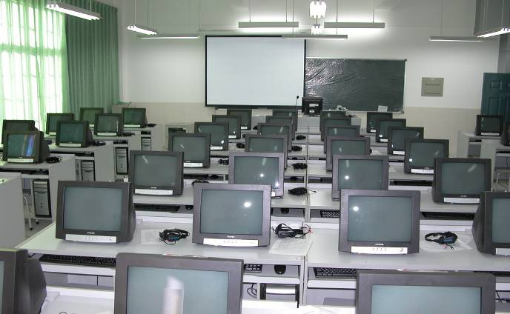
We have a computer room .
There are many computers in it .

Slide 6
This is our library.
There are many books in it.

Slide 7
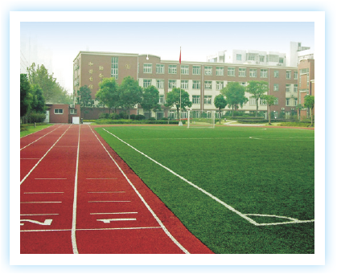
There’s a big playground in our school.
We can run and play there.

Slide 8
Think and say
A: What’s in the school?
B: There’s …
There are …

Slide 9
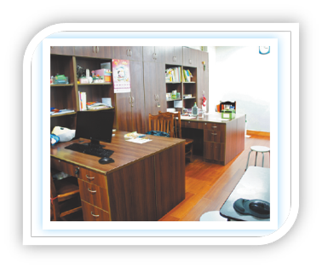
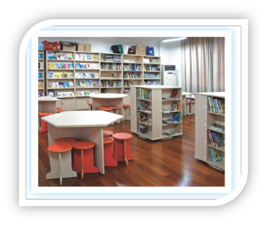
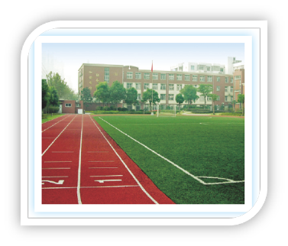
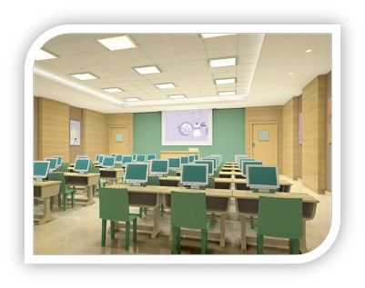
Listen and number
1
3
2
4

Slide 10
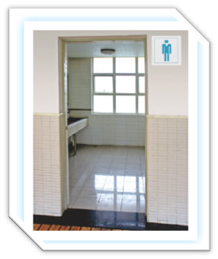
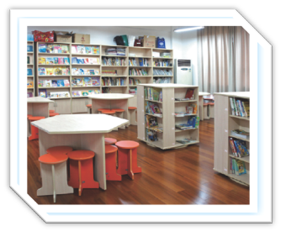
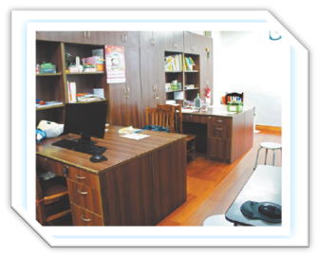
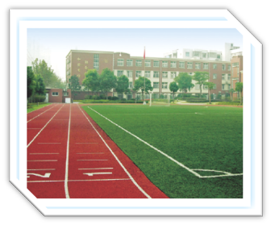
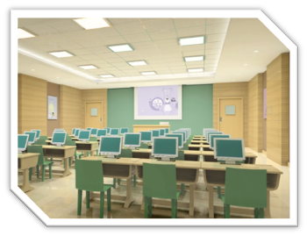
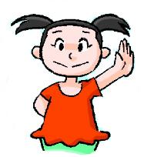
Play a game

Slide 11
Look and say
What’s this?
What’s in it?
What’s it like?
What can you do there?
What can’t you do there?
It’s …
There is/are …
It is …
We can …
We can’t …

Slide 12
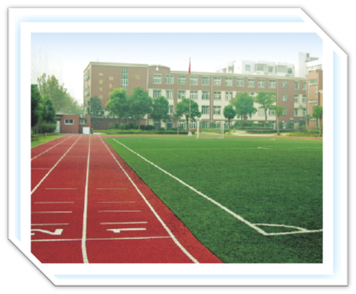
Look and say
What’s this?
What does it have?
What’s it like?
What do you like doing at the playground?

Slide 13
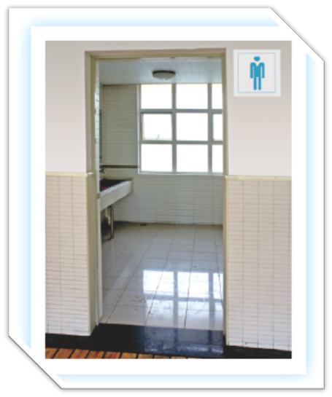
Look and say
What’s …?
What’s …?
What’s …?
What …?

Slide 14
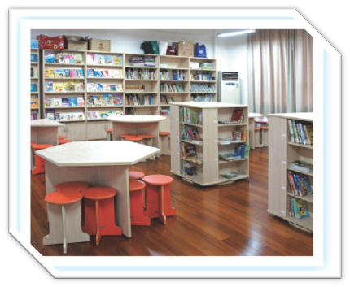
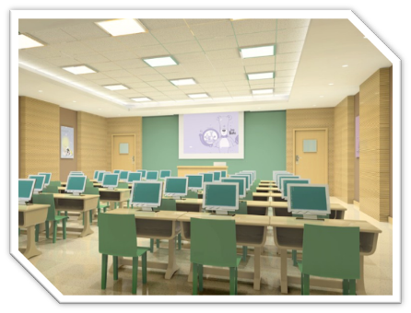
Look and say
What’s …?
What’s …?
What’s …?
What …?

Slide 15
Do a survey
My school | How many?
Classroom(s)
Toilet(s)
Teachers’ office(s)
Playground(s)
Computer room(s)

Slide 16
Listen and complete
Places | How many?
Classroom(s)
Toilet(s)
Teachers’ office(s)
Playground(s)
Computer room(s)

Slide 17
Think and say
This is a …
It is … and …
There is/are …
We can … in it, but we can’t …
I like …

Slide 18
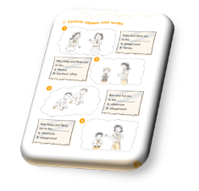
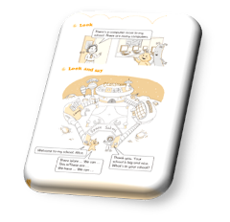
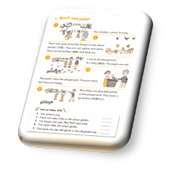
Homework
Finish the report.
Read and recite “Listen and say” on page 38.
Complete Workbook pages 39, 40 and 42.

