Slide 1
人教精通版三年级上册
Unit3 Look at my nose.
WWW.PPT818.COM

Slide 2
Warm-up
Let’s sing

Slide 3
Review
Play a game
Game
I say you do
Face, face, touch your face…

Slide 4
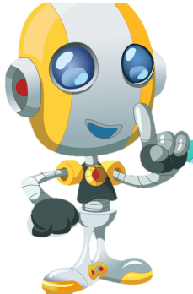
Review
Role-play
Hello! How are you?
Fine, thank you.
Oh, he has a big face.
Look at my face!

Slide 5
Presentation
Hello! How are you?

Slide 6
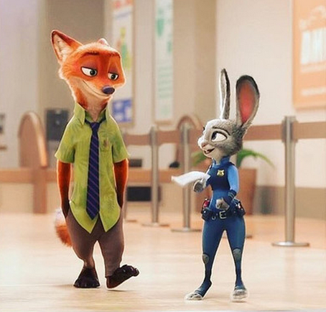
Presentation
Hello! How are you?
Fine, thank you. And you?
I’m fine, too.

Slide 7
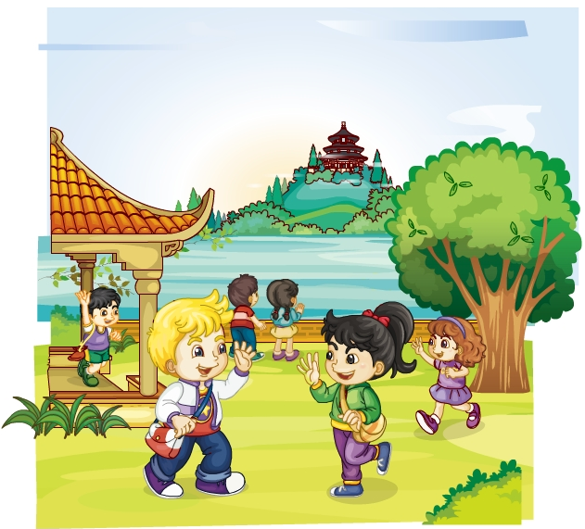
Presentation
Listen and say
猜一猜他们都说了什么呢？

Slide 8
Presentation
Listen and imitate
Hello, Li Yan! How are you?
Good! And you?
I’m fine. Thanks!

Slide 9
Show time
两人一组，练习对话并表演，其他同学评价。
 | 模仿录音中的语音语调，有感情地朗读。
 | 可以脱离课本，适当改动其中部分，语音地道。
 | 适当添加内容，意思完整，有创新，表演生动。
Good
Great
Excellent

Slide 10
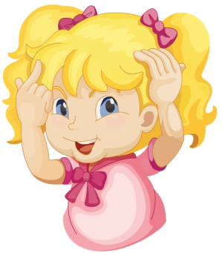
Presentation
Just learn
head
Look at my head. It’s ___.
big

Slide 11
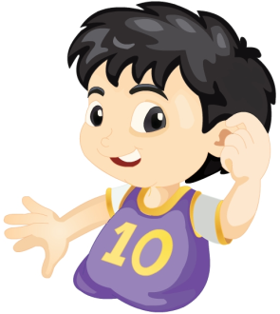
Presentation
Just learn
ear
Look at my ear. It’s ____.
small

Slide 12
Practice
What’s missing?
nose

Slide 13
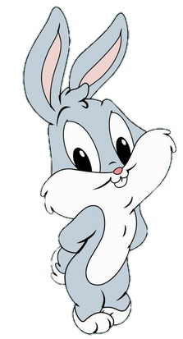
Practice
What’s missing?
ear

Slide 14
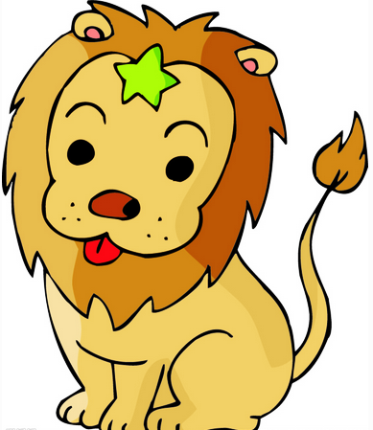
Practice
What’s missing?
mouth

Slide 15
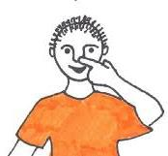
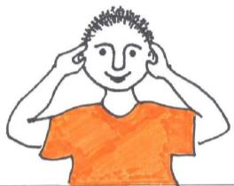
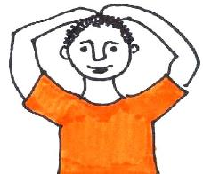
Practice
Pair-work
Listen and do
Touch your…

Slide 16
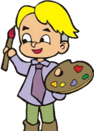
Practice
活动
蒙眼画画
活动时间：5分钟
活动内容：用眼罩把两个学生的眼睛蒙起来，教师或其他同学发指令：Draw a face. Draw two ears… 让蒙着眼睛的学生在黑板上画，然后评价谁画得最好。
展示方式：学生两人一组，到讲台上展示。

Slide 17
Consolidation
Look and match
ear
mouth
eye
head
face
nose

Slide 18
Summary
本课学习的身体部位类的单词有:
head
ear

Slide 19
Summary
如何问候别人并做相关回答呢？
—Hello! How are you?
—Good! And you?
—I’m fine. thanks!

Slide 20
Homework
1. 跟读Just talk部分的课文录音，并注意语音、语调。
2.学唱“Hello! How are you?”这首歌曲，并唱给你的父母听。
3. 预习Lesson16。
Close

