Slide 1
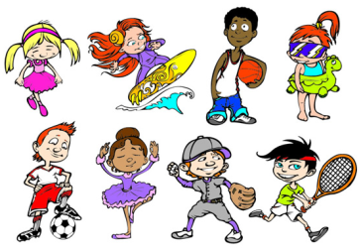
Unit4 What Do You Do on Saturday?
陕旅版
四年级下册
第四课时
WWW.PPT818.COM

Slide 2
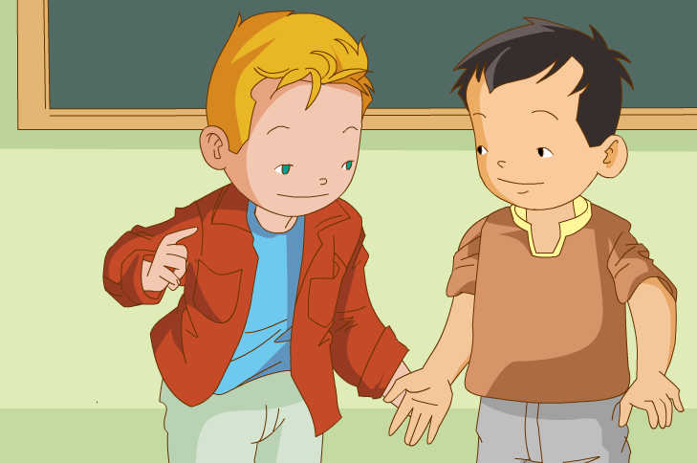
>>Warm-up
Sing a song

Slide 3
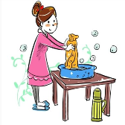
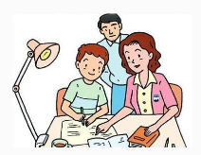
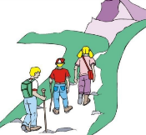
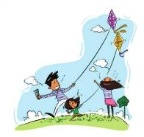
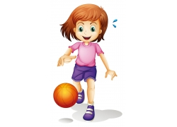
>>Review
Ask and answer
Do /Does …often …?
Yes, .../No, …

Slide 4
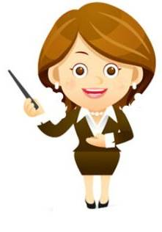
>>Review
Simon says
Fly a kite.

Slide 5
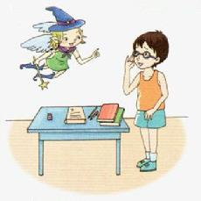
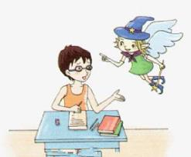
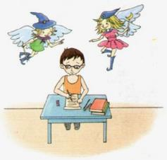
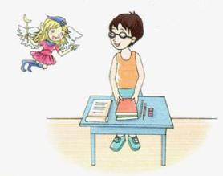
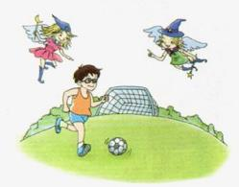
>>Presentation
Look, then ask and answer
1
2
3
4
5

Slide 6
>>Presentation
Look, then ask and answer
Q 1: Who’s in the story?
Toby and a boy.
Q 2: Does the boy often do exercise?
No, he doesn’t.
Q 3: Does the boy often do his homework?
Yes, he does.
Q 4: What is the boy doing in Picture 5?
He is doing some exercise now.

Slide 7
>>Presentation
Read a story
Listen and read
1
2
3
4
5

Slide 8
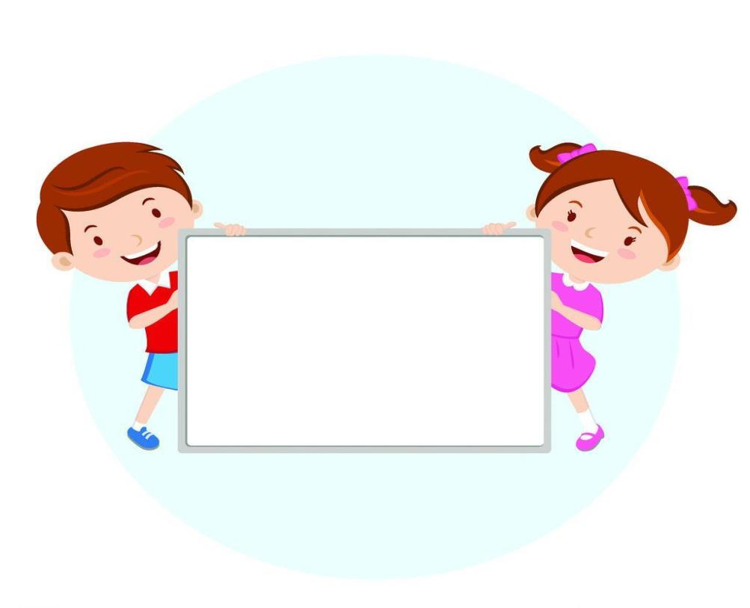
Group work（小组活动）
Make a picture book
1. Number the pictures.
2. Staple your pictures.

Slide 9
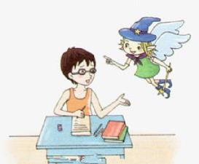
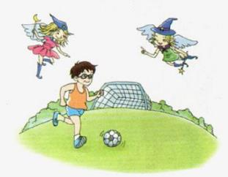
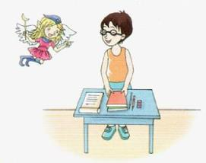
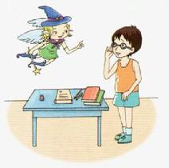
>>Practice
B
Group work
A
E
C
D
答案

Slide 10
>>Presentation
Read a story
Listen and imitate
Toby: Do you often do exercise?
Boy: No, I don’t.
Toby: What do you often do on the weekends?
Boy: I often and do my homework.
Toby: A boy!
Aggie: Let's do some exercise.
Boy: OK.
Toby: Good! He is doing some exercise now.
待在家里
stay at home
poor
可怜的,贫穷的

Slide 11
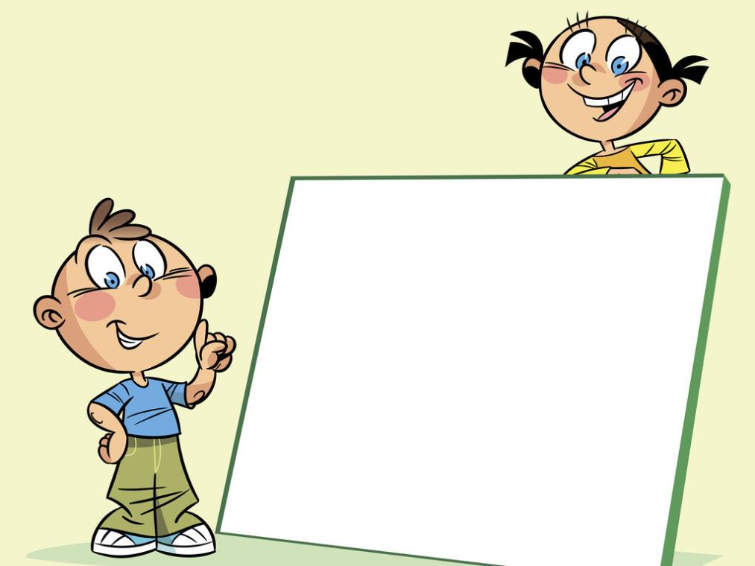
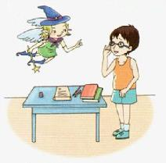
Can you retell the story?
(你能复述这个故事吗?)

Slide 12
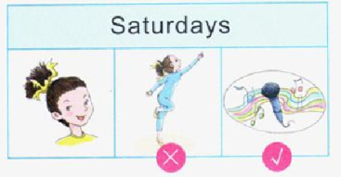
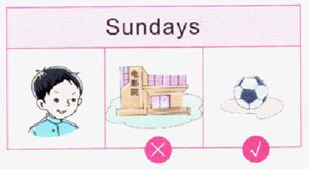
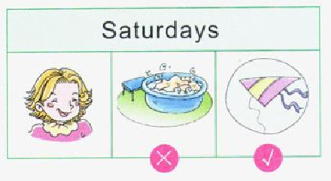
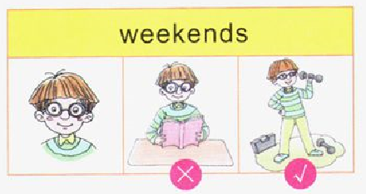
>>Practice
Look, ask and answer
A: Does … often do … on …? B: No, she/he doesn’t.
A: What does … do on …? B: She / He …

Slide 13
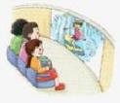
>>Practice
Look and write
I often ______ on Saturdays. And I often
_________ with my family on Sundays.
2. He often _____________ on Saturdays. And he often _______________ on Sundays.
3. We often ______________ and _________
on the weekends.
fly a kite
see a film
plays basketball
climb the mountain
do our homework
play games

Slide 14
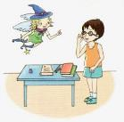
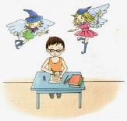
>>Summary
看图片简要复述课文内容：
2
1
3
4
5

Slide 15
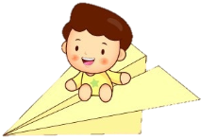
>>Homework
1.听课文录音并跟读，按照正确的语音、语调朗读并表演课文对话。 2.简要复述Read a story，并说给自己的家人听。
3.预习 Unit4 A Let’s learn。
close

