Slide 1
陕旅版英语六年级上册
Unit4 Let’s Go on a Picnic
第1课时
WWW.PPT818.COM

Slide 2
教学目标：
1. 能听、说、读、写短语：go on a picnic, take out of, put into, get to the park, meet at the gate。
2. 能在具体的语境中正确、灵活运用以上词汇。

Slide 3
Warming-up

Slide 4
Free talk
What do you often have for breakfast?
How about your dinner?

Slide 5
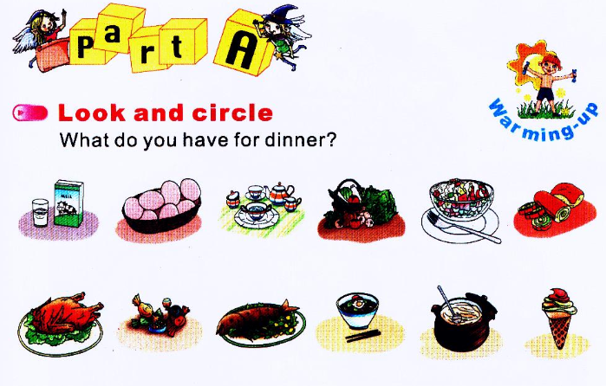

Slide 6
Do you want to go on a picnic this weekend?

Slide 7
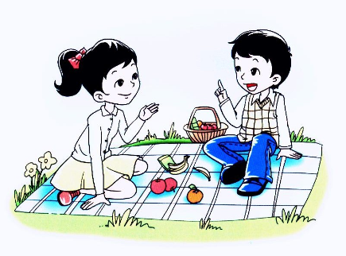
New class
Look at the picture. What are they doing?
They are going on a picnic.
go on a picnic去野餐

Slide 8
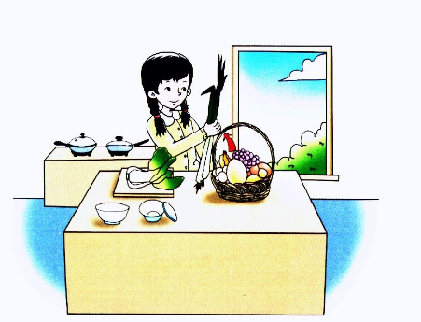
I’ll take these things out of my basket.
take out of 从……取出

Slide 9
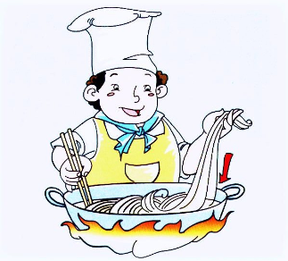
The cook is putting the noodles into the pot.
put into放入；放进……里面

Slide 10
Good to know!
Can you guess what’s the meaning of “Put your face into your pocket.” ?
不要害怕丢脸。

Slide 11
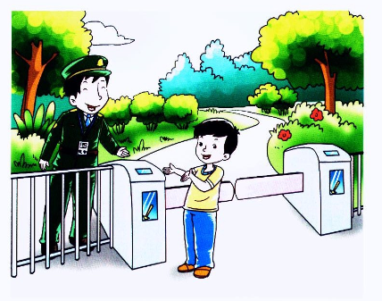
We shall get to the park early.
get to the park到达公园

Slide 12
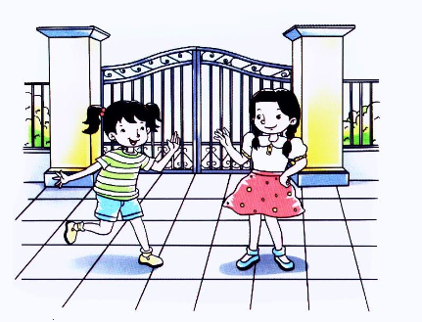
Shall we meet at the gate of the park?
meet at the gate在大门口会合

Slide 13
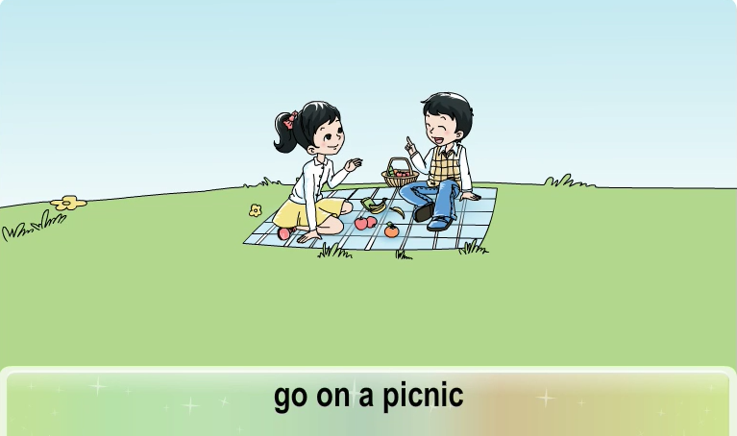
观看动画并跟读短语

Slide 14
Let’s play
Simon says
若指令为Simon says, “Put ... into ... / Take ... out of...”同学们则做动作。若没有Simon says，同学们则不做动作。

Slide 15
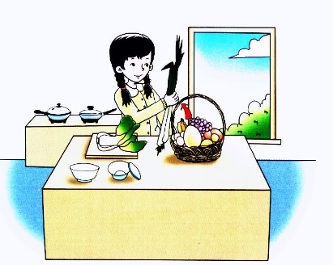
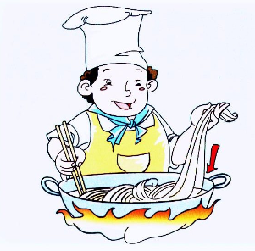
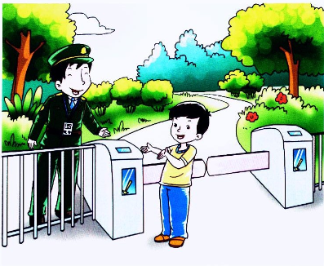
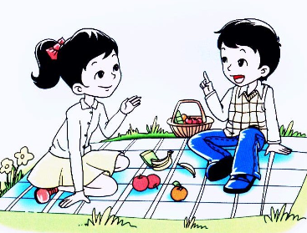
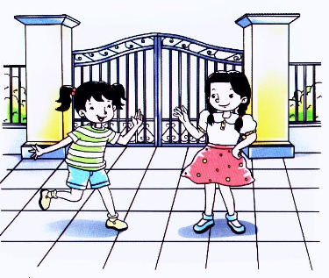
看谁说得好

