Slide 1
Unit 5
What were you doing when the
rainstorm came?
Section A 1a—2d
WWW.PPT818.COM

Slide 2
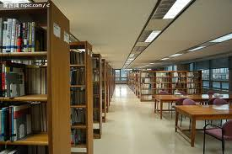

Slide 3
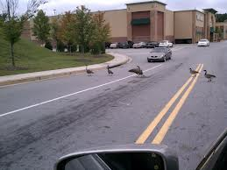
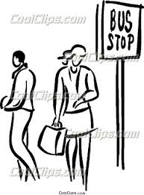
on the street
at the bus stop

Slide 4
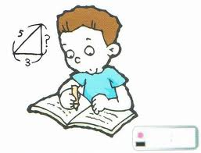
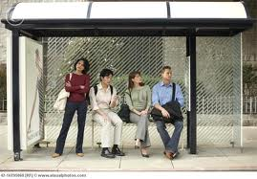
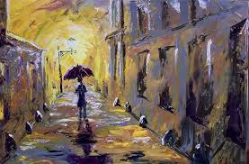
do my homework
wait for the bus
walk home

Slide 5
单词记忆风暴！
Challenge！You’re the best!

Slide 6
过去进行时
构成: was / were + doing
用法:表示过去某一时刻或某一段时间正在进行的动作, 一般用时间状语来表示。
an exact time in the past today
_____|______|_________________|______________
2012 2014
an exact period in the past today
_____|__|____|_________________|______________
2012 2014
所搭配的时间状语：when, while, at the time of, at eight last night

Slide 7
when与while的用法区别
when “当……的时候”，是at that time的意思，表示做某种动作的时间或瞬间。常与一般现在时或一般过去时连用。 When winter comes, the weather gets colder and colder. 当冬天来临时，天气变得越来越冷。 When Linda saw Davy, he was jumping with another dog. 当Linda看到Davy时，他正和另一只狗一起蹦跳着。 while “当……的时候”，是during the time的意思，表示略长的一段时间。常与现在进行时或过去进行时连用。 Mr. White was reading a newspaper while he was waiting for a bus. 怀特先生边等车边看报。 I am doing my homework while my mother is cooking. 我做作业的时候，我妈妈在做饭。

Slide 8
(1) pick up 接电话
The telephone is ringing. Would you pick it up, Bob? 电话响了。Bob，你可以接一下电话吗？
(2) help with 在……方面帮助
Thank you for your help with my English. 谢谢你帮助我学英语。

Slide 9
Homework
What were you doing at these times last Sunday? Fill in the table. Then interview two classmates.
 | You | Friend 1 | Friend 2
9:00 a.m. | run | read | have breakfast
11:30 a.m.
4:00 p.m.
9:00 p.m.

