Slide 1
Unit 2 Can you help me, please?
WWW.PPT818.COM

Slide 2
Can you help me ?
Sure, I can.
Sorry, I can't.
Thank you.
Thank you all the same.

Slide 3
1、Foundation stone
基石
2、Main building
主楼
3. Consolidation
巩固

Slide 4
1
Fundation stone

Slide 5
New words
classroom n. 教室
chicken n. 小鸡
monkey n. 猴子
help v. 帮助
know v. 知道
say v. 说

Slide 6
New phrases
Can you say that again, please?
你能再说一遍吗？
You are welcome.
不用谢。

Slide 7
Guessing game
What's this in English?

Slide 8
Listen，point and spell

Slide 9
Ask and spell

Slide 10
2
Main building

Slide 11
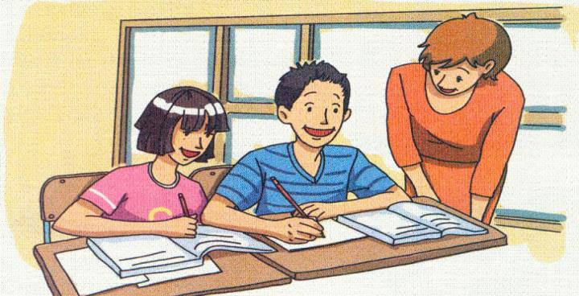
1. Where are they?
2. Who are they ?

Slide 12
Listen and answer
Who has problems and who helps him/her?

Slide 13
Listen and read
Daming: Can you help me, please, Lingling?
Lingling: Yes, of course.
Daming: How do you spell “classroom”?
Lingling: I’m sorry. I don’t know.
Miss Zhou: It’s C-L-A-S-S-R-O-O-M.
Daming: Can you say that again, please?
Miss Zhou: Yes. It’s C-L-A-S-S-R-O-O-M.
Daming: Thank you.
Miss Zhou: You’re welcome.

Slide 14
Have a review
1. Can you help me, please？
2. How do you spell it?
3. Can you say that again,please?

Slide 15
3
Consolidation

Slide 16
Read and match.
1. Can you help me, please?
2. How do you spell “ desk ”?
3. Can you say that again, please?
4. Thank you.
a ) You’ re welcome.
b) Yes, D-E-S-K.
c) It’s D-E-S-K.
d) Yes. Of course.
d
c
b
a

Slide 17
A: Can you help me, please?
B: Yes, of course.
A: What's this in English?
B: It's a ...
A: How do you spell it?
B: It’s ...
A: Can you say that again, please?
B: Yes. It’s ...
A: Thank you.
B: You’re welcome.
Act 1 : Imitation

Slide 18
When do we have problems and who can we ask for help?
Act 2 :
In life
In study
In life
Ask teachers
Ask classmates
Ask parents
Ask strangers
In class
After class
At home
On the road

Slide 19
Narrotor（旁白）：We are in/after/at/on....
A: Can you help me, please?
B: Yes, of course.
A: How ...
B: I’m sorry. I don’t know.
A: Thank you all the same.
C: Can you help me, please?
D :Yes, of course.
C: How...
D: ...
C: Can you say that again, please?
D: Yes....
C: Thank you.
D: You’re welcome.
Example

Slide 20
Narrotor（旁白）：We are on the road
A: Can you help me, please?
B: Yes, of course.
A: How can I get to the Tianehu Lake?
B: I’m sorry. I don’t know.
A: Thank you all the same.
C: Can you help me, please?
D :Yes, of course.
C: How can I get to the Tianehu Lake
D: Walk along this way and turn left.
C: Can you say that again, please?
D: Yes.Walk along this way and turn left.
C: Thank you.
D: You’re welcome.
Example

Slide 21
After class’s consolidation
Imagine a place where you need ask for help and think about who you can ask for help. Then act it out by making a dialogue with classmates.

Slide 22
Thank you

