Slide 1
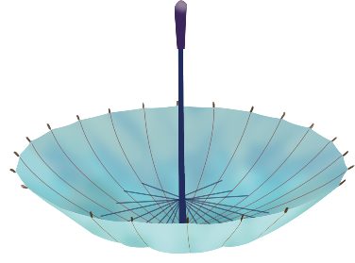
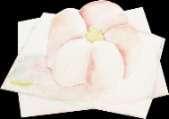
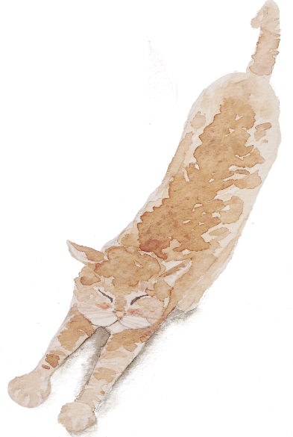
简约风
PPT商务通用模板
单击此处输入公司名称
主讲人:PPT818

Slide 2
单击此处输入标题文本
单击此处输入标题文本
单击此处输入标题文本
单击此处输入标题文本
目 录

Slide 3
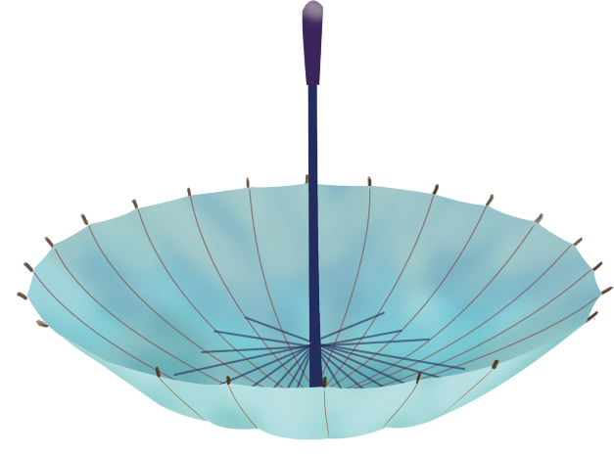
Part.01
单击此处输入标题文本

Slide 4
单击此处输入标题文本
单击此处输入标题文本
02
Good love makes you see the whole world from one person while bad love makes you abandon the whole world for one person.
单击此处输入标题文本
Good love makes you see the whole world from one person while bad love makes you abandon the whole world for one person.
01
单击此处输入标题文本
04
Good love makes you see the whole world from one person while bad love makes you abandon the whole world for one person.
单击此处输入标题文本
03
Good love makes you see the whole world from one person while bad love makes you abandon the whole world for one person.

Slide 5
单击此处输入标题文本
Good love makes you see the whole world from one person while bad love makes you abandon the whole world for one person.
单击此处输入标题文本
Good love makes you see the whole world from one person while bad love makes you abandon the whole world for one person.
Good love makes you see the whole world from one person while bad love makes you abandon the whole world for one person.
Good love makes you see the whole world from one person while bad love makes you abandon the whole world for one person.
Love makes man grow up or sink down.
Love makes man grow up or sink down.

Slide 6
单击此处输入标题文本
单击此处输入标题文本
Good love makes you see the whole world from one person while bad love makes you abandon the whole world for one person.
单击此处输入标题文本
Good love makes you see the whole world from one person while bad love makes you abandon the whole world for one person.
单击此处输入标题文本
单击此处输入标题文本
Good love makes you see the whole world from one person while bad love makes you abandon the whole world for one person.
Good love makes you see the whole world from one person while bad love makes you abandon the whole world for one person.

Slide 7
单击此处输入标题文本
1.
单击此处输入标题文本
3.
单击此处输入标题文本
Good love makes you see the whole world from one person while bad love makes you abandon the whole world for one person.
Good love makes you see the whole world from one person while bad love makes you abandon the whole world for one person.
Good love makes you see the whole world from one person while bad love makes you abandon the whole world for one person.
2.
单击此处输入标题文本
Good love makes you see the whole world from one person while bad love makes you abandon the whole world for one person.

Slide 8
Part.02
单击此处输入标题文本

Slide 9
单击此处输入标题文本
单击此处输入标题文本
01
Good love makes you see the whole world from one person while bad love makes you abandon the whole world for one person.
Good love makes you see the whole world from one person while bad love makes you abandon the whole world for one person.
Good love makes you see the whole world from one person while bad love makes you abandon the whole world for one person.
单击此处输入标题文本
02
Good love makes you see the whole world from one person while bad love makes you abandon the whole world for one person.
单击此处输入标题文本
03
Good love makes you see the whole world from one person while bad love makes you abandon the whole world for one person.

Slide 10
单击此处输入标题文本
Good love makes you see the whole world from one person while bad love makes you abandon the whole world for one person.
Good love makes you see the whole world from one person while bad love makes you abandon the whole world for one person.
单击此处
输入文本
单击此处
输入文本
单击此处
输入文本
Good love makes you see the whole world from one person while bad love makes you abandon the whole world for one person.
单击此处
输入文本
Good love makes you see the whole world from one person while bad love makes you abandon the whole world for one person.

Slide 11
单击此处输入标题文本
单击此处输入标题文本
Good love makes you see the whole world from one person while bad love makes you abandon the whole world for one person.
Good love makes you see the whole world from one person while bad love makes you abandon the whole world for one person.

Slide 12
单击此处输入标题文本
Good love makes you see the whole world from one person while bad love makes you abandon the whole world for one person.
Good love makes you see the whole world from one person while bad love makes you abandon the whole world for one person.
Good love makes you see the whole world from one person while bad love makes you abandon the whole world for one person.
Good love makes you see the whole world from one person while bad love makes you abandon the whole world for one person.

Slide 13
单击此处输入标题文本
01
Good love makes you see the whole world from one person while bad love makes you abandon the whole world for one person.
02
Good love makes you see the whole world from one person while bad love makes you abandon the whole world for one person.
03
Good love makes you see the whole world from one person while bad love makes you abandon the whole world for one person.
04
Good love makes you see the whole world from one person while bad love makes you abandon the whole world for one person.

Slide 14
Part.03
单击此处输入标题文本

Slide 15
单击此处输入标题文本
Good love makes you see the whole world from one person while bad love makes you abandon the whole world for one person.

Slide 16
单击此处输入标题文本
Good love makes you see the whole world from one person while bad love makes you abandon the whole world for one person.
Good love makes you see the whole world from one person while bad love makes you abandon the whole world for one person.
输入标题
Good love makes you see the whole world from one person while bad love makes you abandon the whole world for one person.

Slide 17
单击此处输入标题文本
Good love makes you see the whole world from one person while bad love makes you abandon the whole world for one person.
01
04
Good love makes you see the whole world from one person while bad love makes you abandon the whole world for one person.
Good love makes you see the whole world from one person while bad love makes you abandon the whole world for one person.
02
05
Good love makes you see the whole world from one person while bad love makes you abandon the whole world for one person.
Good love makes you see the whole world from one person while bad love makes you abandon the whole world for one person.
03
06
Good love makes you see the whole world from one person while bad love makes you abandon the whole world for one person.

Slide 18
单击此处输入标题文本
Good love makes you see the whole world from one person while bad love makes you abandon the whole world for one person.
Good love makes you see the whole world from one person while bad love makes you abandon the whole world for one person.
Good love makes you see the whole world from one person while bad love makes you abandon the whole world for one person.
Good love makes you see the whole world from one person while bad love makes you abandon the whole world for one person.

Slide 19
Part.04
单击此处输入标题文本

Slide 20
单击此处输入标题文本
01
02
03
单击此处输入标题文本
单击此处输入标题文本
单击此处输入标题文本
Good love makes you see the whole world from one person while bad love makes you abandon the whole world for one person.
Good love makes you see the whole world from one person while bad love makes you abandon the whole world for one person.
Good love makes you see the whole world from one person while bad love makes you abandon the whole world for one person.

Slide 21
单击此处输入标题文本
单击此处输入标题文本
单击此处输入标题文本
Good love makes you see the whole world from one person while bad love makes you abandon the whole world for one person.
Good love makes you see the whole world from one person while bad love makes you abandon the whole world for one person.
输入标题
Good love makes you see the whole world from one person while bad love makes you abandon the whole world for one person.

Slide 22
单击此处输入标题文本
单击此处输入标题文本
Good love makes you see the whole world from one person while bad love makes you abandon the whole world for one person.
单击此处输入标题文本
Good love makes you see the whole world from one person while bad love makes you abandon the whole world for one person.
单击此处输入标题文本
Good love makes you see the whole world from one person while bad love makes you abandon the whole world for one person.

Slide 23
单击此处输入标题文本
单击此处输入标题文本
单击此处输入标题文本
单击此处输入标题文本
Good love makes you see the whole world from one person while bad love makes you abandon the whole world for one person.
Good love makes you see the whole world from one person while bad love makes you abandon the whole world for one person.
Good love makes you see the whole world from one person while bad love makes you abandon the whole world for one person.

Slide 24
单击此处输入标题文本
单击此处输入标题文本
单击此处输入标题文本
单击此处输入标题文本
Love makes man grow up or sink down.
Love makes man grow up or sink down.
Love makes man grow up or sink down.
单击此处输入标题文本
单击此处输入标题文本
单击此处输入标题文本
Love makes man grow up or sink down.
Love makes man grow up or sink down.
Love makes man grow up or sink down.

Slide 25
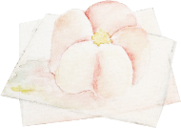
谢谢观看
Thank you for watching
单击此处输入公司名称
主讲人:PPT818

