Slide 1
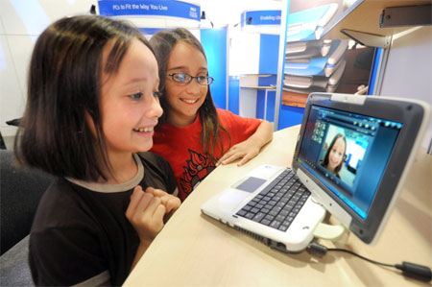
Module 4 Life in the future
Unit 1 Everyone will study at home.
WWW.PPT818.COM

Slide 2
Studying aims：
1. 能够掌握本课重点词汇及短语 in the future, be able to ... 。
2. 能够理解关于学校未来生活的对话。
3. 能够用will (will +do/will +be ) 谈论未来的学校生活。

Slide 3
Free talk
A: What do you use to study now？
B: I use …
A: What will you use to study in twenty years’ time?
B: I will use …

Slide 4
Words and expressions
7. carry ['kærɪ]
8. change [tʃeɪn(d)ʒ]
9. need [niːd]
10. ask [ɑːsk]
11. will [wɪl]
12. able ['eɪb(ə)l]
13. free [friː]
14. more [mɔː]
15. everything ['evrɪθɪŋ]
16. by [baɪ]
17. maybe ['meɪbi]
18. not … any more
19. be able to
20. in the future
v. 拿；带
v. & n. 改变；变化
v.&. v. aux. 需要
v. 询问；问
v. aux. 将；将要；将会
adj. 能够……的
adj. (时间) 空闲的；
adv. 更加；adj. 更多的
pron. 每样事物；每件事；
prep. 用；靠；乘
adv. 也许
不再……
能够做……
将来
1. chalk [tʃɔːk]
2. ruler ['ruːlə]
3. future ['fjuːtʃə]
4. life [laɪf]
5. question ['kwestʃ(ə)n]
6. level ['lev(ə)l]
n. 粉笔
n. 直尺
n. 将来；未来
n. 生活；生命
n. 问题
n. 水平

Slide 5
My dream school
Do you want to know Lingling’s ideas about the future？
?

Slide 6
Listen and choose Lingling’s answers to the questions.
carry change everything future life need will
Will our life be different in the future?
Will our schools change?
Yes, it will. / No, it won’t.
Yes, they will. / No, they won’t.
Will everything be different?
Will students need computers at school?
Will they carry lots of books to school?
Yes, it will. / No, it won’t.
Yes, they will. / No, they won’t.
Yes, they will. / No, they won’t.

Slide 7
Will schools be different in the future?
Lingling's idea
Daming's ideas
_____________
_____________
Betty's ideas
_________________
_________________
Tony's ideas
______________
______________
Schools in the future will be great.
Schools will be different in the future.
Betty is not sure about the answer to the question.
Schools will be different in the future.
will use computers,
won't use chalk
There won't be
Students __________________
_________________________
Teachers _________________
__________________
Schools:_______________
____________
any schools.
but school is good fun.
on a blackboard
can make friends there.
won't use pens
Everyone_______________
and students _______________
_______________________________________
will study at home.
and they ________________________
and paper, or erasers
will use computers
any more.
Students _________________
and _____________________
_____________
They ____________________ ________________________
______________________
get information on
can check the students'
Teachers __________________________
___________________________
a lot of
Students won't have________
_________________
and they will have _________
__________
the Internet.
level and will help them.
homework to do.
a lot of
can ask their teachers
won't be able to do that.
questions by Internet,
Computers__________________________
free time.
telephone, or email.

Slide 8
Read and Role-play
Let’s see which group does the best.
loudly 响亮地 fluently 流利地 beautifully 优美地

Slide 9
Will schools be different in the future?
Daming's ideas
_____________
Betty's ideas
_______________
Tony's ideas
______________
be different
is not sure about...
be different
not be any schools
study at home
use computers and
get information on the Internet
ask their teachers questions by Internet...
use computers
but ... good fun
make friends
check the students'
level and ...
not be able to do ...
not use chalk ...
not use pens and paper, or erasers any more
not have a lot of homework to do
have a lot of free time
Ms Li and her students are talking about the school in the future.
...thinks ... will / can ...
The school life in the future will be (great)...!

Slide 10
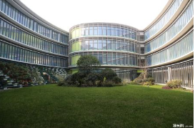
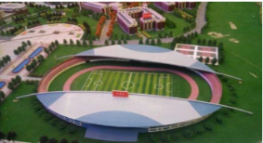
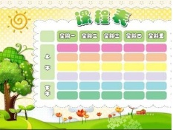
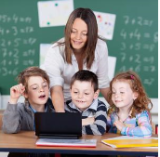
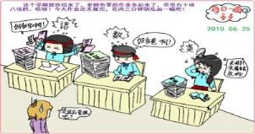
Work in groups
Talk about what our school will be like in 10 years.
buildings
playground
subjects
teacher/classmates
homework

Slide 11
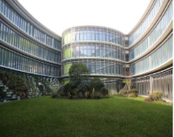
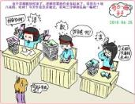
In the future, (I think) ……
There will be... There won’t be...
We will... We won’t...
I/Everyone will... No one will...
Student A: What will our school be like in ten years?
Students B: I think ...
Students C: We will...
Students D: ...
Students E: ...
Students F : ...
Students A: I think it will be (fantastic)...
buildings
playground
subjects
teacher/classmates
homework

Slide 12
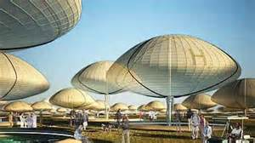
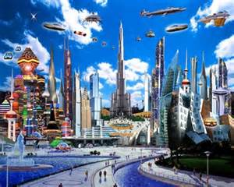
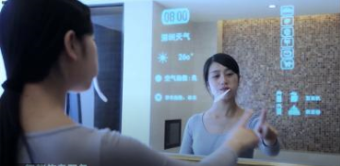
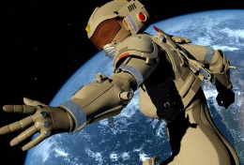
Life is changing. And tomorrow will be better.
生活日新月异，明天一定会更好。

Slide 13
课后测
able level telephone need make because
Betty thinks students always ______ teachers _____computers will never be _____ to check the students’ ______ and answer their questions by __________ or the Internet. Students need to go to school. Because school is good fun, and they can ________ friends there.

