Slide 1
Unit2 I’m in Class One, Grade Three.
人教精通版三年级下册
WWW.PPT818.COM

Slide 2
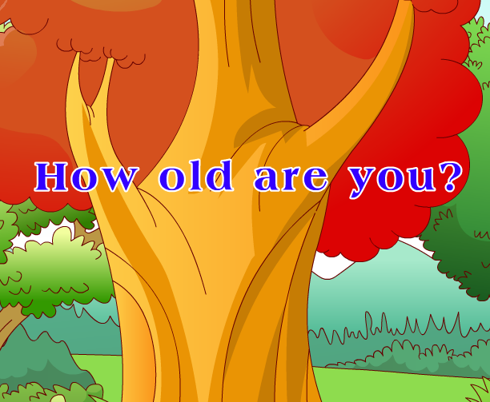
Let’s sing
Warm-up
（单击图片可播放动画）

Slide 3
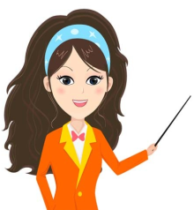
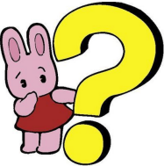
Lead-in
Free talk
How old are you?
I’m …

Slide 4
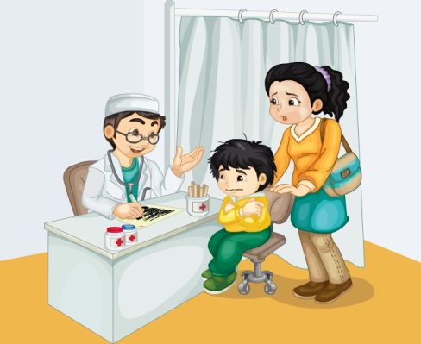
Presentation
Look and guess
How old is the boy? Can you guess?

Slide 5
Presentation
Listen and order
1
Good morning. What’s your name?
My name’s
Gao Wei.
2
3
How old are you?
I’m eight.
4

Slide 6
Presentation
Look and read
（单击图片可播放动画）

Slide 7
Practice
Let’s read
录音 | 课文句子
M: Good morning. What’s your name?
G: My name’s Gao Wei.
M: How old are you?
G: I’m eight.

Slide 8
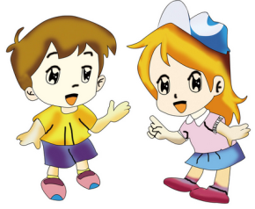
Practice
根据自己的情况，选择来做吧！
Role-play
Level1: 分角色朗读对话，注意模仿语音语调。
Level2: 四人一组，试着表演出来吧。

Slide 9
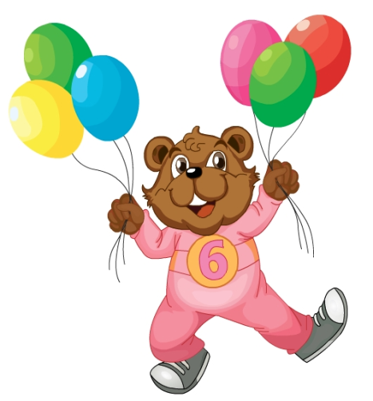
Presentation
Let’s learn
six

Slide 10
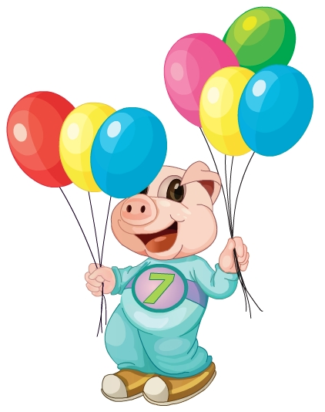
Presentation
Let’s learn
seven

Slide 11
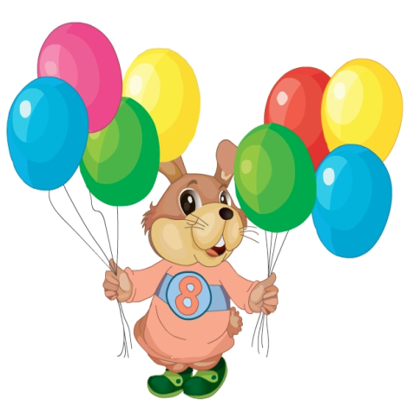
Presentation
Let’s learn
eight

Slide 12
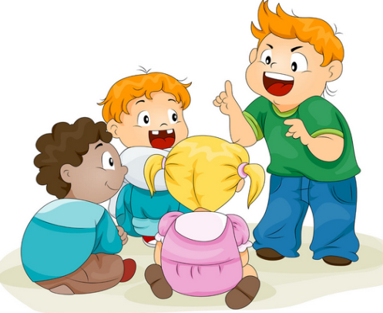
Practice
活动1
找邻居
seven
eight
six

Slide 13
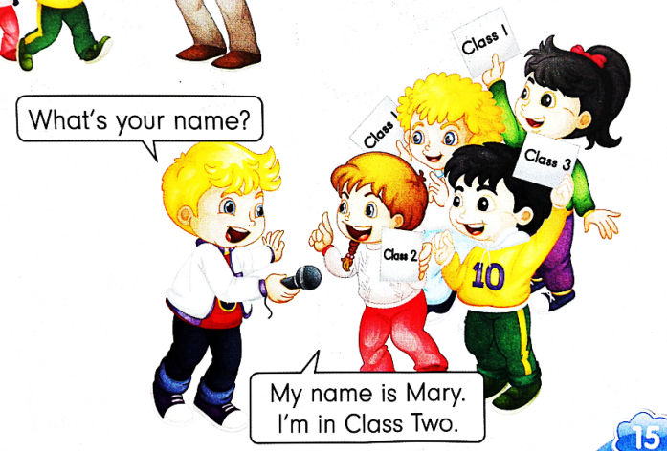
Practice
活动2
访谈活动
7
What’s your name? How old are you?
7
6
5
8
8
6
9
My name’s …, I’m …

Slide 14
Summary
1. 本课学习的数字有哪些？
six
seven
eight
2. 本课的重点句型是什么？
How old are you?
I’m …

Slide 15
Homework
1. 跟读课Just talk部分的录音，注意语音、语调。
2. 回家后用How old are you?询问父母的年龄。
3. 预习Lesson 10。
Close

