Slide 1
U2 The weather is fine all year round
M10 Weather
WWW.PPT818.COM

Slide 2
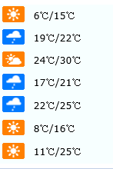
Revision
A: What’s the weather like in… ？
B: It’s…
A: What’s the temperature?
B: It’s between… and… degrees.

Slide 3
Revision
A: What will the weather probably be like in Jiaxing on… ？
B: It will probably be… and the temperature will be between… and…
A: We had better bring …/ wear … , because…

Slide 4
When is the best time to travel around Hangzhou?
A: When is the best time to travel around Hangzhou?
B: The best time to travel around Hangzhou is in… , because…
A: What’s the weather like in Hangzhou in summer / autumn / May/ December…?
B: It’s usually sunny and hot …in Hangzhou in summer/ winter…
So we had better bring … / wear…
flowers come out /trees turn green …
lotus flowers
leavers turn gold then brown …
moon on the peaceful lake in autumn
There might be a lot of snow…

Slide 5
pre- reading
Is the US a very big country?
Do you know any famous cities or states or areas in the US?

Slide 6
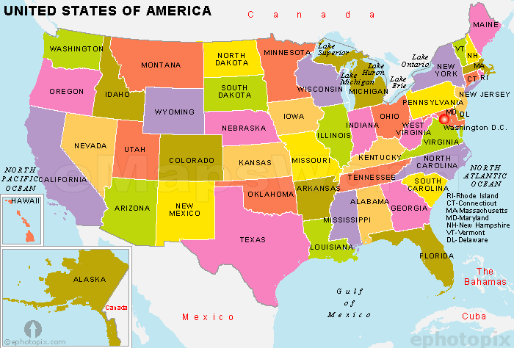
It is about 3, 000 miles (英里) (shanghai- Xinjiang 3200 miles)
Choose carefully about the places to see and the time to go.

Slide 7
Reading and vocabulary
What can you see in the pictures?
What season is it?
What is the weather probably like?

Slide 8
Fast reading
Q 1: Where can you probably see this article?
a story book B. a US history book C. a travelling magazine
Q 2: How many places are mentioned here?
√
Seven.
New York and Washington DC
New England
California
Seattle
Alaska
Texas and the southeast
√
________
√
________
________

Slide 10
Complete the table.
Place | Weather | Best time to go | Things to bring
New York | Winter
New England
California
Alaska | Summer: Winter:
in May or October
a lot of snow
it gets cooler in September
in September
a camera
fine all year round
swimming clothes
all year
days long and warm, cool in the evening
a warm sweater
in summer
very cold

Slide 11
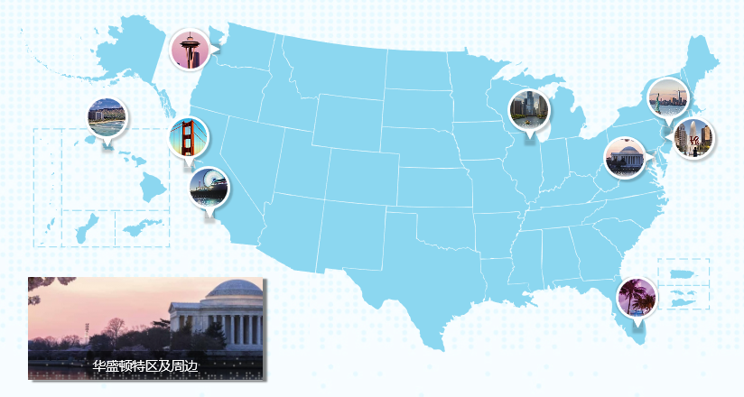
6. Alaska
3. New England
5. Seattle
1. New York
2. Washington DC
4. California
7. Texas

Slide 12
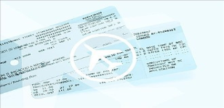
6. Alaska
3. New England
5. Seattle
1. New York
2. Washington DC
4. California
7. Texas
free

Slide 13
New York and Washington DC are good places_________ in _____or ________. But in winter there is ____________.
to visit
May
October
a lot of snow

Slide 14
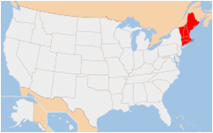
New England
The best time to visit New England is__________ (month). The weather_______________, and the leaves start to_____________________. Bring your __________ so you can ___________of the _______________.
in September
gets cooler
turn gold then brown
camera
take photos
autumn trees

Slide 15
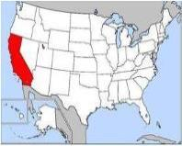
California
California is on____________, and the weather is fine____________. Take your_______________
because you might____________________, even in _______________
the Pacific coast
all year round
swimming clothes
want to go swimming in the sea
December

Slide 16
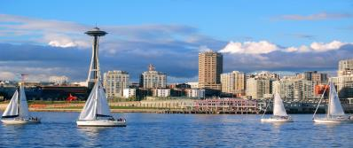
Rainy days
150 /365d
Seattle
northwest
In Seattle, in the___________, it is not very cold but_______________, so bring _______________.
it rains a lot
an umbrella

Slide 17
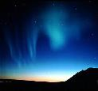
In winter, it can be ________. Don’t forget to _______________
very very cold
bring a very warm sweater with you.
Alaska
Dog race
4~16℃ summer
-7~ -29 ℃ winter
Polar light
In summer, the days are_______ and________, but may be______ in the evening.
If you want to visit Alaska, you’d better go in ____________
long
warm
summer
cool

Slide 18
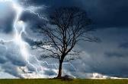
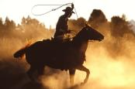
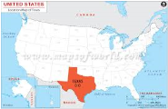
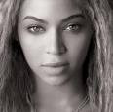
Texas and the southeast
对比
very hot and sunny
storms from time to time
It is usually _______________ compared to other places. There are
_____________________in summer and autumn.

Slide 19
Let’s talk When is the best time to visit … ?
Harbin
Shanghai
Hainan island
Your friend Betty wants to visit China. But she doesn’t know what is the weather like in China. China is the second largest country in the world. Could you help her to choose carefully the places to see and the time to go? Please give her some suggestions.
what’s the weather like there?
What can you do there?
What should you bring or wear? Why?
words you may need
a pair of sunglasses
down [daun] coat 羽绒衣
boots 长筒靴
warm sweater

Slide 20
Life is a journey to experience to learn and to enjoy..

