Slide 1
Unit 10
You’re supposed to shake hands.
Section B (第1课时)
WWW.PPT818.COM

Slide 2
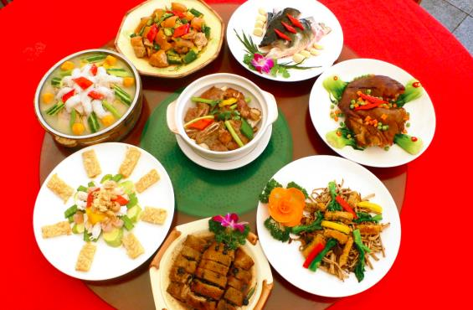
Warming up
Do you know some table manners in China?

Slide 3
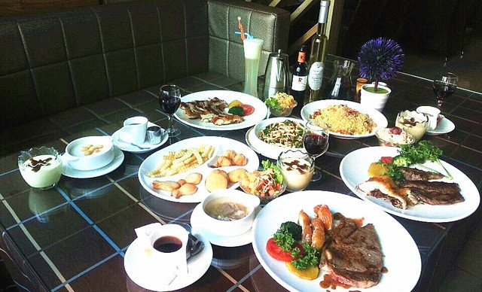
Do you know some table manners in America?

Slide 4
How much do you know about table manners around the world? Take the following quiz. Circle T for true or F for false after each sentence.
1a
Mind your manners!
1.In India,you're supposed to eat with your hands. T F
2.In China,you're not supposed to stick your chopsticks into the
food. T F
3.In Korea,the youngest person is expected to start eating first.
T F
4.In France,you're supposed to put your bread on the table.
T F
5.In China, it's impolite to use your chopsticks to hit an empty
bowl. T F

Slide 5
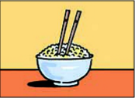
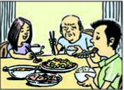
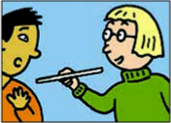
Steve is going to China to study.His friend Yang Ming is telling him about the table manners in China.Listen and number the pictures in the order you hear them.
1b
2
1
3

Slide 6
1c
Listen again. Match these sentence parts.
________1.You’re not supposed to... a.stick your chopsticks into your food.
________2.It’s impolite to... b. point at anyone with your chopsticks.
________3.You shouldn’t... c.start eating first if there are older
people at the table.
c
a
b

Slide 7
1d
Talk about other table manners in your country.
A: We're supposed to...
B: Yes,and it's impolite to...

Slide 8
2a
What do you know about customs in foreign countries? What do you think is the biggest challenge when visiting a foreign country?
e.g. My cousin went to America,and she said that learning basic table manners was her biggest challenge.She never knew what she was supposed to do at the dinner table.

Slide 9
2b
Read the letter and answer the questions.
1.Why is Lin Yue in France?
2.Does she enjoy staying with her host family?How do you know?
3.How does she feel about making mistakes when she speaks French?
4.What is the biggest challenge she is facing?
Because she is on a student exchange program in France.
Yes,she does.She says her host family is really nice and they go out of their way to make her feel at home.
It doesn't worry her as it used to.
Her biggest challenge is learning how to behave at the dinner table.

Slide 10
Dear Laura,
Thanks for your message.Yes,I'm having a great time on my student exchange program in France.I was a bit nervous before I arrived here,but there was no reason to be.My host family is really nice.They go out of their way to make me feel at home.The grandmother knows that I miss Chinese food a lot. So she actually learned how to make Chinese food! She also has a teenage granddaughter about my age who is really kind.She always talks to me in French to help me practice.You wouldn’t believe how quickly my French has improved because of that. I’m very comfortable speaking French now.Although I still make lots of mistakes,it doesn’t worry me like it used to.

Slide 11
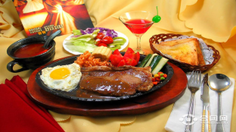
My biggest challenge is learning how to behave at the dinner table.As you can imagine,things are very different from the way they are at home.
For example,you’re not supposed to put your bread on your plate.You’re supposed to put it on the table! I thought that was pretty strange at first,but now I’m used to it.Another example is that you’re not supposed to eat anything with your hands except bread,not even fruit.You have to cut it up and eat it with a fork. Another thing is that it is impolite to say you’re full.If you don’t want any more food, you should just say,“That was delicious.” Also, you’re not supposed to put your elbows on the table. I have to say that I find it difficult to remember everything,but I’m gradually getting used to it.I don’t find French customs so strange anymore.
I’ll write again soon and tell you more about
my life in France. Hope you’re having a good
school year.
Yours,
Lin Yue

Slide 12
Read the sentences and replace the
underlined words with the phrases in the box.
2c
1.Making mistakes in French used to make Lin
Yue nervous.
(something) worry (someone)
2.It was quite hard for her to feel good about
speaking French.
be comfortable (doing)
3.The host family tried very hard to help Lin
Yue.
went out of their way
4.Lin Yue has slowly learned how to be like her
French friends.
gradually gotten used to being
went out of their way
be comfortable (doing)
gradually gotten used to being
(something) worry (someone)

Slide 13
2d
Review the passage and make notes
about French customs in the chart.
Dos | Don'ts
You're expected to put your bread on the table. | You're not supposed to put your bread on your plate.
You're expected to cut up your fruit and eat it with a fork. You're expected to say“That was delicious”if you don't want any more food.
You're not supposed to eat anything with your hands except bread.You're not supposed to say you're full. You're not supposed to put your elbows on the table.

Slide 14
2e
Compare the table manners in France and China in your group.How are they the same or different?Make a list.
e.g. In France,people put their bread on the table.But in
China,we always put our food on a plate or in a bowl.
We never put food on the table.

Slide 15
Language Points
1.In China,you're not supposed to stick your chopsticks into the food.在中国，你不应该把筷子插入食物中。（教材第77页）
（1）stick...into...意为“把……插入……”。
e.g.:Don't stick your fork into your food.
（2）chopstick名词，意为“筷子”，常用复数形式。
e.g.:We usually eat noodles with chopsticks.

Slide 16
2.In Korea,the youngest person is expected to start eating first.在韩国，年龄最小的人应该先开始吃。（教材第77页）
start doing sth.（=start to do sth.）意为“开始做某事”。
e.g.:He started crying.=He started to cry.
【拓展】作“开始”讲时，start与begin两者可互换，但以下几种情况只能用start,不能用begin.
①表示“创办，开设”时。
e.g.:He started a new shop last year.
②表示“机器开动”时。
e.g.:Can you start the car?
③表示“出发，动身”时。
e.g.:We must start early.

Slide 17
3. ...point at anyone with your chopsticks. ……用筷子指着任何人。（教材第77页）
point at 意为“指着”，侧重所指的对象；point to 意为“指向”，侧重所指的方向。
e.g.:The teacher is pointing at the blackboard.
He pointed to the high mountain far away.
【拓展】point用作及物动词时，常用于point sth. at sth.，意为“用……指着……”。
e.g.:You shouldn’t point your finger at anyone.

Slide 18
4. ...start eating first if there are older people at the table.……如果有年长的人在餐桌旁时，先开始吃。（教材第77页）
at the table意为“在餐桌旁”，而at table则意为“在吃饭”。
e.g.:The man sat at the table and asked for a cup of tea.

Slide 19
Exercise
一、根据汉语意思完成句子。
1.在美国，你不应该用手拿东西吃。
In the United States, you’re________ ________ ________
________with your hands.
2.把筷子插到食物里是不礼貌的。
________ ________ ________stick your chopsticks into your food.
3.你的父亲不会为你的错误而生气的。
Your father won't________ ________ about your mistake.
4.你不应该用筷子指着人。
You________ point________ anyone________ your chopsticks.
not
supposed
to
eat
It's
impolite
to
be
angry
shouldn't
at
with

Slide 20
二、单项填空。
( )1.Don’t make______,children.I’m working on my home project.
A.voice B.sound C.noisy D.noise
( )2.The little boy pointed______ the lovely dog and told his
mom that he wanted to have one like it as a pet.
A.at B.in C.out D.with
D
A

Slide 21
( )3.Li Ming is leaving for the US as an exchange student.How ______ he is!
A.exciting B.excited
C.interesting D.surprising
( )4.It’s impolite for you to start ______ if there are older people at the table.
A.to eat first B.to eat late
C.to eating first D.eating late
B
A

Slide 22
Homework
1.Remember the new words and expressions.
2.Read the text carefully and find out important phrases.

Slide 23
Thank you!

