Slide 1
Module 8 Unit 2
We thought somebody was moving about.
WWW.PPT818.COM

Slide 2
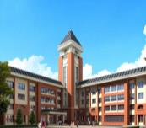
导入
Do you like travelling ? Have you ever been to
Zhangjiajie?

Slide 3
Learning Aims
学习目标
知识目标：
◆To use the following words correctly. (重点)
square , share , shape , human , wake up, path, pull
◆To learn the Object Clause with that . (重点 难点）
能力目标
◆ To get information about Zhangjiajie.
◆ To master the object clause.
情感目标
◆To know more about other person's opinion.

Slide 4
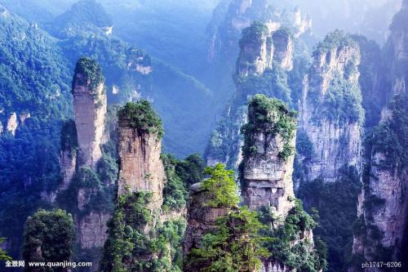
Describe the picture
导入
Haze of thousand peak
千峰逐雾
the words to describe the photo
●a magic land of mountain;
●famous for the strange shape of its tall rocks;
●look like humans / animals.

Slide 5
Match the headings with each
paragraph.
探究
Para 1
Para 2
Para 3
Para 4
A. a special experience at night.
B. their plan.
C. the introduction of Zhangjiajie.
D.The experience of their climbing Mount Tianzi.

Slide 6
Read and answer the following questions
探究
●1.Where is Betty now?
She is in Hunan Province.
●How large is Zhangjiajie?
It’s about 480 square kilometres
●What does the strange shape of its tall rocks look like?
Some look like humans,some look like wild animals.

Slide 7
探究
Number the sentences in the correct order.
a. Betty pulled a leaf off a plant.
5
b. The noise woke everybody up.
2
c. They climbed Mount Tianzi.
4
d. A monkey made some noise.
3
e. They camped by a small lake.
1
f. Lingling's uncle said that people should protect everything in Zhangjiajie.
6

Slide 8
探究
Read Para 1 and fill in the blanks
The Introduction of Zhangjiajie
Where is Zhangjiajie? | Province
How large does it take up? | square kilometres
What is it famous for? | the strange of tall rocks
What does it look like? | It’s a magic land of .
Hunan
480
shape
mountains, forests and rivers

Slide 9
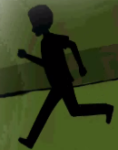
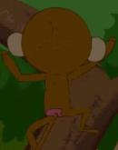
练习
Read Para 2 and find out the answers
●Who was moving about last night？
√
●What was the monkey doing？
The monkey was looking for food.

Slide 10
练习
Read Para 3 and complete the following.
Why did Betty do the next morning?
The next morning , she climbed
Mount Tianzi.
What could they see?
They could only see the mounttain
tops above the clouds.
Why did Betty feel sorry?
Because It was wrong for her
to pull leaves off plants .
protect the environment
It’s our duty to__________________________.

Slide 11
探究
Read Para 4 and find out the answers.
Talk about their plans for tomorrow and next week.
● Tomorrow they ______________________.
are going to Dongting Lake
● Next week they ______________.
will be back home

Slide 12
Summary
小结
1. Vocabulary:
square, kilometre, shape, human, camp , wake sb. up , move about, path, pull
2. Language use：
learning to describe a place

Slide 13
练习
Complete the sentences with the correct
form of the words in the box
1. Are there rocks in _____ or animal _____ in your
home town?
human
shapes
2. How many _________ is Zhangjiajie from your
home town?
kilometres
3. Is it saferto walk along a ____ or climb over rocks?
path
4. Where do you ____you were right now?
wish

Slide 14
练习
Talk about Zhangjiajie acorrding to the table
Zhangjiajie
How large is it? | about 480 square kilometres
Where is it ? | about 400 kilometres from Changsha
what can you see? | mountains, rivers, forests,many kinds of plants and animals
What is special? | strange shape of tall rocks, beautiful sights
Where can you sleep? | hotel or camps

Slide 15
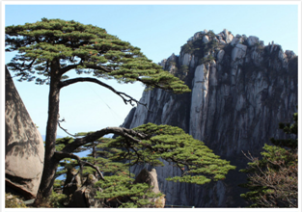
the Yellow Mountain
作业
Anhui Province
1,200 square kilometres
the highest peak-Lotus peak
1864m
Strange pine tree (奇松)
the ocean of clouds (云海)
Hot springs (温泉)
the absurd stone (怪石)
different kinds of plants
and animals
The Yellow Mountain

Slide 16
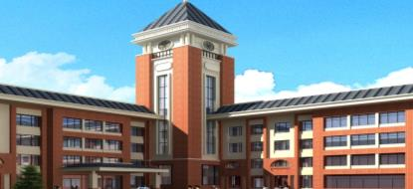
@ Lijun He
Thank you for listening

