Slide 1
Unit 2 Lesson 12
Helen Keller
WWW.PPT818.COM

Slide 2
Warm-up
Helen Keller

Slide 3
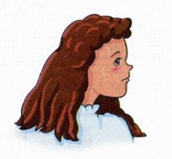
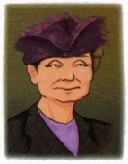
Story time
Fast reading
What was Helen Keller?
She was a writer.
Was she healthy?
No, she was deaf and blind.

Slide 4
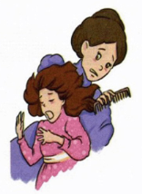
Story time
Intensive reading
When and how did Helen Keller become deaf and blind?
When she was 18 months old, she fell ill and became deaf and blind.
Could her parents help her?
No, they didn’t. They did not
know how to help her.

Slide 5
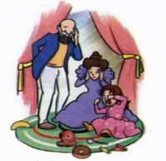
Story time
Intensive reading
Why did Helen often get angry?
Because she couldn't see anything, she couldn't hear anything, and she couldn't speak at all.

Slide 6
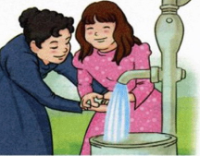
Story time
Intensive reading
Was Helen’s teacher great?
Yes, she was.
Did Helen work hard?
Yes, she did.

Slide 7
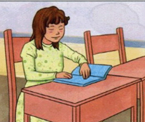
Story time
Intensive reading
Was Helen successful?
Yes, she was.
She learned to speak, read and write.

Slide 8
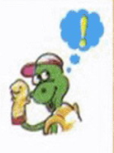
Story time
Intensive reading
What can you learn from Helen Keller?
Always be full of hope for life.
永远对生活充满希望

Slide 9
Read the story again and check the words you meet.
deaf blind
become born
hope later

Slide 10
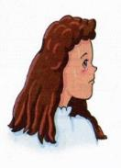
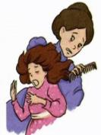
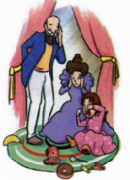
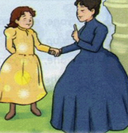
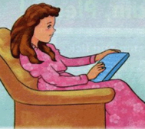
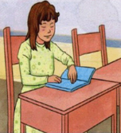
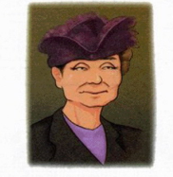
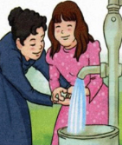
Retell the story
Say something about the pictures.

Slide 11
Summary and evaluation
What have you learned in this class?
A excellent B good C adequate D need improvement
内容 | 学生自评 | 小组互评
我能认真听老师讲课，听同学发言
遇到我会回答的问题主动举手了
活动中坚持使用英语来交际
我能积极参与小组讨论活动，能与他人合作。

Slide 12
Homework
1. Try to retell the story.
2. Find out other famous people’s story.

