Slide 1
Unit 1 Countries
Where's she from？
WWW.PPT818.COM

Slide 2
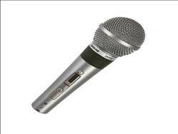
Where are you from?
I’m from…

Slide 3
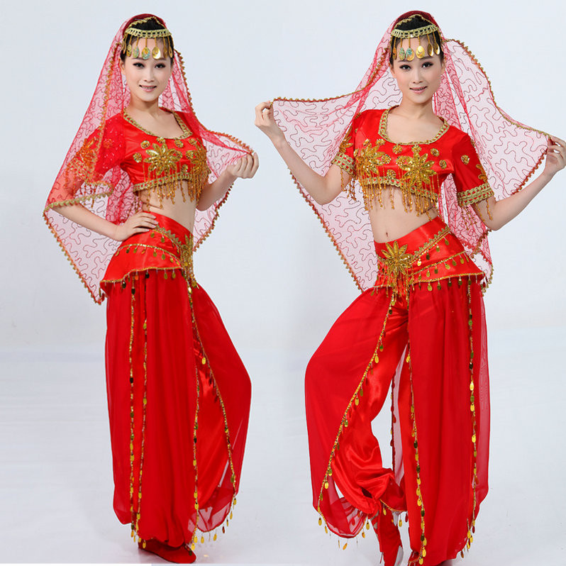
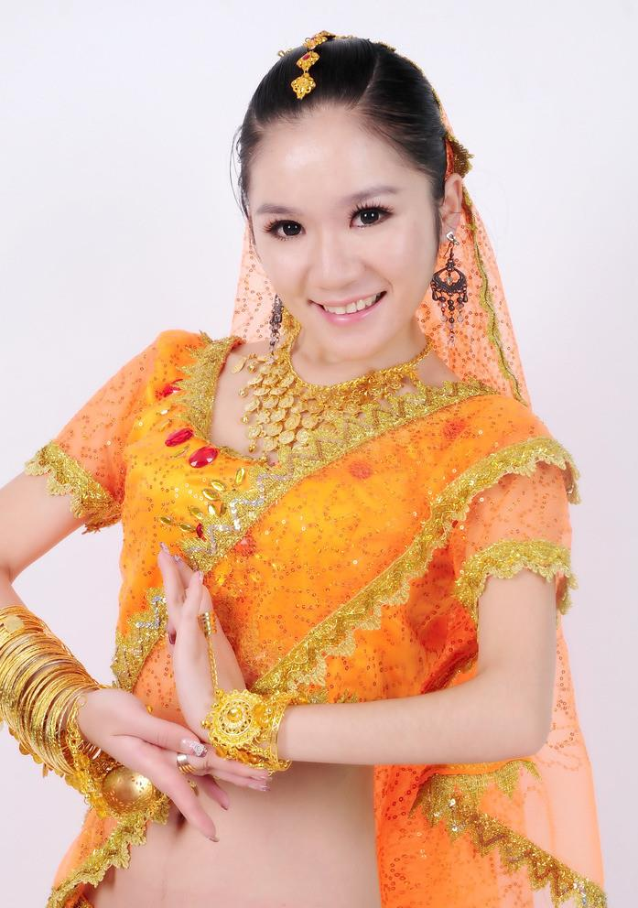
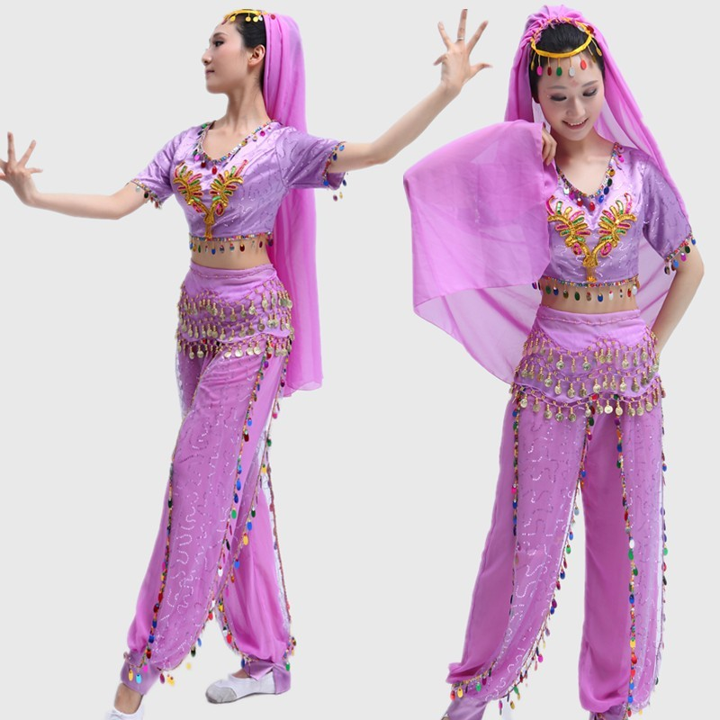
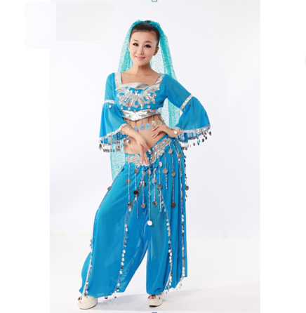
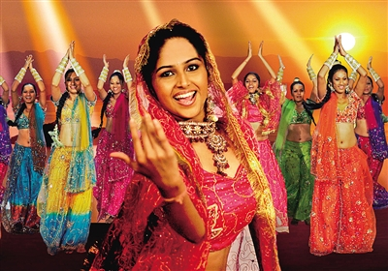

Slide 4
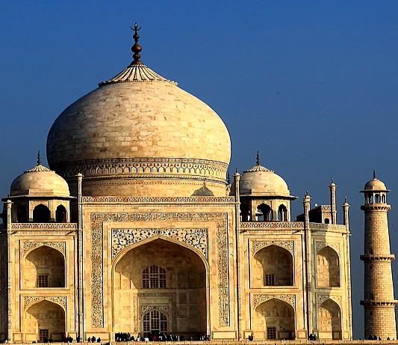
India
印度

Slide 5
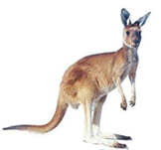
Where are you from?
I’m from…

Slide 6
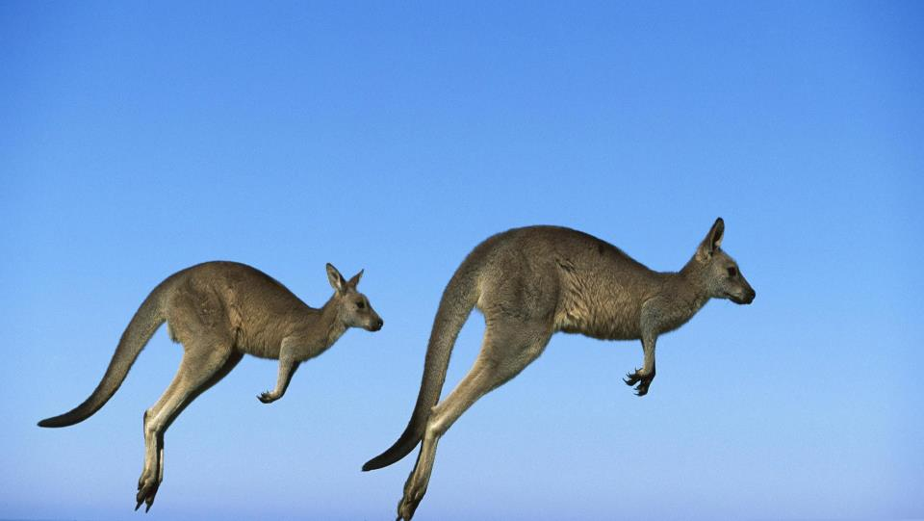
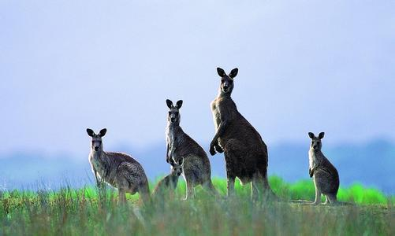
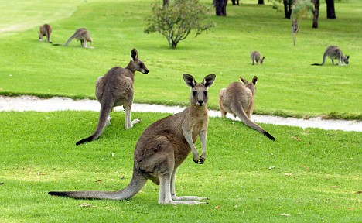
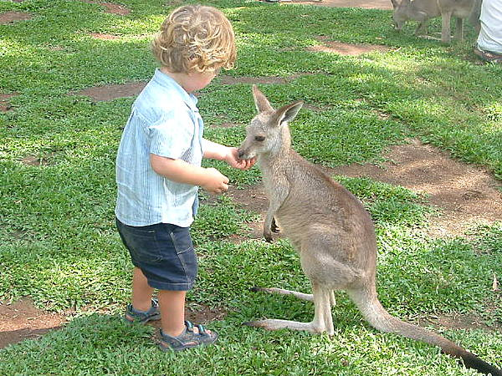
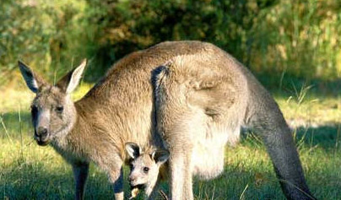

Slide 7
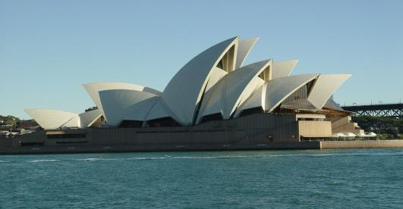
Australia
澳大利亚

Slide 8
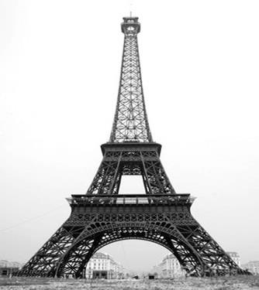
France
法国

Slide 9
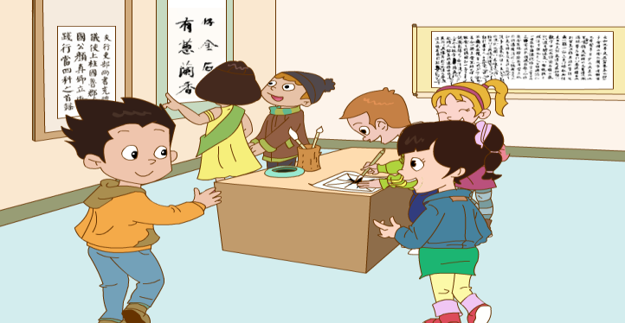
Where’s he from?
He’s from Australia.
Look! They’re our new friends.

Slide 10
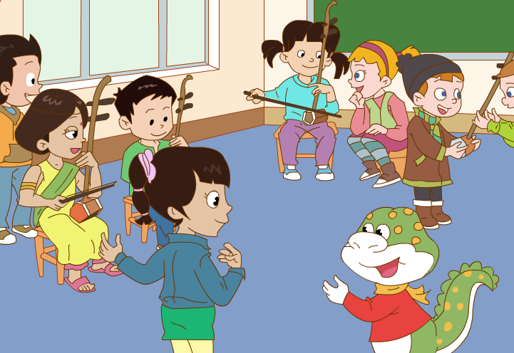
Where’s she from?
She’s from India.

Slide 11
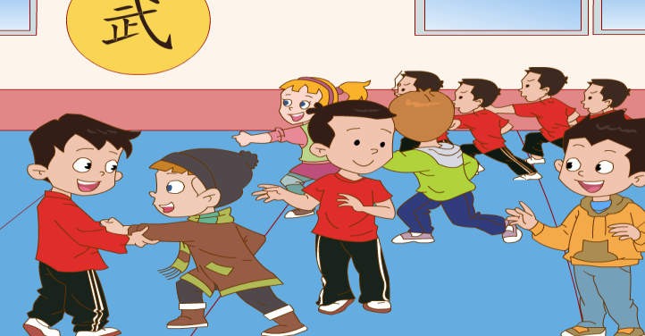
Is he from the U.S.?
No, he isn’t. He’s from France.

Slide 12
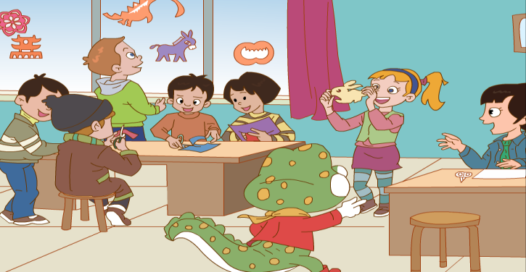
Where’s she from?
She’s from Britain. Her name’s Mary.

Slide 13
A:Where’s he/ she from?
B:He’s/ She’s from…

Slide 14
Homework
repeat the text 3 times.
II. 认真抄写句子两遍并能背诵。
III. 预习。

Slide 15
Thank You

