Slide 1
Unit 5 Look into Science
Science Affects Us
WWW.PPT818.COM

Slide 2
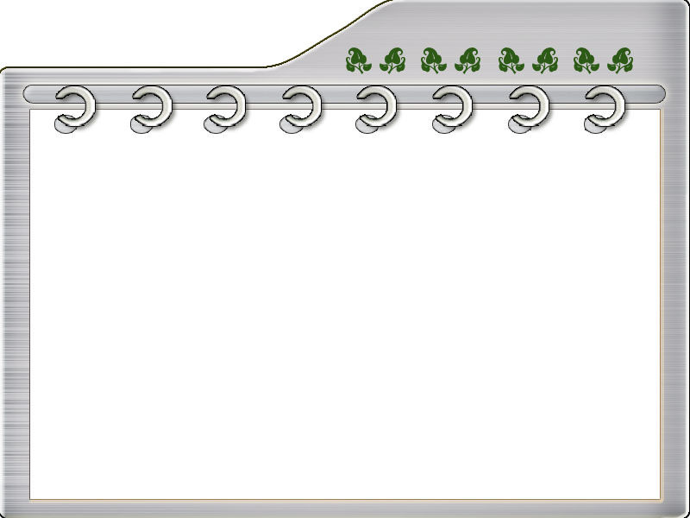
Think about it
● Have you ever done any interesting
experiments? Can you describe one of
them?
● What would life be like without computers
or mobile phones?

Slide 3
New Words
1. affect v. 影响
e.g. How will these changes affect us?
这些变化对我们会有什么影响?
2. suggest v. 建议, 提议; 暗示
e.g. I suggested going for a walk. 我建议去散步。

Slide 4
3. development n. 发展
e.g. The development of the factory is
not very good.
工厂的发展状况不是很好。
4. mobile phone n. 移动电话
e.g. I bought a mobile phone on the
Internet yesterday.
我昨天在网上买了个移动电话。

Slide 5
5. discovery n. 发现; 发觉
e.g. scientific discovery 科学发现
important discovery
重要的发现

Slide 6
Read the lesson and fill in the
blanks.
everyday
Science affects people’s ________ lives. Without the scientific developments of recent years, our lives would be very different. Can you imagine life without computers or _____________?
mobile phones

Slide 7
Scientific __________ are making our lives better and better. DNA is really one of the most amazing things on the earth. Many people think it will _______ the world.
discoveries
change

Slide 8
1. I suggest you try it, too!
我建议你也试一试！
suggest 动词, 意思是“建议; 提出”。后可接名词和v.-ing, 也可接that宾语从句, that从句用should+动词原形, should可以省略。

Slide 9
e.g. Danny suggested going together in one car.
丹尼建议大家同坐一辆车去。
She suggested that we (should) take a walk.
她提议我们出去散步。

Slide 10
suggestion n. 提议; 意见; 暗示
e.g. We have had several suggestions on a name for the baby.
我们已经得到好几个给宝宝取名的建议了。
I would like your suggestions about planning my education.
有关我的教育我需要你的建议。

Slide 11
suggest 和advise 都可作“建议”讲，但二
者的用法有异同。
★相同点：suggest 和advise 后面都可以接
名词、代词、v.-ing 形式或that 从句作宾
语。需要注意的是，当suggest 和advise
后面接that 从句时，从句中的谓语动词要
用“should +动词原形”的虚拟语气形式，
而should常可以省略。

Slide 12
e.g. We suggested / advised an early start.
我们建议早点出发。
Perhaps you could suggest / advise
something that would help her.
也许你可以建议一下帮助她的事。
Peter suggested / advised doing it in a
different way.
彼特建议以不同的方式做这件事。

Slide 13
★不同点：advise 可以用于“advise sb. to do
sth.”结构中，而suggest则不可以。
e.g. My friend Tommy advised me to ring
up to see if Mary was there.
我的朋友汤米建议我打个电话看玛丽
是否在那里。

Slide 14
2. Cover the jar with the cardboard and
turn the jar over.
用硬纸板盖住广口瓶, 再把它倒过来。
turn over的意思是“把……翻过来”。
e.g. The soil must be turned over before
planting.
播种前必须先翻土。

Slide 15
turn over 还有“移交; 仔细考虑”的意思。
e.g. If you can turn it over in time, I’ll
lend the book to you.
如果你能按时还书, 我就把它借给你。
You should turn over the problem for
hours before you make a decision.
决定这个问题之前, 你应该仔细考虑
几个小时。

Slide 16
3. The air pressure pushing up on the
cardboard is higher than that of the
water pushing down from inside the jar.
托着纸片的向上的空气压力要大于广口
瓶内水的向下的压力。
push up意思是“向上推；提高”。
e.g. Will you help me to push up the window?
你能帮我把窗户推上去吗？

Slide 17
push down 意思是“向下按; 推倒; 压倒”。
e.g. What they have done pushed down
prices.
他们的做法压低了价钱。

Slide 18
4. The higher air pressure outside the jar
holds the cardboard in place.
广口瓶外面的空气压力大, 把纸片托在
原位置。
in place意思是“原位; 在恰当的位置”。
e.g. I like to have everything in place.
我喜欢把一切东西都放在适当的位置。

Slide 19
Fill in the blanks with the correct
forms of the words in the box.
discover affect suggest place develop
suggests/suggested
1. Jenny _________________ they use a
stronger piece of cardboard for the
experiment.
2. The air pressure _____________ the
result of the experiment.
affects/affected

Slide 20
3. The experiment led to a wonderful
_________.
4. What are your plans for the
____________ of your company?
5. They used a rock to hold the map in
_____.
discovery
development
place

Slide 21
Here are some inventions. How
do they affect our everyday lives?
Talk about them with your partner.
TV camera radio computer telephone light bulb clock
washing machine compass telescope X-ray eyeglasses

Slide 22
With TV Without TV
I watch TV to get information.
________________________________________________
I would spend more time talking with my family.
________________________________

Slide 23
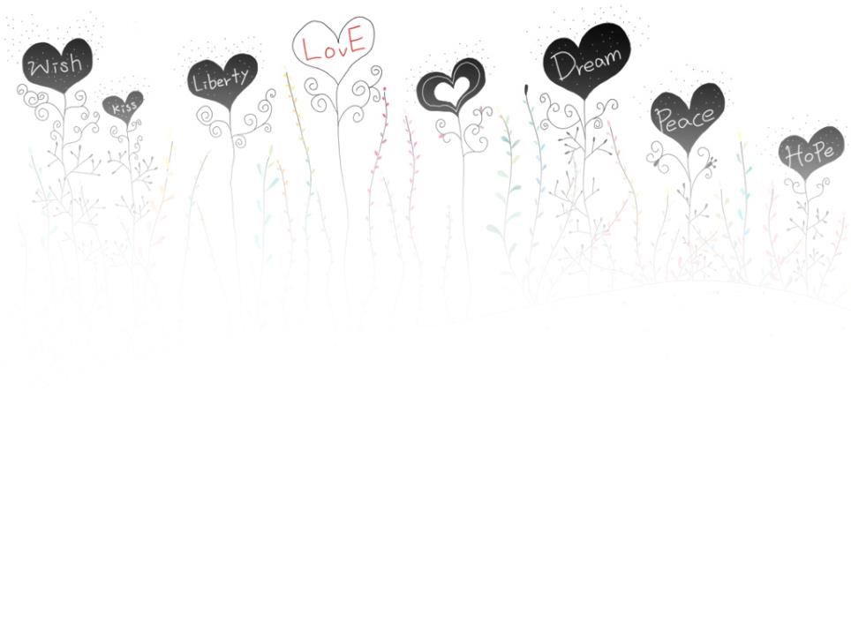
Homework
Research and collect some fun and interesting scientific facts to share with the class.

