Slide 1
陕旅版英语五年级上册
Unit6 How Much Is It?
第2课时
WWW.PPT818.COM

Slide 2
教学目标
1. 听懂、会说句型：What can I do for you? I want to buy ...并能在实际情景中正确运用。
2. 能熟练运用句型：How much is it? It’s ... yuan.并能和同桌合作就单个物品的价格进行问答。

Slide 3
Listen to a song

Slide 4
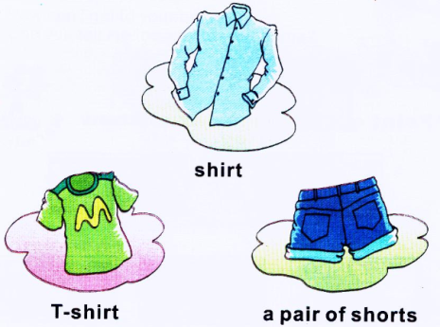
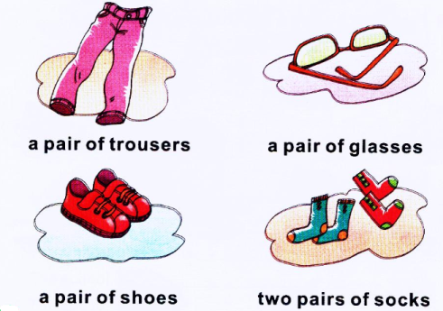
Review

Slide 5
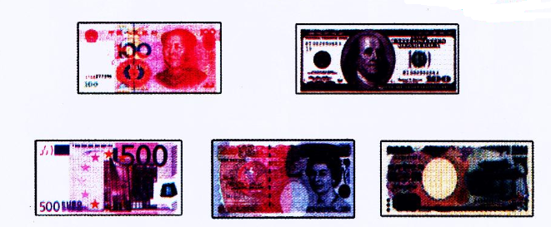
Look at these pictures. What are they? Do you know?
Who knows the money?
RMB yuan
dollar
euro
pound
Japanese yuan

Slide 6
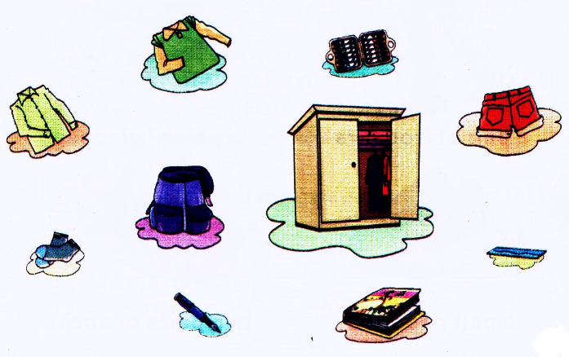
Put the things in the right places
教师引领学生用英语说出图中物品的名称，并指导学生将物品归类，放到合适的位置：服装放入衣柜，文具放入书包。

Slide 7
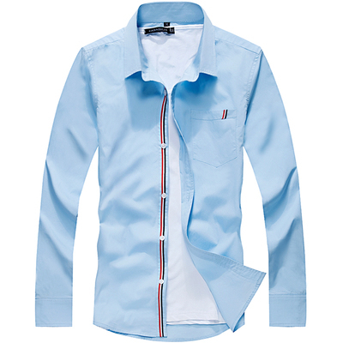
Do you like this shirt?
How much is it?
RMB100yuan

Slide 8
Let’s talk
How many people are there in the dialogue?
老师提醒同学们带着问题听课文录音
Who are they?
Which T-shirt / one does Su Nan like?
How much is the T-shirt?

Slide 9
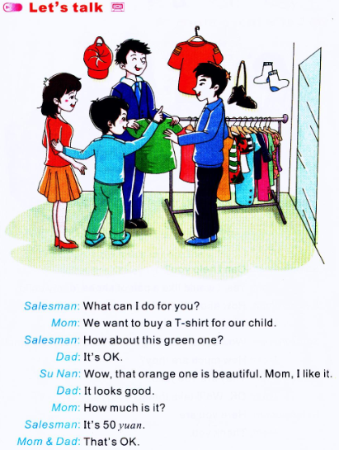

Slide 10
How many people are there in the dialogue?
老师提醒同学们带着问题听课文录音
Four.
Who are they?
They are salesman, Mom, Dad and Su Nan.
Which T-shirt / one does Su Nan like?
He likes the green one.
How much is the T-shirt?
It’s 50 yuan.

Slide 11
课文应用：---What can I do for you?
我能为你们做点什么？/您要买什么？
---I/ We want to buy…
我/我们想买……

Slide 12
Summary
购物用语：
(1) ---May/ Can I help you?
---Yes. I would like…
(2) ---How/ What about this/ these one?
---It looks/ They looks…
(3) ---What size?
---Size…
(4) ---What size/ kind/ color do you want?

Slide 13
课文应用：---How much is it?它多少钱？
---It’s 50 yuan.50元。
询问价钱时用：
How much is it?（单数）/ How much are they?（复数）
回答用：
It’s…/ They are…yuan.

Slide 14
Role play
四人一组，分角色扮演爸爸、妈妈、苏楠和售货员，看哪组表演的好！

Slide 15
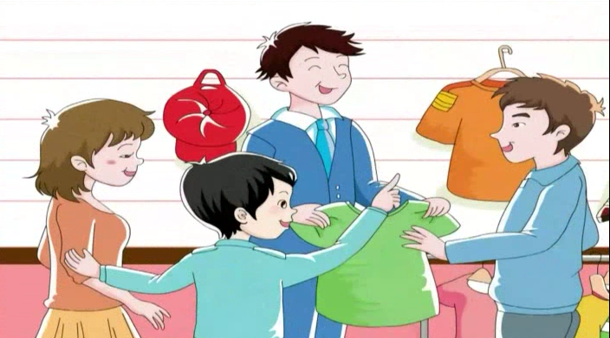
观看动画并大声跟读

Slide 16
Let’s play—价格“战”
(1) 教师随机指一位学生，让他展示他所准备的标价物品（注意把价签部分面向自己），请其他同学猜价格：
S1: How much is it?
S2: Is it...yuan?
(2) 每件物品只能猜三次，被猜中的学生可把他的物品摆放在货架（可以用讲桌充当）上，没有被猜中的物品则先放在一边，再邀请下一位学生展示猜价。

