Slide 1
Unit 7 What did you do yesterday?
WWW.PPT818.COM

Slide 2
小组讨论： What do you do when you are happy? 当你开心的时候，你会做什么？

Slide 3
meet my friends
见朋友
eat at a restaurant
在餐馆吃饭

Slide 4
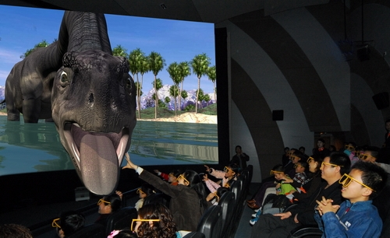
ride my bike
骑自己的自行车
see a film
看电影

Slide 5
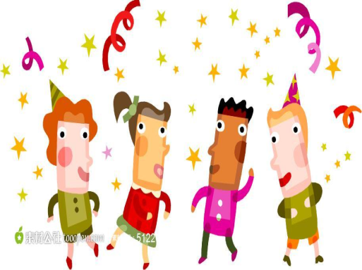
read a storybook
看故事书
have a party
开派对

Slide 6
go to the countryside
去郊外
go shopping
购物

Slide 7
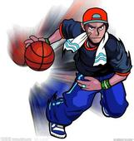
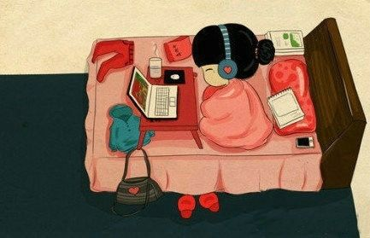
play basketball
打篮球
stay at home
待家里

Slide 8
clean my room
打扫自己的房间
do my homework 做自己的作业

Slide 9
meet my friends 见朋友 eat at a restaurant 在餐馆吃饭
ride my bike 骑自己的自行车 see a film 看电影
read a storybook 看故事书 have a party 开派对
go to the countryside 去郊外 go shopping 购物
play basketball 打篮球 stay at home 待家里
clean my room 打扫自己的房间
do my homework 做自己的作业

Slide 10
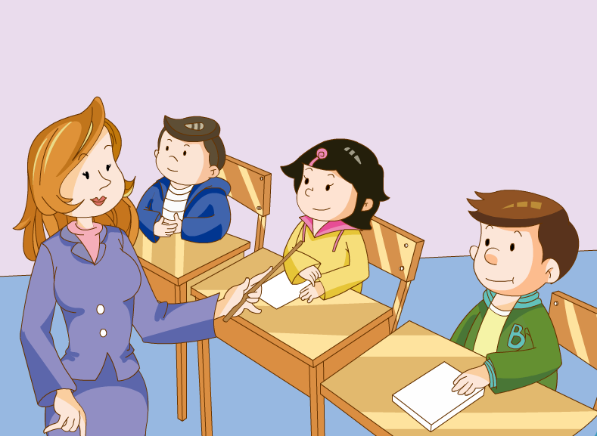
Look! Miss White is talking about yesterday in her class. Do you know what date yesterday is?
1/17/2023

Slide 11
1/17/2023

Slide 12
Read the dislogue , then circle the past tense verbs in the dialogue. Try to traslate the dialogue. 阅读读对话，圈出过去式的动词。并试着翻译课文。 （小组讨论合作完成任务）
1/17/2023

Slide 13
Yesterday was Children’s Day. Tell me, children, what did you do?
I went shopping with my mother and bought a new pair of sports shoes. Do you like them?

Slide 14
They look great. I played basketball at the park. It was so much fun. But my mum was angry because I came home late.
And you Ben? Where did you go yesterday?

Slide 15
I stayed at home all day. In the morning I cleaned my room and in the afternoon I did my homework. It was no fun at all
Poor Ben!

Slide 16
过去式短语：
met my friends 见朋友 meet→met
ate at a restaurant 在馆吃饭 eat →ate
rode my bike 骑自己的自行车 ride→rode
saw a film 看电影 see →saw
read a storybook 看故事书 read →read
had a party 开派对 have →had
went to the countryside 去郊外 go →went
went shopping 购物
played basketball 打篮球 play→played
stayed at home 待在家里 stay→stayed
cleaned my room 打扫自己的房间 clean→cleaned
did my homework 做自己的作业 do→did

Slide 17
Practise
根据本节课所学过去 式的表达，小组练习以下两个对话：
对话一：
A:What did you do yesterday?
你昨天做了什么？
B: I...
对话二：
A: Where did you go yesterday?
你昨天去了哪里？
B: I...
1/17/2023

Slide 18
Homework
1. 朗读课文至少10遍；
2. 完成三级训练Unit7第32—34页。
1/17/2023

Slide 19
Thank you
very much!

