Slide 1
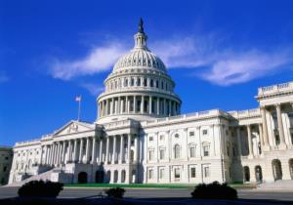
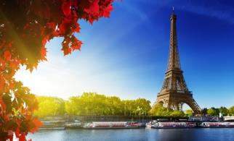
Great cities of the world
WWW.PPT818.COM

Slide 2
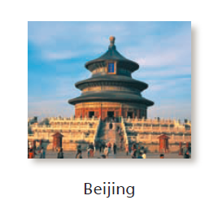
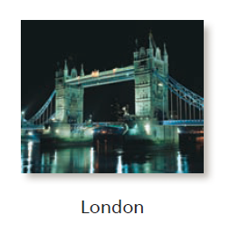
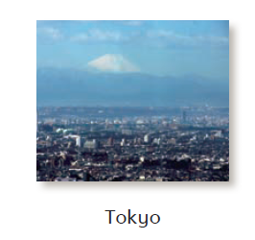
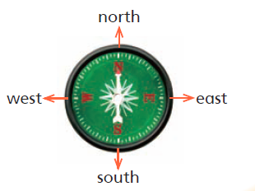
Look and say
Which one is missing?

Slide 3
Look and say
Which one is missing?

Slide 4
Look and say
Which one is missing?

Slide 5
Look and say
Which one is missing?

Slide 6
Look and say
Which one is missing?

Slide 7
Look and say
Which one is missing?

Slide 8
Look and say
Which one is missing?

Slide 9
Ask and answer
√
√
How long does it take to get to … from Beijing by …?
It takes about … by …

Slide 10
Look and read

Slide 11
Look and read

Slide 12
Look and read

Slide 13
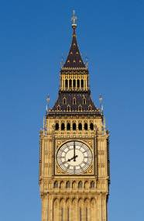
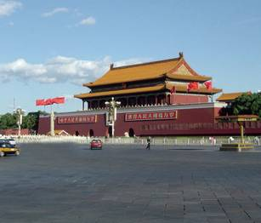
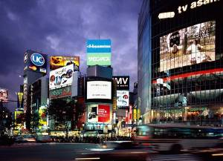
Think and say
Great cities of the world
Where are they?
What can we see or find in these cities?
What do tourists enjoy doing there?
What food do people love eating there?
…?

Slide 14
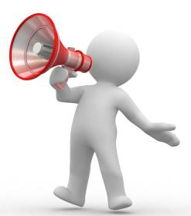
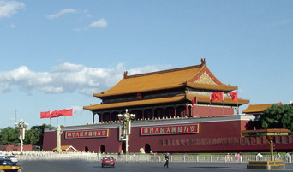
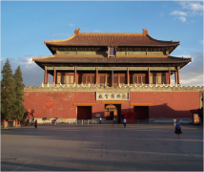
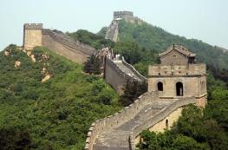
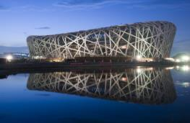
Think and say
Beijing
The Palace Museum
The Great Wall
The National Stadium
...

Slide 15
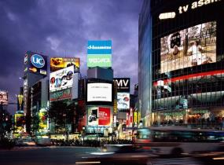
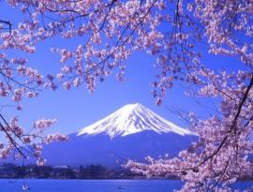
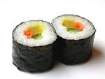
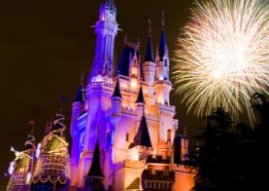
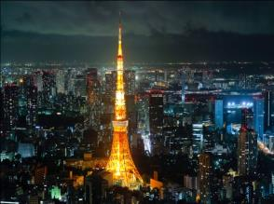
Think and say
Tokyo
Mount Fuji
tall buildings
Tokyo Disneyland
Tokyo Tower

Slide 16
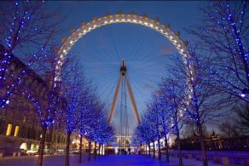
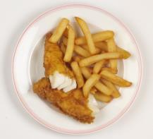
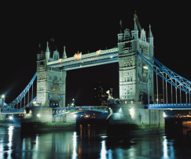
Think and say
London
London Eye
Big Ben
Tower Bridge

Slide 17
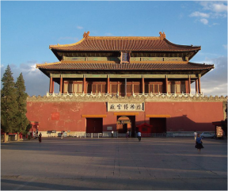
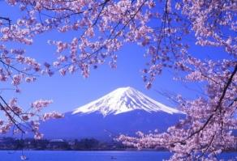
Look and say
…
Beijing
Tokyo
London
Great cities of the world
Paris
Washington D.C.

Slide 18
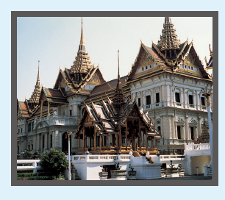
Look and read
Bangkok
Bangkok is the capital of Thailand. It is southwest of Shanghai. There are many temples and beaches in Bangkok. A lot of tourists enjoy swimming in the sea at these beautiful beaches. There are about 8 million people in Bangkok. They love eating fruit. They also love eating spicy food.

Slide 19
Think and say
The city I want to visit
… is the capital of … It is … You can … Tourists like … People there like eating …
I want to visit this great city!
How long does it take to get to this city from your city by plane?

Slide 20
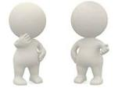
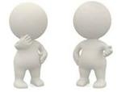
Make a travelling plan
Which city do you want to visit?
I want to visit …
1.
Really? Shall we go together?
Sure.
A
B
2.
Step 1: Ask and find friends.
B
A

Slide 21
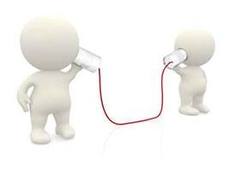
Make a travelling plan
Step 2: Ask and answer. Then make a plan.
How long does it take to get to … from … by …?
What can we see/find in …?
What can we visit?
What can we eat?
… ?
A
B

Slide 22
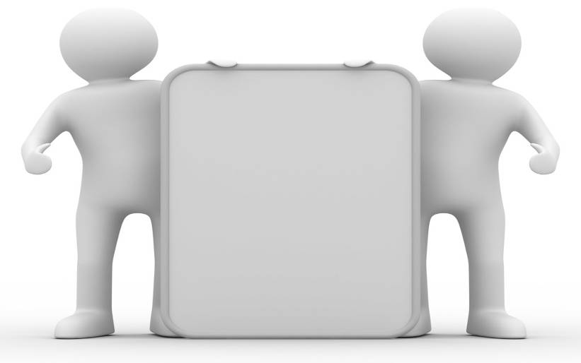
Make a travelling plan
Step 3: Report your plan.
We would like to go to … this winter holiday.
… is the capital of …
We can see/find …
We want to visit …
We like eating …
We think we will have a good time there.

Slide 24
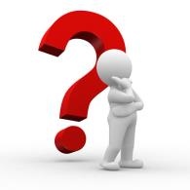
herb
jerk
girl
birthday
burn
further
purse

Slide 26
locker
singer
winner
traveller
alone
grandma
grandpa

Slide 27
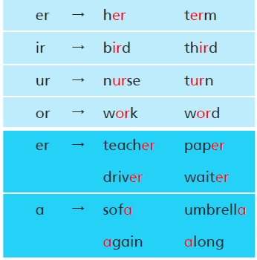
long
short

Slide 28
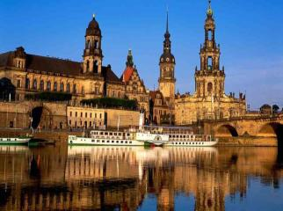
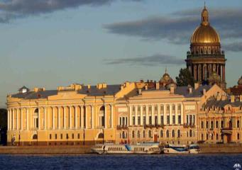
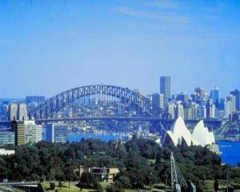
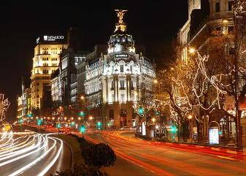
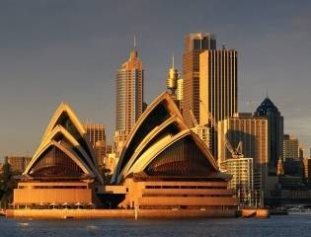
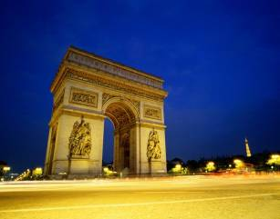
Read ten thousand books
Travel ten thousand miles

Slide 29
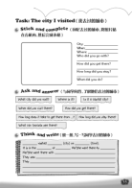
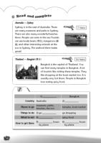
Homework
1. Read Student’s Book pages 58 to 63.
2. Share your travelling plan.
3. Finish Workbook pages 54 and 55.

