Slide 1
Unit4 At the Sports Meeting
陕旅版六年级下册
第二课时
WWW.PPT818.COM

Slide 2
>>Review
Quick response
long jump
throwing
running race
high jump
100-meter race
have a sports meeting

Slide 3
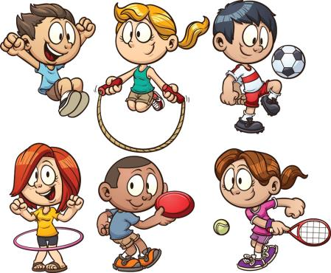
>>Lead-in
Think and talk
A: What’s your favorite sport?
B: My favorite sport is …
A: How often do you play it?
B: I play it …

Slide 4
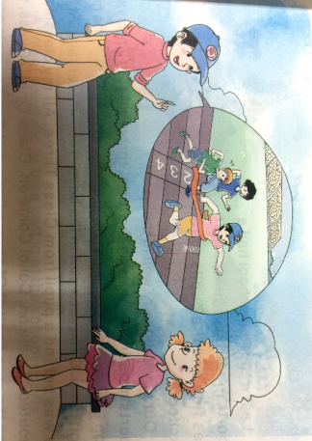
>>Presentation
Look, then ask and answer
Q 1: Look at the picture. Who is the boy?
He is Liu Zhaoyang.
Q 2: What are they talking about?
They are talking about the sports meeting.

Slide 5

>>Presentation
Listen, then ask and answer
Q 1: How does Liu Zhaoyang look? Why?
He looks tired. Because he took part in the
boys’ 100-meter race and the long jump.
Q 2: How did he do at the sports meeting?
He was the first in the 100-meter race.
Q 3: Who was the first in the 100-meter race?
Liu Zhaoyang.

Slide 6
>>Presentation
Let’s talk
Amy: You look tired.
Liu: Yes. We had the school sports meeting
yesterday.
Amy: What sport did you take part in?
Liu: I took part in the boys’ 100-meter race and
the long jump.
Amy: Great! Did you win?

Slide 7

>>Presentation
Let’s talk
Liu: Yes. I was the first in the 100-meter race.
Amy: How about the long jump?
Liu: I lost it.
Amy: Anyway, you did well.
Liu: Thank you.

Slide 8
>>Practice
Read it by yourselves for one minute .
自读课文一分钟。
一分钟倒计时
60
10
50
Learning tip :
当你自己朗读时，遇到不会读或不明白意思的单词或句子，可以把它圈起来，请教同学或老师！
20
40
30
开始

Slide 9




  Role play
角色扮演，小组先进行练习，然后展示，其他同学评价。
 | 小组合作，声音洪亮，有感情地正确朗读课文。 |  | C
 | 小组合作默契，声音洪亮，脱离课本，口语表达较准确流利，感情与肢体语言较丰富。 |  | B
 | 小组合作默契，声音洪亮，能结合已有知识或生活，对内容有创新，口语表达准确流利，感情与肢体语言丰富。 |  | A
Good
Great
Excellent

Slide 10
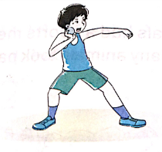
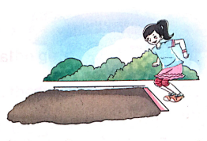
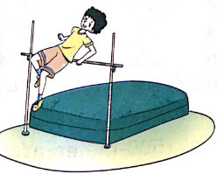
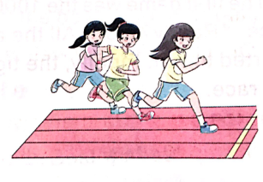
>>Practice
Look and say
What sport is it?
throwing
long jump
high jump
100-meter race

Slide 11


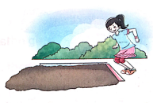

>>Practice
Ask and answer
A: What sport did he take part in at the school
sports meeting?
B: He took part in the throwing.
A: Did he win it?
B: Yes, he did./No, he didn’t. He lost it.

Slide 12
>>Practice
Make new conversations and act
boys’ throwing throw far
girls’ 60-meter race run fast
girls’ high jump jump high
A: We will have a sports meeting next week.
B: Really? What sport will you take part in?
A: I will take part in the boys’ throwing.
B: Do you throw far?
A: Yes, I do. I won’t it last year.

Slide 13

>>Summary
本课所学的重点句型：
-What sport did you take part in?
-I took part in the …
-Do you win?
-Yes. I was the first in …

Slide 14


>>Homework
1.听课文录音并跟读，按照正确的语音、语调朗读并表演课文对话。
2.仿照课文Let’s talk进行新的对话创编。
3.预习 Unit4 B Let’s learn more。
close

