Slide 1
陕旅版英语五年级上册
Unit5 Can You Tell Me the Way to the Supermarket?
第3课时
WWW.PPT818.COM

Slide 2
教学目标：
1. 拓展学习问路的句型How can I get to the ...?并能综合运用第一及第二课时所 学的内容，根据实际情况正确应答。
2. 能在教师的引导下，完成Part B Look and talk部分以及Part C Ask and answer 部分的活动。

Slide 3
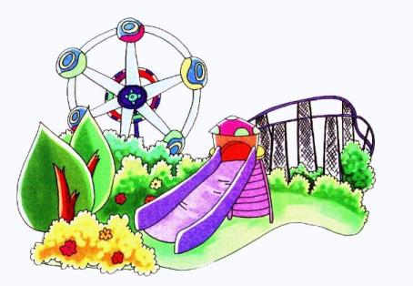
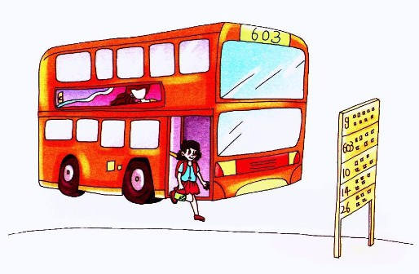
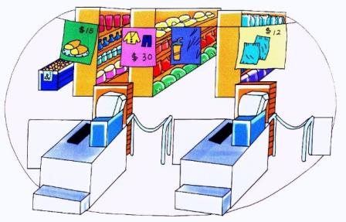
Review
What’s this?

Slide 4
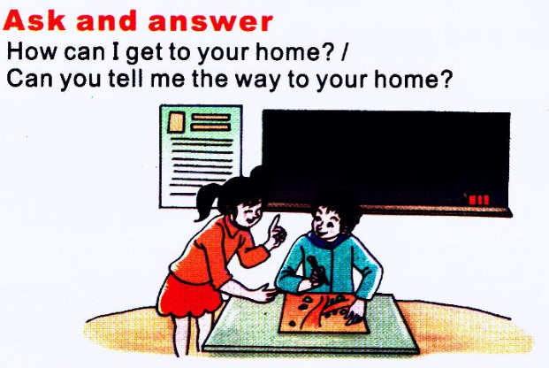
Where is your home?
PPT模板：www.1ppt.com/moban/ PPT素材：www.1ppt.com/sucai/
PPT背景：www.1ppt.com/beijing/ PPT图表：www.1ppt.com/tubiao/
PPT下载：www.1ppt.com/xiazai/ PPT教程： www.1ppt.com/powerpoint/
资料下载：www.1ppt.com/ziliao/ 范文下载：www.1ppt.com/fanwen/
试卷下载：www.1ppt.com/shiti/ 教案下载：www.1ppt.com/jiaoan/
PPT论坛：www.1ppt.cn PPT课件：www.1ppt.com/kejian/
语文课件：www.1ppt.com/kejian/yuwen/ 数学课件：www.1ppt.com/kejian/shuxue/
英语课件：www.1ppt.com/kejian/yingyu/ 美术课件：www.1ppt.com/kejian/meishu/
科学课件：www.1ppt.com/kejian/kexue/ 物理课件：www.1ppt.com/kejian/wuli/
化学课件：www.1ppt.com/kejian/huaxue/ 生物课件：www.1ppt.com/kejian/shengwu/
地理课件：www.1ppt.com/kejian/dili/ 历史课件：www.1ppt.com/kejian/lishi/

Slide 5
观看动画，回答问题

Slide 6
How can I get to the zoo?
How can I get to the park?
How can I get to the bus station?
How can I get to the school?
How can I get to the supermarket?
How can I get to the library?

Slide 7
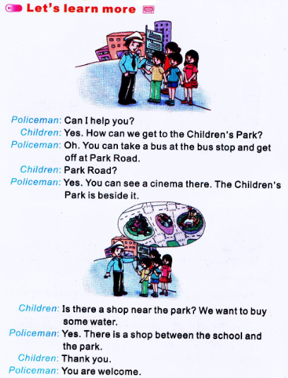

Slide 8
画一画
根据对话中的内容，画出儿童公园和商店的位置。

Slide 9
Summary
---How can we/ I get to the…?
去……怎么走？
---You can…
你可以……
The…is beside/ behind it.
……就在她旁边/后边。
There is a…between…and…
在……和……之间有一个……。

Slide 10
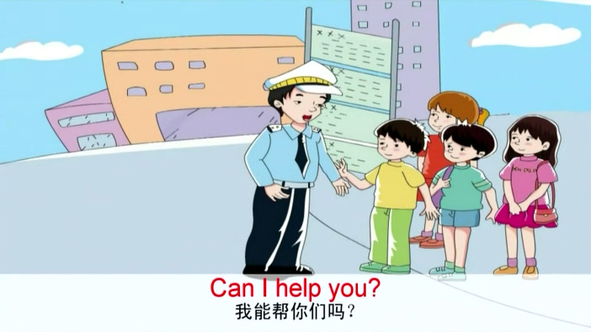
观看课文动画并跟读

Slide 11
Questions:
(1) How can they get to the Children’s Park?
(2) What do they want to buy?
(3) Who helps the children?
看完动画，你会回答这些问题了吗？

Slide 12
我是小小调查员
How can you go to school?
Name | Take a bus | By taxi | By bike | By car | On foot

Slide 13
Let’s play—盲人指路
Vocabulary Bank
turn right向右拐
turn left向左拐
go along沿着，顺着
get to到达，抵达

Slide 14
