Slide 1
Section C Developing ideas & Presenting ideas & Reflection
外研版高中英语必修二
Unit 1 Food for thought
WWW.PPT818.COM

Slide 2
Ⅰ
Ⅱ
Ⅲ
Ⅰ.知识体系图解
belong
swing
honey
construction
satisfying
chef
convenient
identify
recipe
blog

Slide 3
Ⅰ
Ⅱ
Ⅲ
originally
ranking
official
reconstruct
salty
sour
resist
adapt
breast
onion

Slide 4
Ⅰ
Ⅱ
Ⅲ
试验;检验
属于
空间狭小
最终做……
打听(不在时所发生的事情),别后叙谈
抚养
与……相似
适应
尝试
需要
购买;捡起

Slide 5
Ⅰ
Ⅱ
Ⅲ
Ⅱ.释义匹配
1.convenient A.the process of building things such as houses,bridges,roads etc.
2.construction B.to fight against something or someone that is attacking you
3.resist C.suitable for your purposes and needs and causing the least difficulty
4.official D.to recognize and correctly name someone or something
5.identify E.someone who is in a position of authority in an organization
答案:1.C 2.A 3.B 4.E 5.D

Slide 6
Ⅰ
Ⅱ
Ⅲ
Ⅲ.介(副)词填空
1.They are now discussing when to put the machine test.
2.Normal universities belonging the Education Department would recruit some students for free.
3.Every time they went dancing they ended in a bad mood.
4.They worked a break until about eight in the evening.
5.The university has been famous medical studies ever since its foundation.
to
to
up
without
for

Slide 7
重点词汇
重点句式
高分写作
随堂练习
1.belong to属于
【课文原句】Can you guess which fridge belongs to which person?
你能猜出哪个冰箱是属于哪个人的吗?
【词汇精讲】
belong to是动词短语,意为“属于,应在某处;适应”。
The four countries that belong to the United Kingdom work together in some areas.
属于联合王国的四个国家在某些领域共同努力。
Those books belong to the library but this is my own.
那些书是图书馆的,但这本是我自己的。

Slide 8
重点词汇
重点句式
高分写作
随堂练习
【温馨提示】belong to中to为介词,后接名词的普通格或代词宾格。作后置定语时常用动词-ing形式。
Anyone has no right to take the land belonging to the state as their own.
任何人都没有权力占有属于国家的土地。
【词汇拓展】
【误】The computers inside the classroom are belonged to our school.
【正】The computers inside the classroom belong to our school.
教室里的电脑属于我们学校。

Slide 9
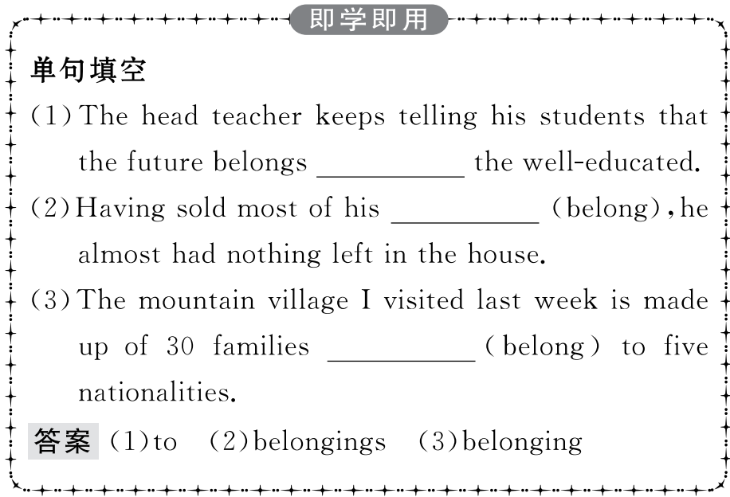
重点词汇
重点句式
高分写作
随堂练习

Slide 10
重点词汇
重点句式
高分写作
随堂练习
2.end up (尤指经历一系列意外之后)最终处于,到头来
【课文原句】I often end up saving part of my meal for the next day.
最后,我常常把一部分饭留到第二天吃。
【词汇精讲】end up是动词短语,意为“最终处于,到头来,结果为,以……结束”。
The result was that the ship ended up at the bottom of the canal.
结果船最终沉到了运河底。
Every time they went dancing they ended up in a bad mood.
每次他们去跳舞,都会不欢而散。

Slide 11
重点词汇
重点句式
高分写作
随堂练习
【词汇拓展】
Even a successful inventor makes many experiments that end up in failure.
即使是成功的发明家也做了很多以失败告终的实验。
If we reuse something,it will not end up as waste.
如果我们重复使用某物,它将不会被浪费。

Slide 12
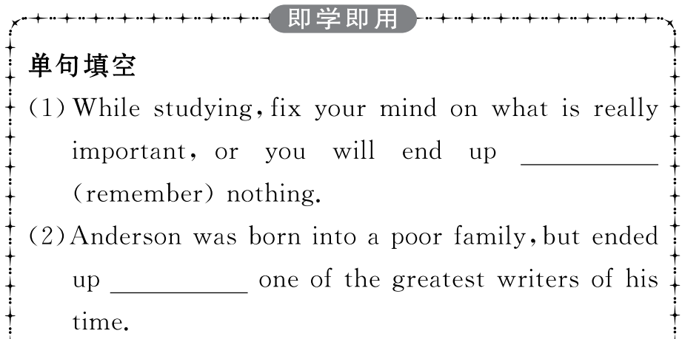
重点词汇
重点句式
高分写作
随堂练习

Slide 13
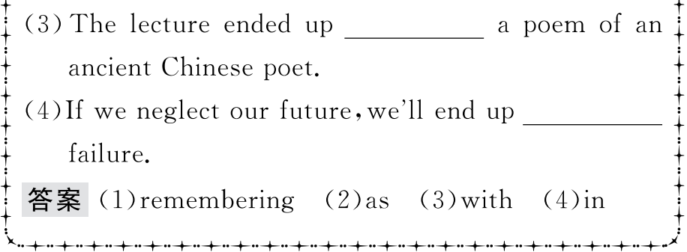
重点词汇
重点句式
高分写作
随堂练习

Slide 14
重点词汇
重点句式
高分写作
随堂练习
3.catch up 打听(不在时所发生的事情),别后叙谈
【课文原句】Cooking together gives us a chance to relax and catch up on each other’s days.
一起做饭给了我们一次放松和别后叙谈的机会。
【词汇精讲】本句中的catch up是动词短语,意为“打听(不在时所发生的事情),别后叙谈,补做”。
The ladies spent some time catching up on each other’s health and families.
女士们花了点时间叙旧,聊了聊彼此的健康和家庭状况。
During the evenings,the school is used by kids who want to catch up on English and maths.
每到晚上,就有孩子来学校补习英语和数学。

Slide 15
重点词汇
重点句式
高分写作
随堂练习
【词汇拓展】

Slide 16
重点词汇
重点句式
高分写作
随堂练习

Slide 17
重点词汇
重点句式
高分写作
随堂练习
4.satisfying adj.令人高兴的,令人满意的
【课文原句】When I get back home,there’s nothing more satisfying than a big meat dinner.
当我回家的时候,没有比一顿包含很多肉食的晚餐更让人满意的了。
【词汇精讲】句中的satisfying是形容词,意为“令人高兴的,令人满意的”,可作定语或表语。
There is little doubt that a diet high in fibre is more satisfying.
毫无疑问,高纤维的饮食更能给人带来满足感。
We will provide qualified products and satisfying service for you.
我们将竭诚为您提供最优质的产品和最令人满意的服务。

Slide 18
重点词汇
重点句式
高分写作
随堂练习
【词汇拓展】
Seeing what I had done,the teacher nodded with satisfaction.
看到我做的事情,老师满意地点了点头。
The teacher is quite satisfied with the great progress we have made recently.
老师对我们近来所取得的巨大进步感到满意。

Slide 19
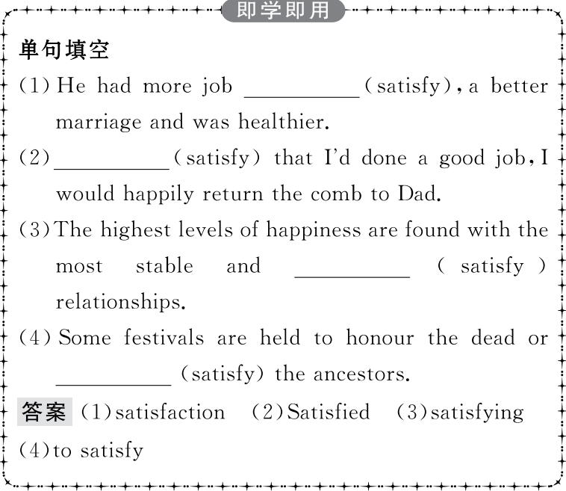
重点词汇
重点句式
高分写作
随堂练习

Slide 20
重点词汇
重点句式
高分写作
随堂练习
5.convenient adj. 方便的,便利的
【课文原句】I know we should eat more fresh fruit and vegetables,but ready meals were so convenient.
我知道我们应该多吃些新鲜的水果和蔬菜,但是即食食品太方便了。
【词汇精讲】句中的convenient是形容词,意为“方便的,便利的”。
There are countless articles telling us how the Internet has made our lives more convenient.
有无数的文章告诉我们,互联网如何使我们的生活更加方便。
Subways are fast and convenient,but rush hours can be terrible.
地铁快捷方便,但是,交通高峰时段情况就可能非常糟糕。
Our house is very convenient for schools and stores.
我们的房子离学校和商店很近。

Slide 21
重点词汇
重点句式
高分写作
随堂练习
【词汇拓展】
Can you telephone me at your convenience to arrange a meeting?
你能不能在方便时给我来个电话,安排一下见面?
For disabled customers it would be more convenient to place the toilets near the entrance to the cinema.
在影院入口处的附近安排厕所会让残疾人顾客感觉更加方便。

Slide 22
重点词汇
重点句式
高分写作
随堂练习
【温馨提示】convenient作表语时,不可用人作主语,而要用物或形式主语it。“当你方便的时候”应译成“When it is convenient to you”而不能译成“When you are convenient”。
Would it be convenient for you to pick me up at four o’clock and take me to the airport?
你方便四点钟来接我并送我去机场吗?

Slide 23
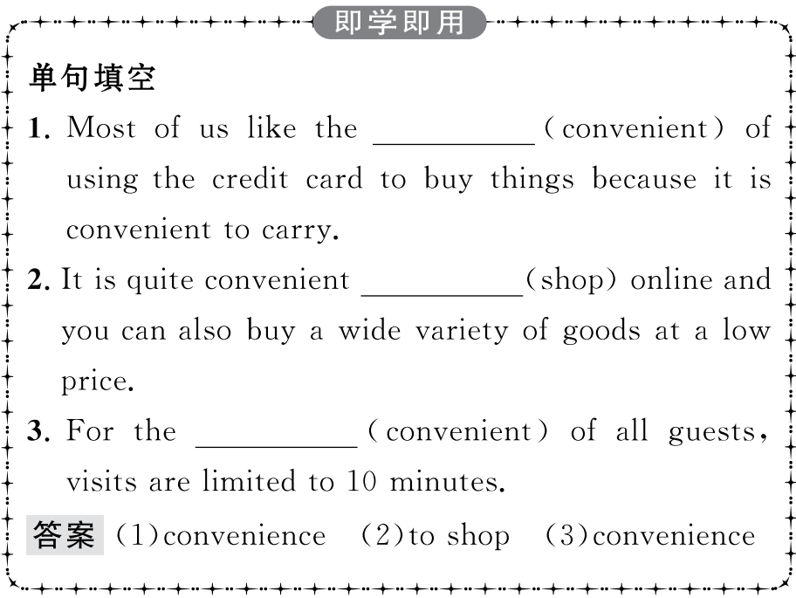
重点词汇
重点句式
高分写作
随堂练习

Slide 24
重点词汇
重点句式
高分写作
随堂练习
6.adapt v.(使)适应,(使)适合
【课文原句】What’s more,it is easy to make and can be adapted to individual tastes.
而且,它很容易制作,并能适应个人的口味。
【词汇精讲】句中的adapt是及物动词,意为“(使)适应,(使)适合”,作不及物动词意为“适应”,常和介词to连用。
It was not long before the children adapted to the life in the country.
不久孩子们就适应了乡下的生活。
It was the culture that made it hard for him to adapt to/adapt himself to the new environment abroad.是文化使得他很难适应国外的新环境。
Elephants need large living spaces,so it’s difficult for them to adapt to the changes.

Slide 25
重点词汇
重点句式
高分写作
随堂练习
大象需要很大的生活空间,所以它们很难适应变化。

Slide 26
重点词汇
重点句式
高分写作
随堂练习
This play was adapted from the book Betrayed Spring by Jack Lindsay.
此剧是根据杰克·林赛所著小说《被出卖了的春天》改编而成的。
This novel has been adapted for radio from the Russian original.
这部小说已由俄语原著改编成无线电广播节目。
When you go to a new country,you must adapt yourself to new customs.
当你到一个新的国家,你必须使自己适应新的风俗习惯。

Slide 27
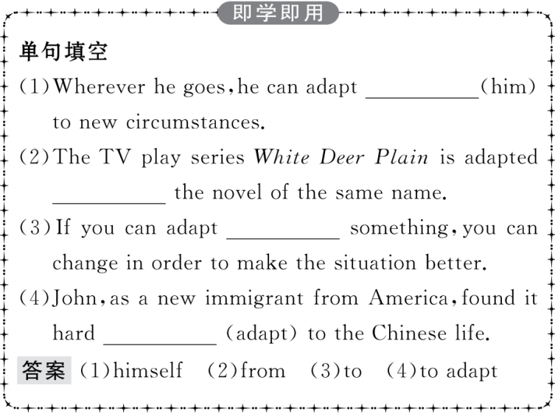
重点词汇
重点句式
高分写作
随堂练习

Slide 28
重点词汇
重点句式
高分写作
随堂练习
7.pick up买,购买
【课文原句】So,don’t forget to pick up some chicken on your way home and try this recipe out!
所以,别忘了在回家的路上买些鸡肉,试试这个食谱!
【词汇精讲】本句中的pick up是动词短语,意为“买,购买”。
He picked up some vegetables on his way home.
他回家的路上买了些蔬菜。
Where did you pick up the dictionary?
你从哪里买的这本字典?

Slide 29
重点词汇
重点句式
高分写作
随堂练习
【词汇拓展】
My parents want me to go to the airport with them to pick him up.
我的父母想让我和他们一起去机场接他。
The boy saw some money on the ground and picked it up.
那男孩看到地上有些钱就捡了起来。

Slide 30
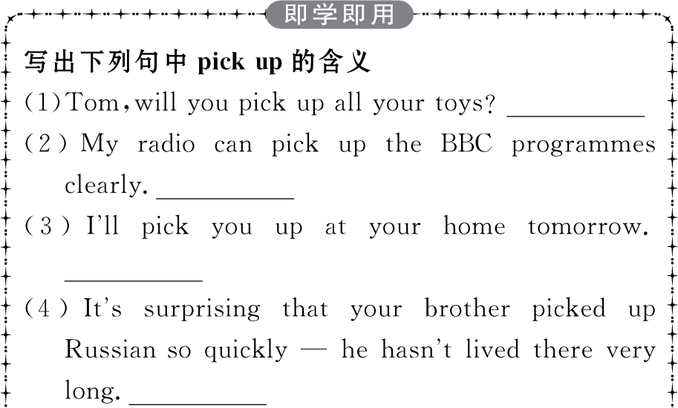
重点词汇
重点句式
高分写作
随堂练习

Slide 31
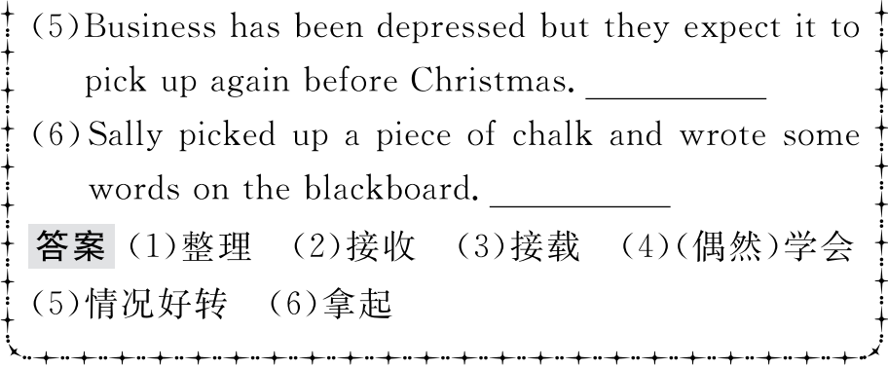
重点词汇
重点句式
高分写作
随堂练习

Slide 32
重点词汇
重点句式
高分写作
随堂练习
My fridge is usually half empty and I’m often too tired to eat much anyway.
我的冰箱通常一半是空的,我经常太累了以至于无论如何也吃不多。
【句式剖析】
句中too...to do sth意为“太……而不能做某事”,是一个表示否定意义的句型。
She was too excited to say a word when she heard the news.
当她听到这个消息时她激动得说不出话来。
They realized that it was too late to catch the last train.
他们意识到太晚了,赶不上最后一趟火车了。

Slide 33
重点词汇
重点句式
高分写作
随堂练习
【句式拓展】
“too...to...”不同搭配下的不同含义:
(1)某些形容词与“too...to...”句型连用时,too (=very) 表示肯定的意义。这些形容词多为表示情感的词,如glad,pleased,surprised,delighted,happy,easy,willing,ready,eager,anxious等。
(2)too...to...结构和never或not连用时,表示肯定意义。意为“无论……也不过分;越……越……”。
They seemed to be too nervous and were too anxious to leave.
他们看起来太紧张,并且急于离开。
I am only too glad to accept your invitation.
我很乐意接受你的邀请。

Slide 34
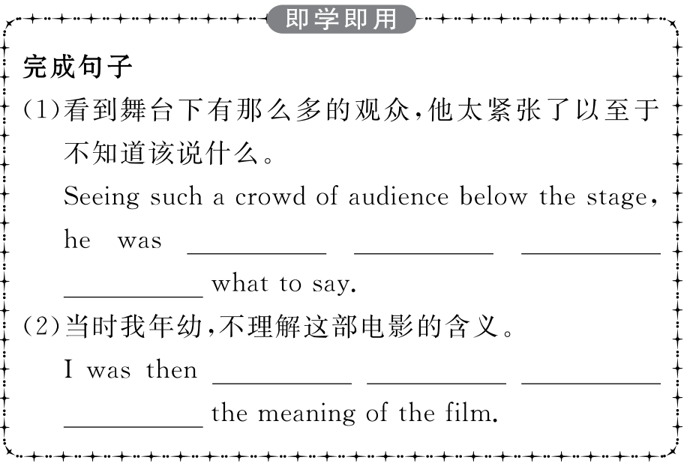
重点词汇
重点句式
高分写作
随堂练习

Slide 35
重点词汇
重点句式
高分写作
随堂练习

Slide 36
重点词汇
重点句式
高分写作
随堂练习
假如你是李华,最近你的一个外国朋友Peter来信说想了解一些有关中国水饺的情况。根据下列要点写封回信:
1.水饺在人们心目中的地位;
2.水饺的种类和吃法;
3.一些春节期间吃水饺的习俗。
注意:
1.根据提示要点写一篇不少于80词的文章;
2.可适当增加细节以使行文连贯;
3.开头和结尾已给出(不计入总词数)。

Slide 37
重点词汇
重点句式
高分写作
随堂练习
一、审题定调
1.确定体裁:本次写作是一封信件,内容为告知外国朋友中国水饺的相关情况。根据写作材料,该类短文可使用说明文的形式。
2.确定人称:由于是介绍事物,所以主要人称为第三人称。
3.确定时态:由于介绍的是水饺的相关情况,所以主要时态用一般现在时。
二、谋篇布局
本文可分为三个段落。
第一段:开门见山,表明写信的目的。
第二段:介绍水饺及其做法(深受人们欢迎;水饺的种类等)。
第三段:春节期间吃水饺的习俗。

Slide 38
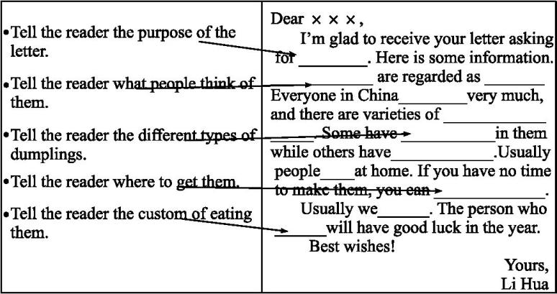
重点词汇
重点句式
高分写作
随堂练习
三、短文模板

Slide 39
重点词汇
重点句式
高分写作
随堂练习
四、组织语言
1.常用语块

Slide 40
重点词汇
重点句式
高分写作
随堂练习
2.遣词造句

Slide 41
重点词汇
重点句式
高分写作
随堂练习
五、连句成文
参考范文
Dear Peter,
I’m glad to receive your letter asking for the information about Chinese dumplings.Here is some information.
In China,dumplings are regarded as real Chinese food.Everyone in China is fond of dumplings very much,and there are varieties of them.Some have meat and vegetables in them while others have sugar,eggs and other tasty things.Usually people make dumplings at home.If you have no time to make them,you can buy them in supermarkets.Then you take them home,heat them up and eat them with vinegar.

Slide 42
重点词汇
重点句式
高分写作
随堂练习
The Spring Festival is very important in China.During the Spring Festival,we make dumplings.Usually we put a coin in one dumpling.Whoever eats the dumpling with the coin in it will have good luck in the year.
Best wishes!
Yours,
Li Hua

Slide 43
重点词汇
重点句式
高分写作
随堂练习
Ⅰ.单词拼写
1.It can be (令人满意的) to work in the garden.
答案:satisfying
2.The Chinese language has many dialects spoken,yet Mandarin has always been the (官方的) language.
答案:official
3.It took him a while to (使适应) himself to his new surroundings.
答案:adapt
4.We found the English treacle pudding too good to (抵制).
答案:resist
5.A bicycle is often more (方便的) than a car in towns.
答案:convenient

Slide 44
重点词汇
重点句式
高分写作
随堂练习
Ⅱ.短语填空
1.Come over for a chat so we can on each other’s news.
答案:catch up
2.Bill was born in Canada but was in America.
答案:brought up
3.Don’t play with the typewriter;you could breaking it.
答案:end up
4.What do you get when you these numbers?
答案:add up
5.If you are in at six this evening,I’ll call by and my books.
答案:pick up
end up,catch up,pick up,bring up,add up

